Slide 1
PEACEPLUS
Building a more peaceful, prosperous and sustainable future in a post- conflict society
The Special EU Programmes Body (SEUPB)
Gina McIntyre, Chief Executive

Slide 2
The Good Friday Agreement
OUR BEGINNINGS
Strand
One
Institutions in Northern Ireland
Strand
Two
North-South
Strand
Three
East-West
British/Irish Council Rights
Safeguards and Equality of Opportunity
Security
Policing and Justice
Prisoner Release
We are responsible to
two Sponsor Departments, the Department of Finance in Northern Ireland and the Department of Public Expenditure and Reform in
Ireland along with the European Commission and the North South Ministerial Council

Slide 3
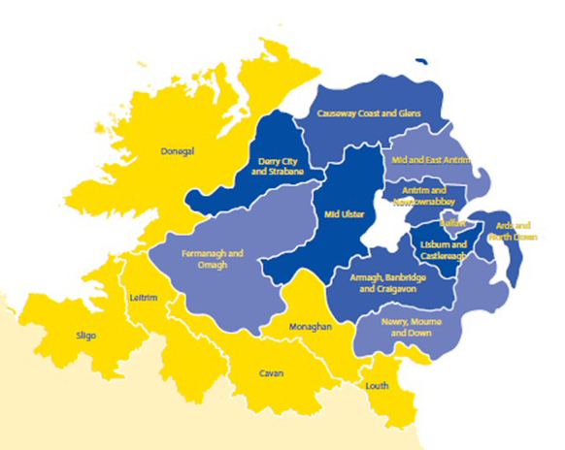
What is the PEACE Programme?
PEACE Programme – created in 1995 as the EU’s positive response to the Northern Ireland ceasefires. Unique Programme across all member states:
PEACE I (1995) – Addressing the immediate legacy of the conflict
PEACE II (2000) – Reinforcing progress through economic development and cross-border co-operation
PEACE III (2007) – Reinforcing progress by promoting reconciliation
PEACE IV (2014) – Enhanced focus on children and young people

Slide 4
What has it achieved?
ABOUT PEACE…
EU’s response to the Northern Ireland Peace Process
€2.265 billion direct funding into communities in NI and border counties, 1995-2020
22,500 significant projects delivered
Grassroots approach – empowering communities to take lead in driving peacebuilding and social/economic renewal
Long process of change, building trust and dialogue
Force for good – delivered intergenerational societal transformation

Slide 5
Sample impacts of previous
PEACE Programmes
PEACE I
PEACE II
PEACE III
PEACE IV
€667m
Total Investment
€995m
Total Investment
€333m
Total Investment
€270m
Total Investment
15,016
Projects
77,652
People entering employment/ education/training
6,999
People in receipt of trauma counselling
2,417
Teachers trained in shared education
836,162
Participants
161,599
People participating in cross border activities
8,393
Events promoting reconciliation
7
Capital projects creating new shared spaces

Slide 6
What has it achieved?
ABOUT PEACE…
Designed to address issues arising from the existence of borders in the Single European Market
Promoted cooperation and strengthened region’s connections with rest of Europe
€229 million in 2014-2020 to cross-border cooperation programmes build on existing infrastructure and capabilities
Promoted exchange of knowledge, transfer of best practice and public sector collaboration on cross-border basis
Particular impact in health and social care and delivering services more cost-effectively
Supported joint approaches and encouraged greater partnership between local authorities and economic/social stakeholders

Slide 7
Importance of INTERREG funding in our programme area
The programmes provide for integrated development between neighbouring MSs in the border region
Unlock competitiveness potential for industrial and cultural activities and growth related to human and social capital
Solutions to social economic or environmental issues in sectors such as education, tourism, job opportunities, mobility, medical services, cultural and heritage
Focus on cooperation/shared ownership - centres of innovation, for example, universities and allow for exchange of knowledge and access to experts
Upscaling and regional approach to cross-border work, mainstreamed
Programmes became a valuable part of the regional policy approach and funding gets spent
Local level knows what they need/a bottom-up approach engaging with all levels up to government- building capacity - place-based sensitivity ownership
Build capacity and trust
Delivery of essential services in a more cost-effective manner

Slide 8
Sample impacts of previous
INTERREG Programmes
INTERREG IIIA
INTERREG IVA
INTERREG VA
20,562
People involved in community development projects
3,552
Business assisted to promote innovation
7,500+
Hectares of threated habitat protected
102
Rural businesses created
121,741
Beneficiaries of cross-border collaboration
5549
Patients have availed of e-health interventions
2,650
New full-time jobs created
954
New jobs created
2
New cross border greenways created

Slide 10
Bringing it all together
Why we still require PEACEPLUS
25 years on

Slide 11
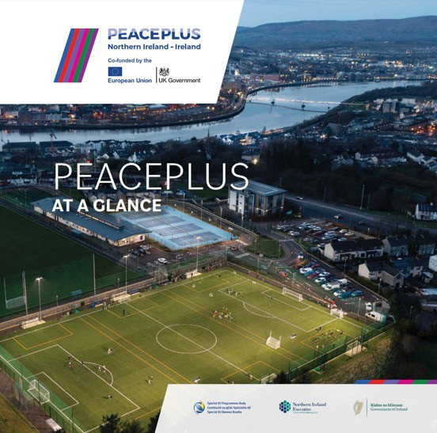
The next step on our journey
PEACEPLUS
Bringing it all together
Public Consultation
Overall objective
Build peace and prosperity, and ensure PEACEPLUS will leave a lasting and tangible legacy
€1.1 billion
Programme Value
22
Investment Areas
Six
Themes

Slide 12
PEACEPLUS Programme
Thematic Areas

Slide 13
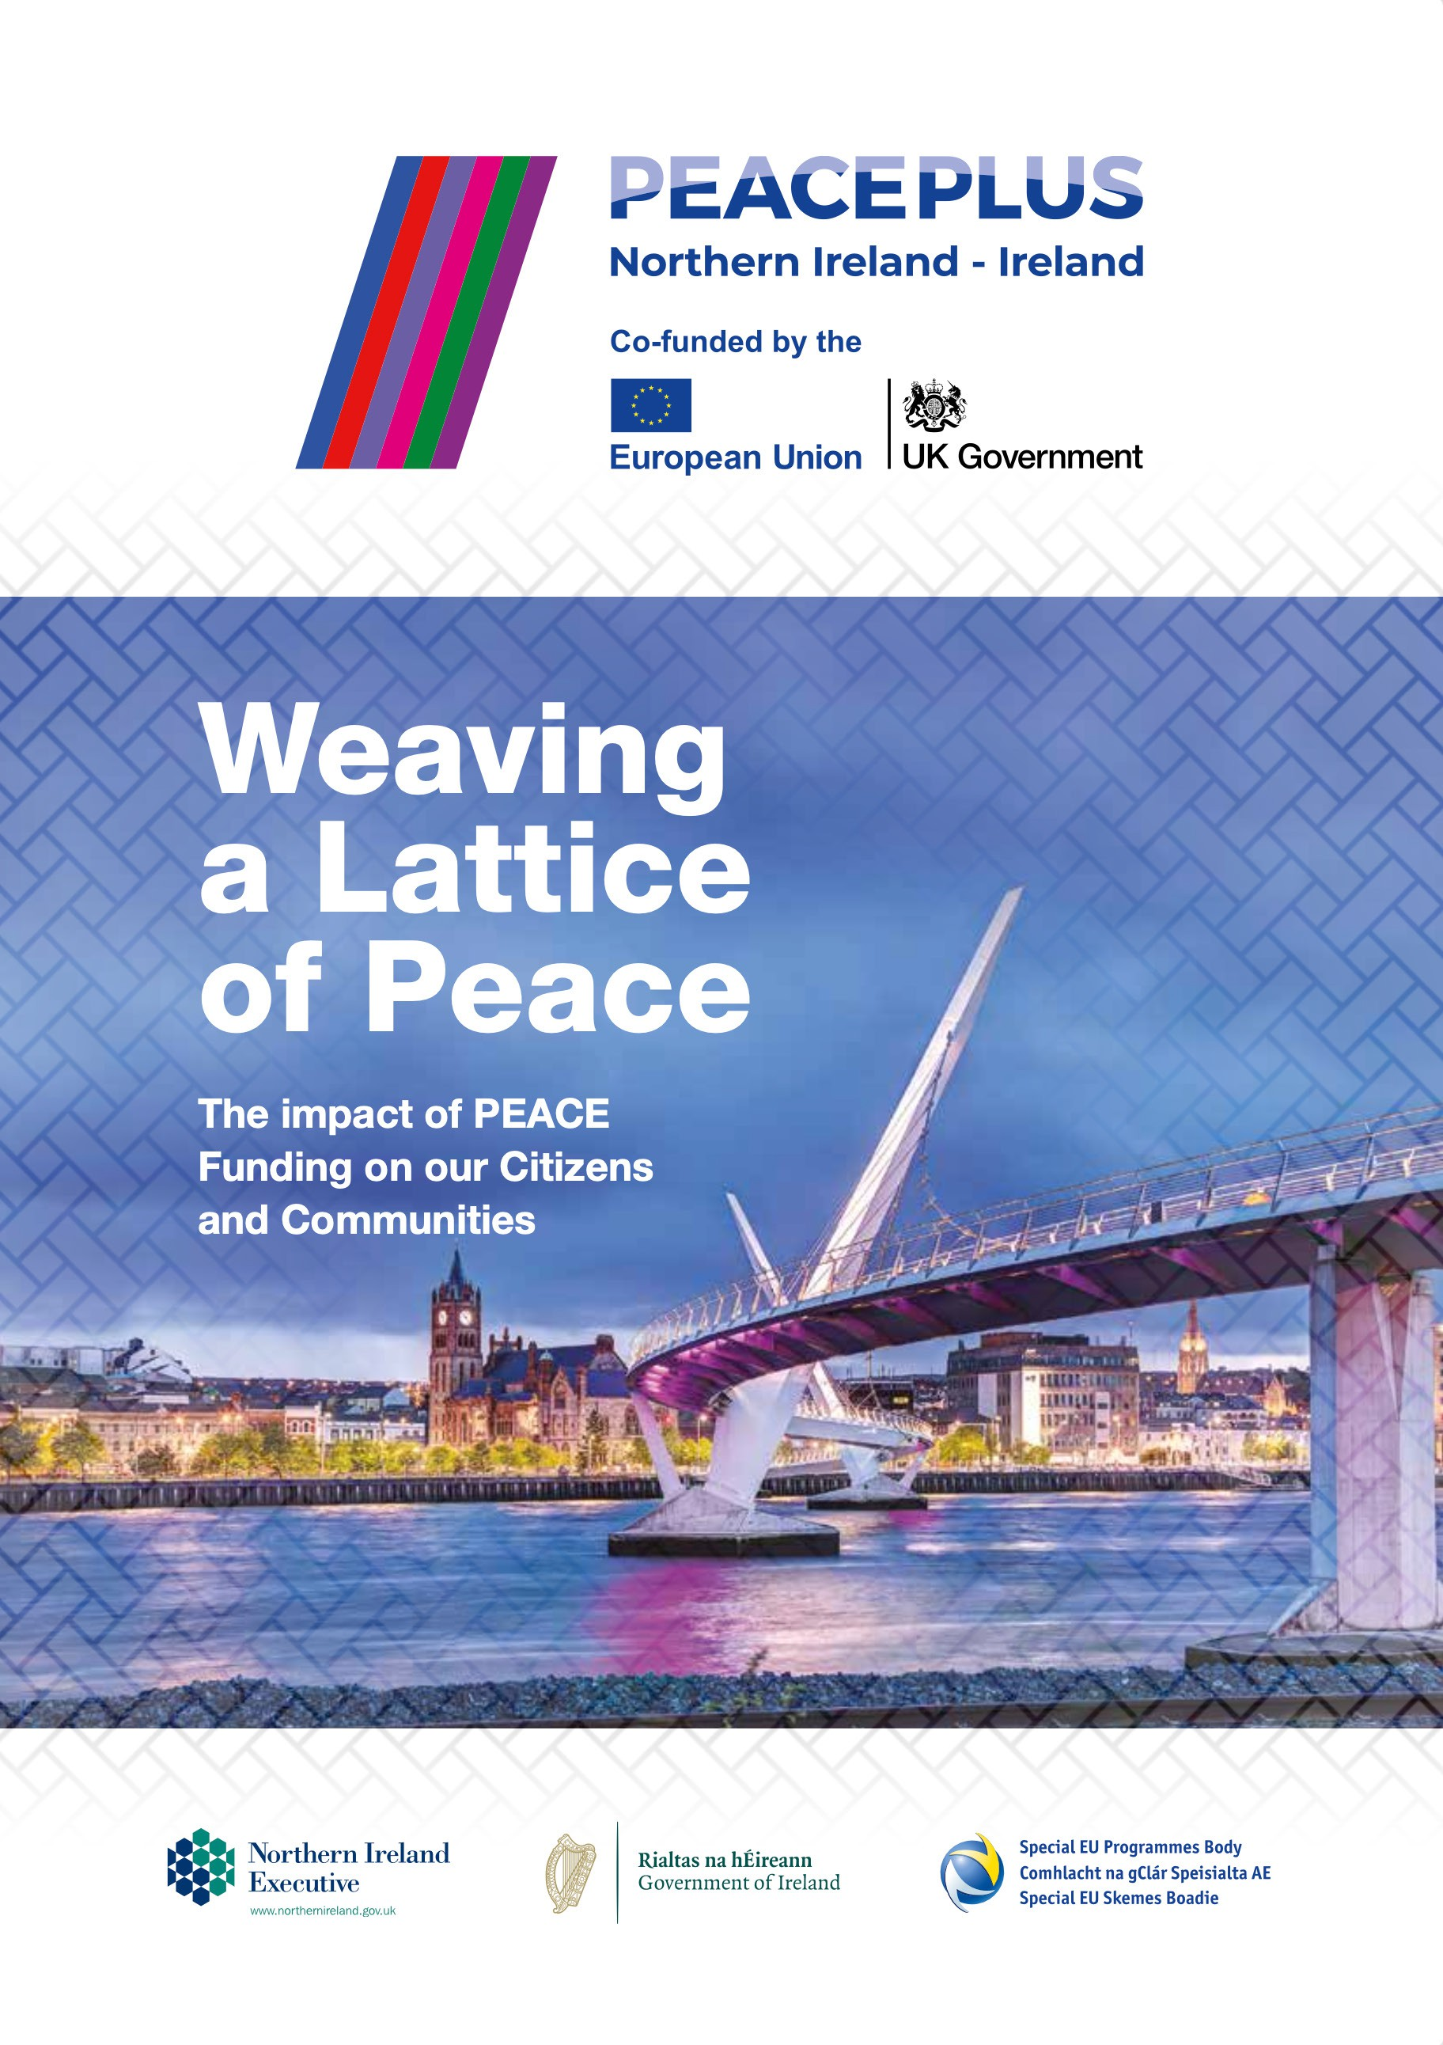
PEACEPLUS Programme
Priority Areas
Support, develop, enable and engage communities
Development of Local Action Plan by Local Authorities, co-creation with the communities at a local level
Meaningful engagement – new innovative approaches to delivery of services.
Inclusion of civil society at every level - address societal and community challenges
Real and lasting impact especially those most affected
Engage those marginalised to become involved in improving their physical and social environment – regenerate local areas
Small grants <€100k – administratively simpler
Cross-border legal and administrative challenges

Slide 14
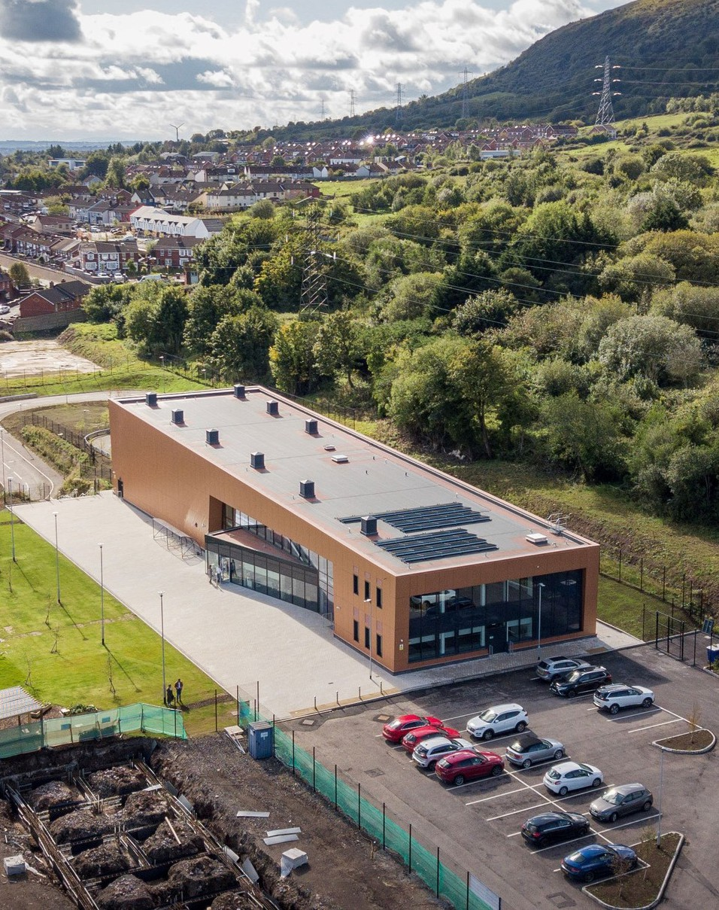
PEACEPLUS Programme
Priority Areas
Investment in our young people to improve their life opportunities
Encourage social economy and entrepreneurship
Community leadership
Investment in the economy – SMES support for research, skills, lifelong learning
Investment in rural and border communities - regeneration and reimaging, access to services
Iconic spaces – new and vibrant town centres and villages
Health and wellbeing of citizens - equality of access to services
Environmental protection activities
Continued impact of Brexit

Slide 15
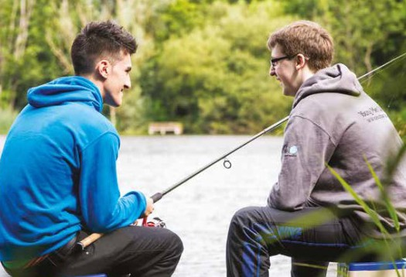
The importance of the PEACE Programme today, 25 years on
Key problems relating to the post-conflict peace region is building relationships, trust and changing individuals
Fostering change requires:
Focus on process of change most appropriate for changing attitudes, divisions and prejudice
Focus on ‘individual change theory’ for changing attitudes, divisions and prejudice
Focus on ‘healthy relationships theory’ for building relationships and changing individuals
Impact on developing and encouraging an inter-generational, societal transformation

Slide 16
Current and significant challenges to peace across the programme area
The impact of the UK referendum to leave the EU opened old wounds and created division
The administrative arrangements mask a deeper issue of cultural trauma
The hard-to-reach groups need to be given a voice and an opportunity
We need to create a space for all cultures and identities – recent high-profile tensions towards ethnic minorities
Health inequalities and high levels of suicide, addiction, substance abuse and educational underachievement in many communities
Economic challenges
Environmental challenges

Slide 17
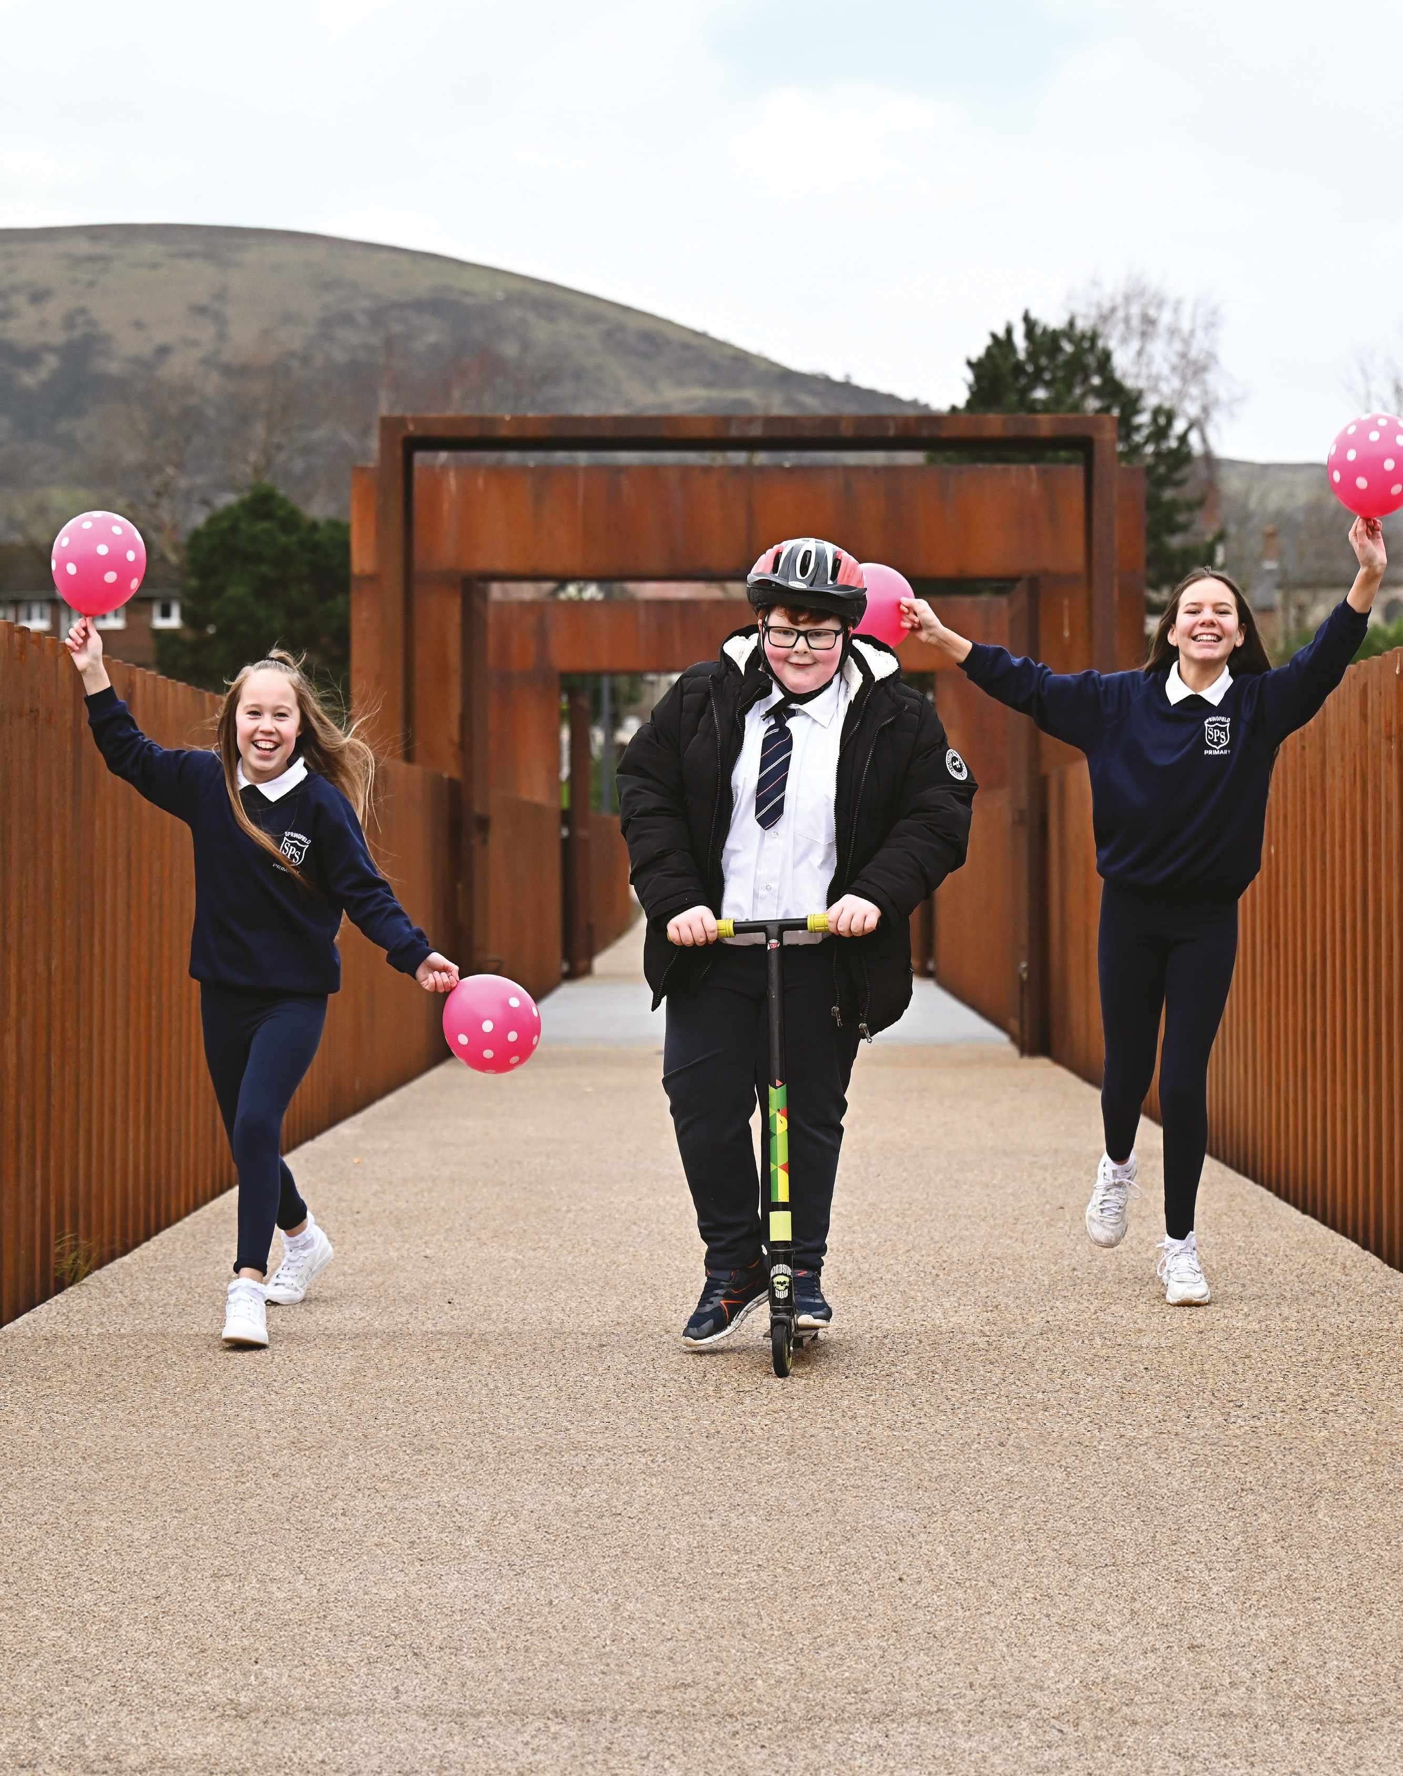
PEACE as a playbook for peacebuilding in a post-conflict society
With almost 30 years of PEACE Programmes, there are opportunities to transfer knowledge and experience to other countries emerging from conflict, as well as those with social division, globally to help inform the development, designing and implementation of future peacebuilding programmes
The achievements here in a relatively short time since the signing of the peace accord can be used as a framework by other nations still in the grip of conflict or struggling to transition to a peaceful society
Every conflict situation is culturally different, and the approach would have to be adjusted region to region. However, the outcome remains the same - establish a peaceful, stable and prosperous society for the citizens.
Rebuilding countries after widespread destruction and human suffering is hugely complex and requires a multifaceted and long-term, collective approach by the authorities and international partners.

Slide 18
The priorities of PEACE Programmes for post-conflict societies today
They must have the formal political process in a post-agreement arena, and part of a wider more complex process
Various parallel processes from individual to institutions. Civic Society included – Partnership Principle
Importance of champions – importance of inclusion
Programmes gave validation to work that was required to promote social and political reintegration
Peace is not a cash solution – it will take effort and generational work
Peace is fragile, it needs repeating. Evidence of transgenerational trauma in our region is very high
Cultural trauma – cycle of past hurt
Manage expectations from politicians and public about what the Programmes can achieve
Realise economic potential of areas such as cyber and advanced manufacturing

Slide 19
Thank you
Scan here to find out more on our webpage

