Slide 1
PEACEPLUS INFORMATION
ROADSHOW
28th June 2023
The Mac, Belfast

Slide 2
Welcome
Gina McIntyre – CEO SEUPB

Slide 3
Purpose of today
To hear more about the content of the Programme
Learn about the opportunities that exist for you and the organisations you represent
To discuss ideas and ask questions directly with SEUPB staff (Thematic Tables)
To network and look for partners

Slide 4
PEACEPLUS Programme Overview
PEACEPLUS
Peace
Prosperity

Slide 5
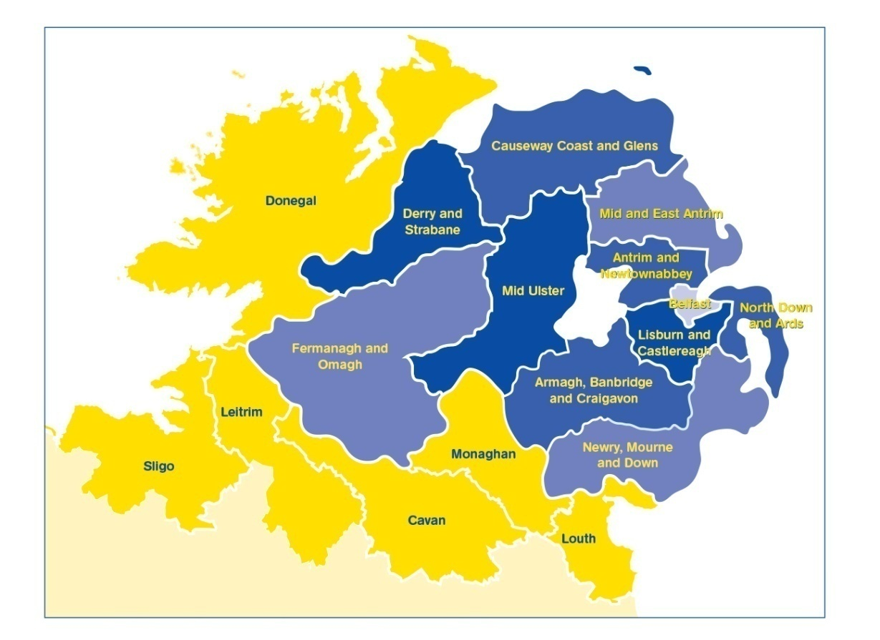
PEACEPLUS (2021-2027)
Programme area: Northern Ireland & the border counties of Ireland
Participation from partners outside the area
Programme value: €1.144 billion
Six themes, 22 investment areas – Smaller grants for community activity
Focus on areas and communities most affected – Rural communities/border areas Social Economy – New emerging technology
THINK BIG & THINK DIFFERENTLY!
Notes:
The Programme will:
continue to take the opportunities and address the needs arising from the peace process in order to boost economic growth and stimulate social and economic regeneration; and,
and
promote social inclusion, particularly for those at the margins of economic and social life.
The value of the programme, over seven years, is €1.144bn
The ERDF contribution (80%) has been matched by the UK and Irish governments. This means that applicants can apply for 100% of their project value.
It is a wide-ranging Programme with six themes and 22 investment areas.
All investment areas have a sharp focus on the peace impacts and legacy they will leave.
Cross-community and cross-border collaboration is key to the programme, and all projects must have demonstrable peace impacts.
Commission rules allow for participation with partners outside the area of Northern Ireland and the Six Borders Counties. If you are considering partners from outside the region, what matters is that the benefits of the project are significant for the Programme area.

Slide 6
The Themes and Investment Areas
Declan McGarrigle - Managing Authority PEACEPLUS

Slide 7
Theme 1 Overview
1.1 Co-designed Local Community Peace Action Plans
(€110m)
110,000 participants
1.2 Empowering Communities
(€30m)
24,000 people engaged
Theme 1: Building Peaceful and Thriving Communities
(€250m)
1.3 Building Positive Relations
(€35m)
58,000 people engaged
1.4 Reimaging Communities
(€75m)
50,000 participants

Slide 8
Theme 2 Overview
2.1 SME Development and Transition
(€25m)
1,430 SMEs innovating
2.2 Innovation Challenge Fund
(€65m)
82 SMEs innovating
Theme 2: Delivering Socio-Economic Regeneration and Transformation
(€170m)
2.3 Programme Area Skills Development
(€50m)
8,000 participants completing training
2.4 Smart Towns and Villages
(€30m)
9 solutions

Slide 9
Theme 3 Overview
3.1 Shared Learning Together Education Programme (€51.3m)
106,971 pupils/young people
Theme 3: Empowering and Investing in Our Young People (€123m)
3.2 PEACEPLUS Youth Programme
(€47m)
7,500 completing training schemes
3.3 Youth Mental Health and Wellbeing
(€25m)
56,000 completions in training

Slide 10
Theme 4 Overview
Theme 4: Healthy and Inclusive Communities
(€172m)
4.2 Rural Regeneration and Social Inclusion
(€50m)
25,000 participants
4.1 Collaborative Health and Social Care
(€97m)
82,000 beneficiaries
4.3 Victims and Survivors
(€25m)
20,000 beneficiaries of interventions

Slide 11
Theme 5 Overview
5.1 Biodiversity, Nature Recovery and Resilience
(€40m)
50 management units
1 joint strategy
Theme 5: Supporting a Sustainable and Better Connected Future
(€303m)
5.2 Marine and Coastal Management
(€24.8m)
13 joint strategies
8 solutions
5.6 Enhanced Sustainable Travel Connectivity
(€165m)
230,000,000 passenger-km/year
5.3 Water Quality and Catchment Management
(€21m)
1 joint strategy
3 solutions
5.5 Geothermal Energy Demonstration Programme
(€20m)
2 solutions
5.4 Water Quality Improvement Programme
(€32m)
2 joint strategies
1,000 people connected

Slide 12
Theme 6 Overview
Theme 6: Building and Embedding Partnership and Collaboration (€52m)
6.2 Maintaining and Forging Relationships between Citizens
(€20m)
7,500 participations
6.1 Strategic Planning and Engagement (€32m)
12 joint strategies and action plans

Slide 13
What areas are open?

Slide 14
Open calls
IA | Title | Open date | Closing date | Outputs | Results
1.1 | Co-designed Local Community Action Peace Action Plans | 15/06/23 | 14/12/23 | 17 action plans. | 110,000 people engaged.
1.4 | Reimaging Communities | 15/06/23 | 07/09/23 | 10 shared spaces. | 50,000 participants.
3.1 | Shared Learning Together Education Programme (Formal) | 15/06/23 | 07/09/23 | 120,735 participations (young people) 1,761 participations (teachers and practitioners). | 90,551 completions (young people). 1,321 completions (teachers and practitioners).
3.1 | Shared Learning Together Education Programme (Informal) | 15/06/23 | 07/09/23 | 21,893 participations (young people). 319 participations (youth workers) | 16,420 completions (young people). 239 completions (youth workers).
3.2 | PEACEPLUS Youth Programme (Main) | 15/06/23 | 10/08/23 | 9,750 participations. | 7,500 completions.
3.2 | PEACEPLUS Youth Programme (Quality and Impact Body) | 15/06/23 | 07/09/23 | 298 participations. | 229 completions.

Slide 15
Open calls
IA | Title | Open date | Closing date | Outputs | Results
3.3 | Youth Mental Health and Wellbeing | 20/06/23 | 12/09/23 | 75,000 participants. | 56,000 completions.
4.3 | Victims and Survivors | 15/06/23 | 07/09/23 | 15,000 participants in interventions. 1,000 participants in education & training. 1 strategy and action plan. | 20,000 beneficiaries of interventions. 750 completions of education & training. 1 strategy and action plan taken up.
5.5 | Geothermal Energy Demonstration Programme | 20/06/23 | 12/09/23 | 2 pilot actions. 2 jointly developed solutions. | 2 solutions taken up or up-scaled by organisations.

Slide 16
Small Grants Programmes
Paul Beattie – Director, Managing Authority

Slide 17
PEACEPLUS Small Grants Programmes
IA | Title | Maximum grants
1.2 Strand 1 | The Empowering Communities to Embed Peace Small Grants Programme (€20m) | €100,000
6.2 | Maintaining and Forging Relationships between Citizens (€20m) | €100,000
Managed by Pobal and Delivery Partner
Reduced administration for application and implementation
Pre-application support
Calls opening end of 2023

Slide 18
Further details:
www.seupb.eu
peaceplussupport.seupb.eu

Slide 19
Questions?

Slide 20
Thematic Tables and Discussion

