Slide 1


Investment Area 2.4
Smart Towns and Villages
PEACEPLUS Programme

Slide 2
PEACEPLUS Programme
Investment Area 2.4 – Smart Towns and Villages
Introduction & Housekeeping – Karyn McNiece, SEUPB
Welcome & Overview of PEACEPLUS Programme – Declan McGarrigle Interim Director of PEACEPLUS Development
Overview of Policy Interests from Ireland – Rosie Smyth, Dept. of Rural and Community Development
Overview of Policy Interests from Northern Ireland – Gareth Evans, Dept. of Agriculture, Environment and Rural Affairs
Pre-Application Support & Concept Note – Dr Paul Cowie
Questions and Answers
Notes:
**HOLDING SLIDE - AGENDA**
Good morning and thank you for joining us today.
We are delighted to welcome you to our tenth pre-application workshop for the PEACEPLUS Programme – Area 4.2 Rural Regeneration and Social Inclusion
Similar support will continue be offered for the other areas of the Programme in the following weeks and months. Keep a look at our website and social channels for all updates.
Before we get into the main content of today’s workshops, I’ll take you briefly take you through the agenda…..
Then I will move onto providing an overview of Area 4.2, the Rural Regeneration and Social Inclusion Programme.
Lorraine McCourt will take you through the steps in building a strong proposal, and provide some broad parameters as to how things might roll out over the next six months.
There will also be an opportunity to ask questions at the end of the presentations and todays session, so please keep hold of your questions until the Q&A section. All answers will be added to the FAQs on our website.
Finally at the end of today’s session we would like to invite you all to an informal networking lunch here in The Junction.

Slide 3
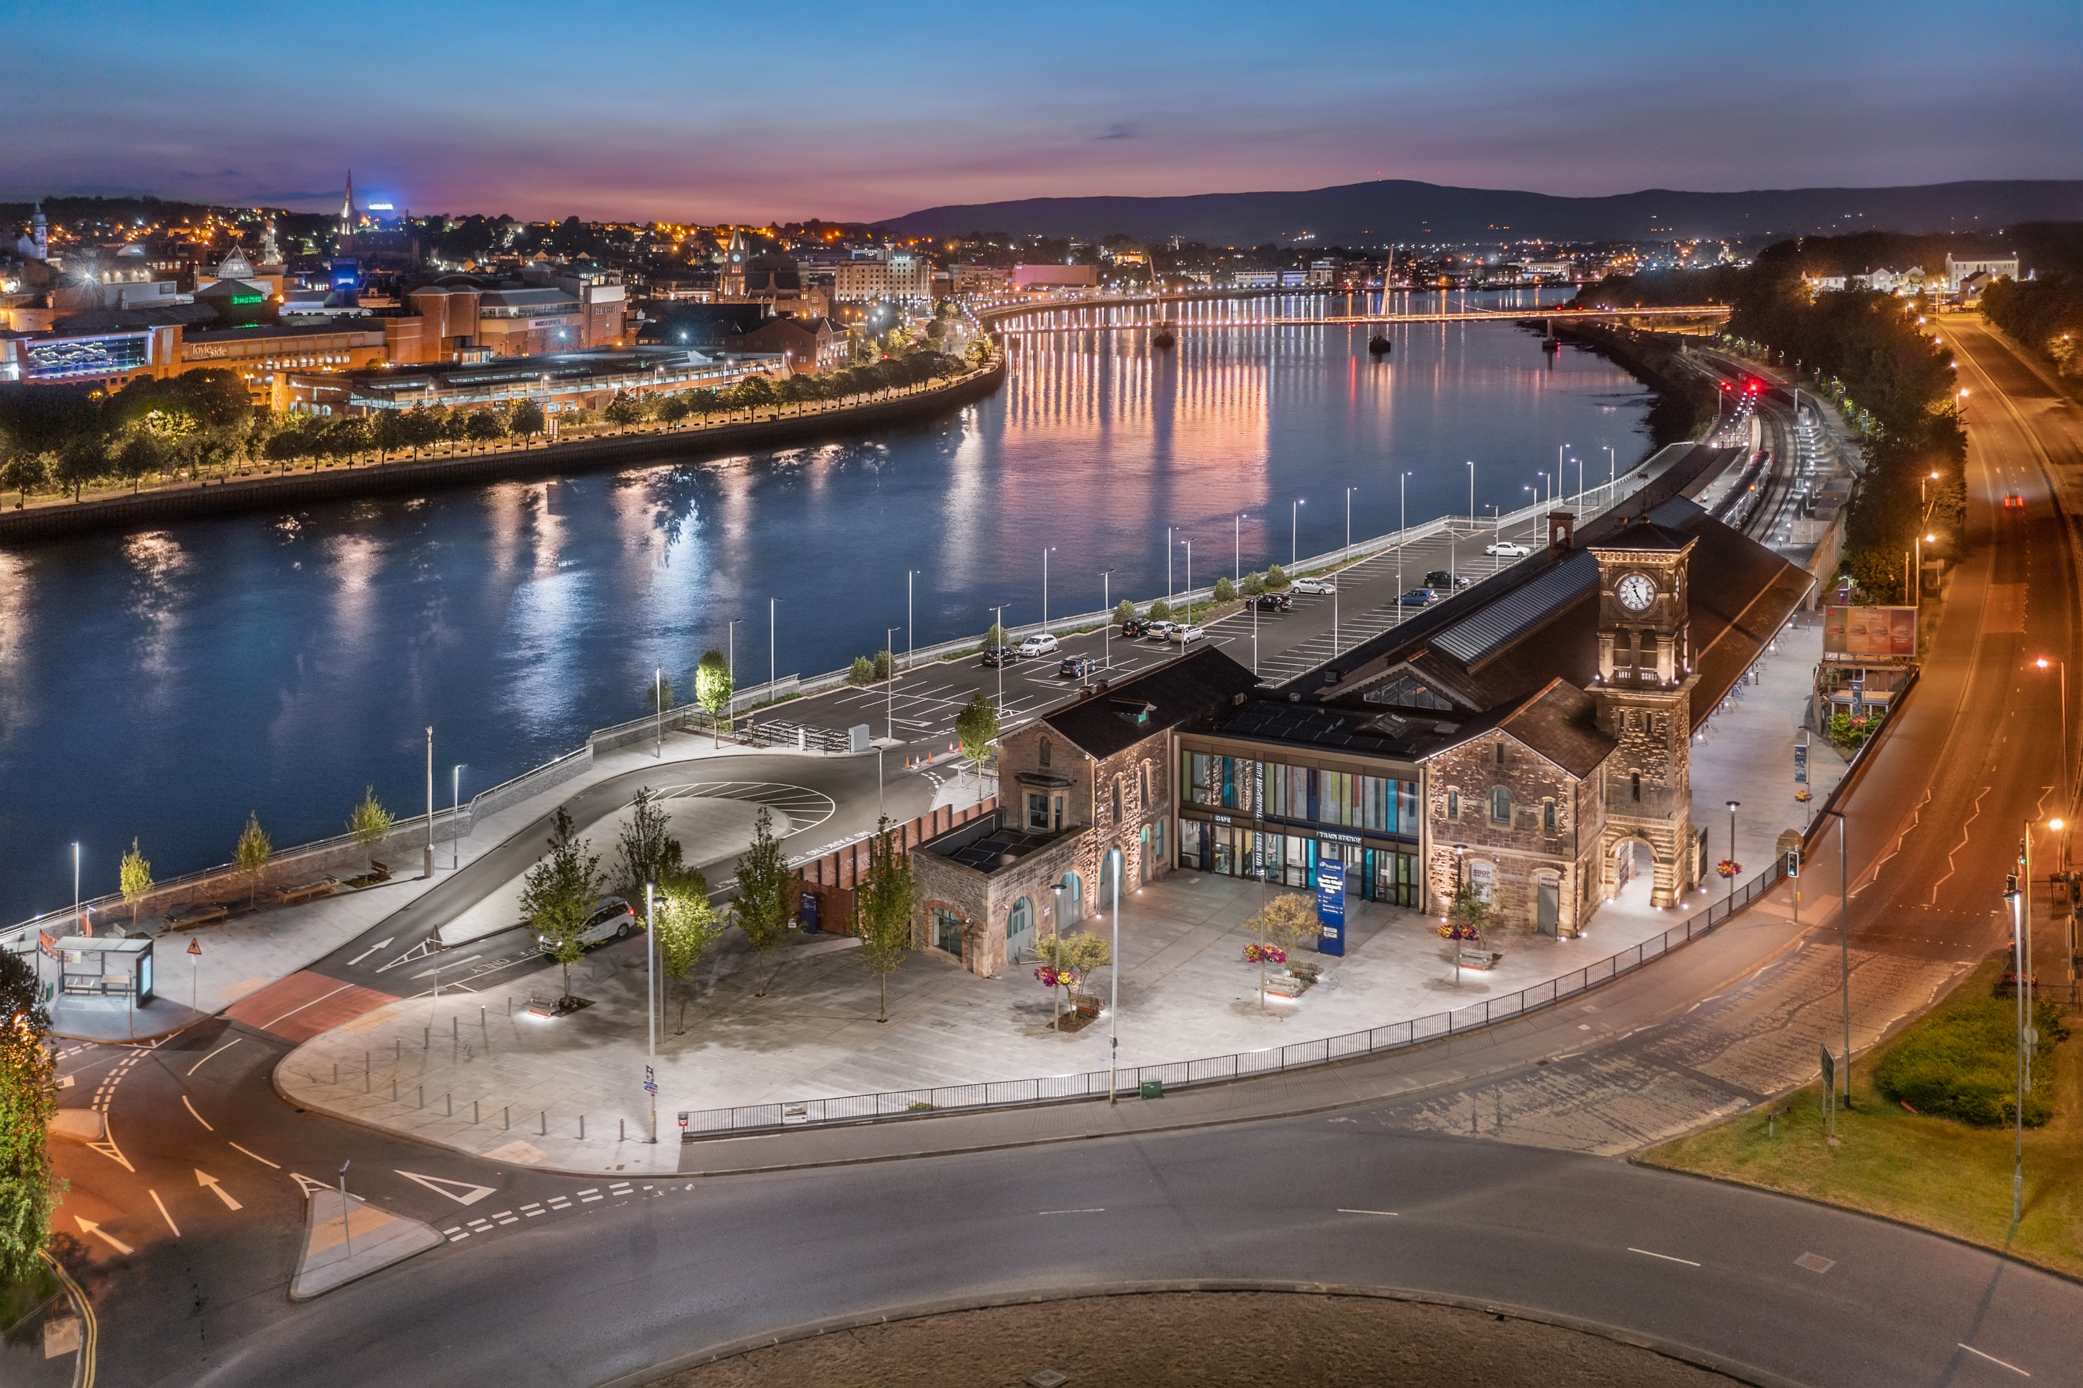
PEACEPLUS Programme
Declan McGarrigle, SEUPB
Interim Director PEACEPLUS

Slide 4

PEACEPLUS Context: How did we get here?
Support of the NI Executive, the Government of Ireland, the UK Government and the European Union.
Building upon previous PEACE & INTERREG programmes.
Renewed focus on peace and reconciliation.
Ensuring all projects contribute to cross-border and economic and territorial development.
Notes:
We have reached this point through a detailed process of collaboration with the Northern Ireland Executive, the Government of Ireland, the UK government, and the EU.
Together, we have drafted a new Programme that will contribute to a more peaceful, prosperous and stable society in Northern Ireland and the border region of Ireland. We believe it will leave a significant and lasting legacy.
It is an exciting programme which builds on the legacy of all previous PEACE and INTERREG programmes.
PEACEPLUS funding is distinct. It will fund activities that promote peace and reconciliation and contribute to cross-border economic and territorial development.

Slide 5
How was PEACEPLUS Developed?
Intensive review, research and public engagement
Stakeholder engagement
Public events – including specific events with young people
Survey submissions
Public consultation (2021)
Bi-laterals with government north-south (ongoing)
Notes:
So how was PEACEPLUS developed?
It has been a long road in getting to this point, but, given the scale and scope of the Programme, it has been well worth it.
The SEUPB commenced the PEACEPLUS development process in 2019. Since then, there has been considerable preparatory work, research, and stakeholder engagement.
This has included: public events, survey submissions, public consultation, and ongoing bi-lateral meetings with Governments north-south.

Slide 6
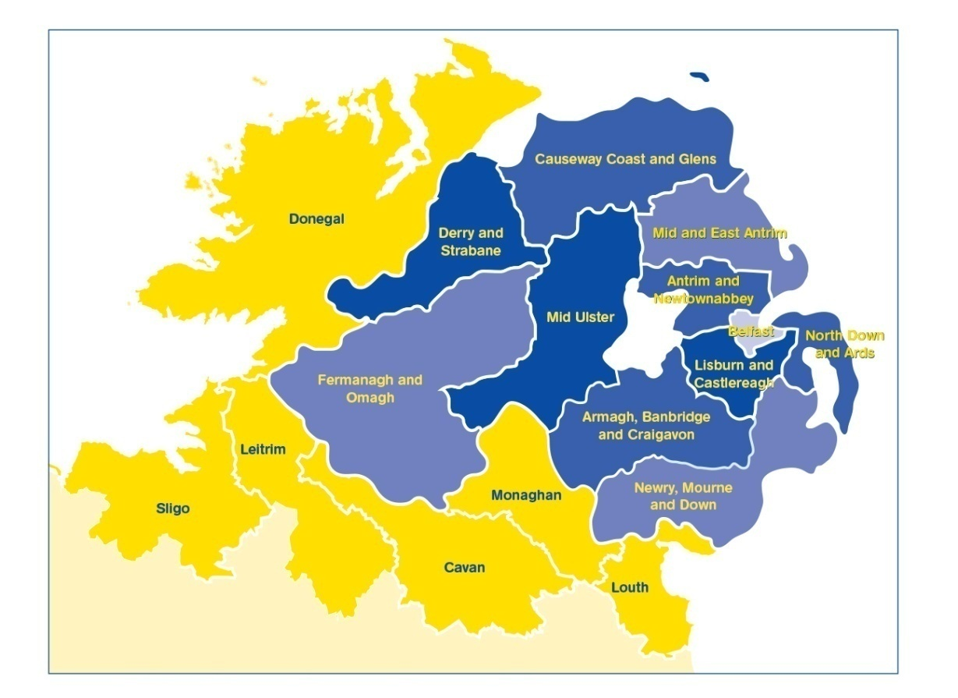
PEACEPLUS (2021-2027)
Programme area: Northern Ireland & the border counties of Ireland
Programme value: €1.144 billion
Six themes, 22 investment areas
Participation from partners outside the area
Notes:
The Programme will:
continue to take the opportunities and address the needs arising from the peace process in order to boost economic growth and stimulate social and economic regeneration; and,
and
promote social inclusion, particularly for those at the margins of economic and social life.
The value of the programme, over seven years, is €1.144bn
The ERDF contribution (80%) has been matched by the UK and Irish governments. This means that applicants can apply for 100% of their project value.
It is a wide-ranging Programme with six themes and 22 investment areas.
All investment areas have a sharp focus on the peace impacts and legacy they will leave.
Cross-community and cross-border collaboration is key to the programme, and all projects must have demonstrable peace impacts.
Commission rules allow for participation with partners outside the area of Northern Ireland and the Six Borders Counties. If you are considering partners from outside the region, what matters is that the benefits of the project are significant for the Programme area.

Slide 7
PEACEPLUS
Peace
Prosperity

Slide 8
Programme Overview:
Where does Smart Towns and Villages fit in?
Theme 1
Building Peaceful and Thriving Communities
€250m
Theme 2
Delivering Socio- Economic Regeneration & Transformation
€170m
Theme 3
Empowering and Investing in Our Young People
€123m
Theme 4
Healthy and Inclusive Communities
€172m
Theme 5
Supporting a Sustainable Future
€303m
Theme 6:
Building and Embedding Partnership and Collaboration
€52m
Thematic Areas
1.1 Co-designed Local Community Peace Action Plans
1.2 Empowering Communities
1.3 Building Positive Relations
1.4 Reimaging Communities
2.1 Programme Area SME Development and Transition
2.2 Programme Area Innovation Challenge Fund
2.3 Programme Area Skills Programme
2.4 Smart Towns and Villages
3.1 Shared Learning Together Education Programme
3.2 PEACEPLUS Youth Programme
3.3 Youth Mental Health
4.1 Collaborative Health and Social Care
4.2 Rural Regeneration and Social Inclusion
4.3 Victims and Survivors
5.1 Biodiversity, Nature Recovery and Resilience
5.2Marine and Coastal Management
5.3 Water Quality and Catchment Management
5.4 Water Quality Improvement Programme
5.5 Geothermal
5.6 Transport
6.1 Strategic Planning
6.2 Maintaining and Forging Relationships between Citizens
Investment Areas

Slide 9
Project Lifecycle
PREDEVELOPMENT
Elaboration of project idea, concept note, partner search
Call
PROJECT DEVELOPMENT AND APPLICATION
PROJECT CLOSURE
Strategy and content, responsibilities, application requirements
Project assessment and selection
Final reporting, post-project activities, use of results
Modification assessment and selection.
Monitoring achievement.
PROJECT IMPLEMENTATION
CONTRACTING AND START-UP
Letter of Offer, Partnership Agreement, kick off, detailed planning, conditions
Coordination of activities, reporting, monitoring, modifications, evaluation, financial management, communication
Notes:
Pink diamonds: Some key points where programme committees have a role in.
All projects, regardless of the type (from previous slide) have the same project lifecycle

Slide 10
PEACEPLUS – Smart Towns and Villages Programme
Theme 2. Delivering Socio-Economic Regeneration and Transformation (€170m)
2.1 SME Development and Transition
2.2 Innovation Challenge Fund
2.3 Programme Area Skills Development
2.4
Smart Towns and Villages

Slide 11
Policy Perspective/Considerations
Investment Area 2.4
Smart Towns and Villages
Workshop 15th March 2023
Accountable Department of Rural and Community Development

Slide 12
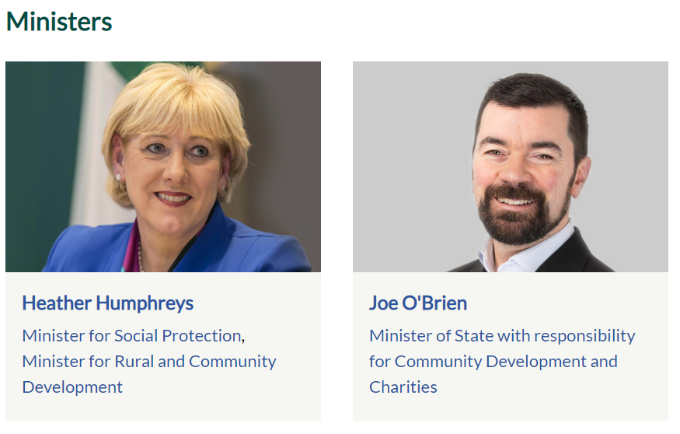

Slide 13
The Department of Rural and Community Development’s mission is to promote rural and community development and to support vibrant, inclusive and sustainable communities throughout Ireland.
Our Vision is a sustainable society with individual and community wellbeing at its heart, supporting thriving rural communities, and where all communities, urban and rural, have opportunities to grow together and develop economically, socially and culturally.
A key objective of all the programmes under our Department’s remit, is that they are targeted at those sectors and areas most in need; acknowledging the ongoing and future economic and social challenges we face, as a result of a number of contributing factors.

Slide 14
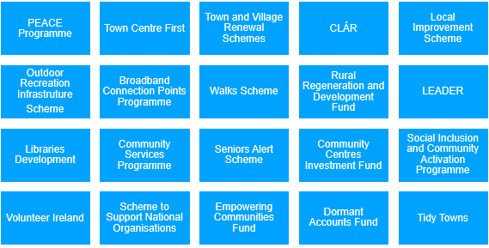
DRCD’s Programmes

Slide 15
DRCD’ engagement on PEACE Programmes
Our Department is an Accountable Department for a number of thematic areas under the PEACE IV Programme and under PEACEPLUS we are an Accountable Department for a number of investment areas including Smart Towns and Villages.
The objective of this investment area is to reap the benefits of digitalisation for citizens, companies, research organisations and public authorities and projects should display how technology will play a role in meeting the identified and real needs of the communities they serve.
Many of you here today have played a leading role in the delivery of PEACE Programmes over the years and have had good success in the transformation of vacant spaces and facilities within your areas into centres for communal recreational and social use;
You will need to ensure that the new proposals and programmes are aligned with the relevant Government and EU Strategies/Policies.

Slide 16
Advice and Guidance
Smart Town and Village projects should enable, accelerate and support strategic goals such as well-being, sustainability, economic growth and cross border relationships.
PEACEPLUS is additional funding and should not displace core public funding already provided. It should not duplicate other existing funds and so project proposals need to outline how the project will directly contribute to peace and reconciliation, they must have a clear peace focus.
Digital and online resources offer the opportunity to create new ways of doing things, promote innovation and breathe new life into local communities, making them more attractive places to live and work, as well as contributing to a more sustainable future, while also renewing and reinvigorating the local towns and villages.
Be innovative and show how the use of digital technology can unlock new innovations or create an intelligent process which can itself be a catalyst for change.

Slide 17

Navigating EU funding can be challenging. Access Europe, which is run by The Wheel, builds the capacity and supports the development of partnerships between Irish civil society organisations and European partners, as well as the creation of networks promoting participation in EU programmes and policy-making, including PEACEPLUS.

Slide 18


The iCommunity focuses specifically in North/South collaboration and bringing communities together to explore shared challenges including rural connectivity and digital inclusion, to come up with new ideas and responses to challenges, that could become joint projects.

Slide 19

Enterprise Ireland Strategy 2022-2024
Enterprise Ireland is the agency responsible for strengthening the engagement of enterprise with research and innovation, and for supporting in-company innovation and research and development via financial assistance, advice, training and access to key skills.
The strategy outlines that increased levels of investment in innovation, digital adoption and transformation are essential to strengthen the productivity and operational effectiveness of Irish enterprise, developing high value products and services and delivering competitiveness on international markets.
Their ambition is to build enterprise capacity in innovation by providing enhanced, long-term funding measures that are customised to clients unique needs and enable companies to start their digital maturity journey through a suite of advisory and funding assistance.

Slide 20

New Decade, New Approach
The Irish Government is committed to working with the Northern Ireland Executive, through the North/South Ministerial Council, to help deliver projects that will benefit people across the island of Ireland, North, South, East and West;.

Slide 21

Ireland – Key Documents

Slide 22
Ireland – Key Strategy Documents
Programme for Government: Our Shared Future
We have committed to
working with our EU partners and UK Government to secure the necessary funding for the EU PEACE Plus Programme;
to contribute to peace-building initiatives; and
to working with all communities and traditions on the island to build consensus around a shared future.

Slide 23
Ireland – Key Strategy Documents
Programme for Government: Our Shared Future
We have committed to
working with our EU partners and UK Government to secure the necessary funding for the EU PEACE Plus Programme;
to contribute to peace-building initiatives; and
to working with all communities and traditions on the island to build consensus around a shared future.

Slide 24
Ireland – Key Strategy Documents continued
Our Rural Future: Rural Development Policy 2021 – 2025
Supports the development of Smart Towns and Villages which use innovative solutions to improve resilience, build on local strengths and maximise opportunities to create desirable places for people to live and work.
Smart Towns and Villages is a concept based on people in rural areas building on, and enhancing, their existing strengths and assets to find practical solutions to deal with both the challenges and opportunities facing their communities. It is complementary to the Town Centre First principle.

Slide 25
Town Centre First Policy
The Town Centre First policy contains 33 actions which aim to give towns the tools and resources they need to create town centres that become more viable, vibrant and attractive locations for people to live, work, socialise and run a business.

Slide 26
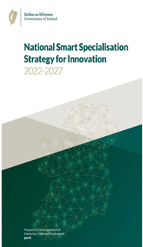

National Smart Specialisation Strategy for Innovation 2022 - 2027
Digitalisation requires investment by enterprises to innovate and by people to learn new skills.
This means encouraging greater investment by enterprises in research, development, innovation and digital skills.
The Department of Enterprise, Trade and Employment and its agencies design and deliver programmes to drive the digitalisation of enterprises in Ireland.
This work is bolstered by research and skills initiatives under the Department of Further and Higher Education, Research, Innovation and Skills and digital adoption; and
Broadband programmes under the Department of the Environment, Climate and Communications.

Slide 27
National Broadband Plan
A digitally connected Ireland will enhance our competitiveness, enabling more quality jobs in both urban and rural communities, and providing an improved quality of life for citizens and communities across the country.
The availability of access to high-speed broadband in rural communities can have a transformative effect, it will support enterprise development and job creation and will enable rural communities to avail of opportunities presented by the digital economy.

Slide 28
Harnessing Digital – The Digital Ireland Framework – launched February 2022
Digital Skills; This next phase of Ireland’s digital journey reflects and builds on considerable national work.
The Strategy is in line with the EU’s Digital Decade and associated four cardinal points of the EU Digital Compass
    Digital Infrastructure;
    Digital Transformation of Business; and
    Digitalisation of Public Services

Slide 29

Sustainable, Inclusive and Empowered Communities: a five-year strategy to support the community and voluntary sector in Ireland 2019-2024
Supports partnership and collaborative effort at all levels and between all stakeholders, comprising high level objectives and associated actions to support communities, their representative organisations, and the community and voluntary sector.

Slide 30

Roadmap for Social Inclusion 2020 – 2025
The Roadmap for Social Inclusion sets out goals to measure progress across many aspects of social inclusion, including;
empowering communities to address social exclusion, through investment in infrastructure at local level to support rural renewal and strengthening rural communities; and
recognising that digital connectivity will be critical to sustaining rural communities and combatting social isolation,
with the overall objective of achieving a better quality of life for all.

Slide 31


DAERA vision for rural - Sustainability at the heart of a living, working, active landscape, valued by everyone.
The aim for the Rural Policy Framework for NI is: To create a rural community where people want to live, work and be active in a sustainable and environmentally responsible way.

Slide 32
Thematic Pillar 5 - Connectivity
To improve connectivity between rural and urban areas

Slide 33

Key Findings
Less commuting will lead to a reduction in carbon emissions
Infrastructure can enhance employment & education opportunities.
Remote working could lead to improvements in quality of life & health
Population growth projections will put further pressure on limited infrastructure
Quality services need to be available within a reasonable travel time
Notes:
Reduction in commuting will lead to a reduction in carbon emissions
Remote working could lead to improvements in quality of life & health
Appropriate infrastructure can enhance employment & education opportunities, access to rural leisure activities, & increasing population growth in rural areas helping to support sustainability
Population growth projections will put further pressure on limited infrastructure
Quality services need to be available within a reasonable travel time

Slide 34
Priority Interventions
Broadband: To support improved telecommunications infrastructure including high speed broadband making it available to as many people as possible regardless of where they live
Access: To reduce barriers to accessing services in rural areas
Connectivity: To support balanced regional development by promoting better connectivity between urban and rural centres

Slide 35
Programme for Government Outcomes
Outcome 1: We prosper through a strong, competitive, regionally balanced economy
Outcome 2: We live and work sustainably – protecting the environment
Outcome 3: We have a more equal society
Outcome 11: We connect people and opportunities through our infrastructure

Slide 36
Smart Towns and Villages
Overview of Area 2.4
Dr Paul Cowie

Slide 37
Smart Towns and Villages
Specific Objective
“Support economic and social development using Information Communication Technology (ICT) to deliver outcomes in target areas, particularly those of a rural nature, leading to the creation of a more cohesive community”.
Resulting in:
“More citizens and communities accessing and utilising Information Communications Technology (ICT) to enhance social service deliver and economic development.”

Slide 38
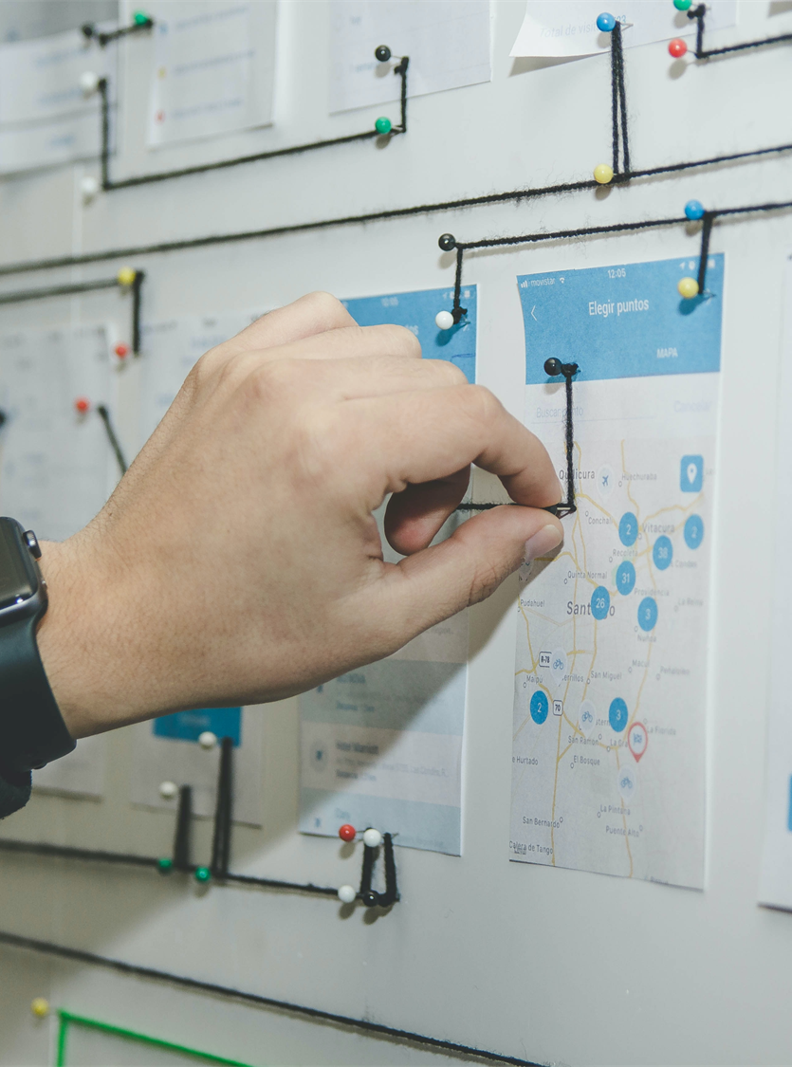
Smart Towns and Villages
WHAT DOES SMART TOWNS AND VILLAGES
SEEK TO ACHIEVE?
This investment area is an area in which collaborative cross border approaches are proven to deliver considerable benefits to the citizen and the Programme area.
How?
Through working with a range of stakeholders to development smart solutions to challenges facing rural communities.
This should build upon existing collaborative relationships and services on a cross-border basis

Slide 39
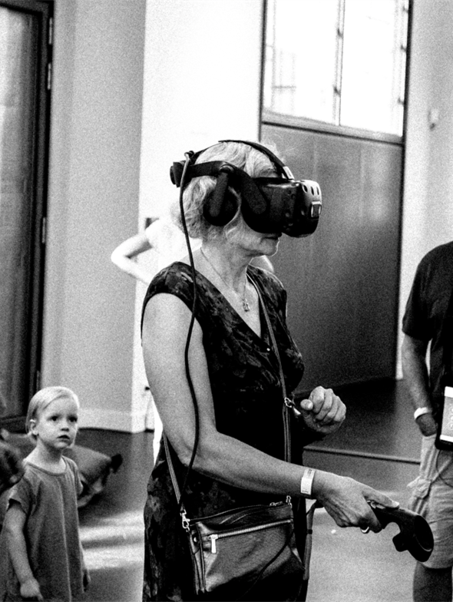
Smart Towns and Villages
WHAT IS SMART?
Smart means using technology to enable, accelerate or support strategic goals such as economic growth, wellbeing, sustainability and cross-border relationships. This means placing technology in the service of wider societal goals and to tackle major rural challenges.

Slide 40

Smart Towns and Villages
WHO?
A suitable cross-border partnership with the capacity to deliver on all the outputs and results is required.
A partnership able to develop solutions and have the capacity/influence to develop socially driven and technologically supported projects to enhance the social and economic wellbeing of people living in the Programme area.
A partnership able to develop and implement the project within the project’s lifetime.

Slide 41

Budget and Grant Rate
Total Budget available for Investment Area 2.4 is €30 million
(Inclusive of €24 million ERDF and €6 million governmental match funding).
100% of eligible project costs can be sought.

Slide 42

Smart Towns and Villages
SCOPE AND RANGE
ICT enabled community and economic development initiatives
The scope may include:
Mobile digital hubs
transforming existing assets
Mentoring programmes
Digital clusters
Social enterprise / innovation-led projects

Slide 43

Smart Towns and Villages
MEASURING CHANGE
Your project must result in new jointly developed solutions. In addition, PEACEPLUS requires you to consider, integrate and demonstrate how this project contributes to a more peaceful, prosperous and stable society in N. Ireland and the border counties of Ireland.

Slide 44
Smart Towns and Villages Indicators
Output indicator
Result indicator
9
jointly developed solutions
9
solutions taken up or up-scaled by organisations

Slide 45
PRE-APPLICATION SUPPORT & CONCEPT NOTE
Notes:
I now want to take you through the pre-application support on offer over the coming months.

Slide 46

Smart Towns and Villages
CONCEPT NOTE
The uncompleted form is short, 3 pages, with one page of guidance.
Provide high level project details and answer 5 questions, each between 300-500 words.
Advice is available pre- and post-completion.
Please complete and return it no later than 26th April 2023 to paul.cowie@urbanforesight.org

Slide 47
PREPARE AND PLAN IN ADVANCE
Explore and share ideas with potential partners
Learn, early on, if Area 2.4 is or is not for you, and be signposted elsewhere
Opportunities of getting support in advance of
the call
Tell us about your idea and receive feedback
Find out if this is the right investment area for you
Receive advice on how your outline idea might be strengthened
Notes:
Pre-development support includes:
This is the chance to tell us about your idea and receive feedback;
Receive advice on how your outline idea might be strengthened;
Find out if this is the right investment area for you;
Learn, early on, if Area 4.1 is or is not for you, and be signposted elsewhere;
For those with strong concept notes, we will have one-to-ones to discuss how the project can be further developed.

Slide 48
Smart Towns & Villages
CONCEPT NOTE (CN)
The Concept Note:
covers some (but not all) of the questions that will be in the
application-proper;
will help you put in place the foundations of your project so you are better prepared when the call opens;
is not a formal application;
is not scored
From today, 15th March 2023, any organisation interested in becoming a Lead Partner under Area 2.4 may complete and submit a Concept Note for comment, advice, and support.

Slide 49
Smart Towns & Villages
CONCEPT NOTE:
QUESTION 1
About Your Project
How has need been identified for your project?
How does your project align with what PEACEPLUS, and in particular Area 2.4, is trying to achieve?
To note, supported projects should:
Develop and area-based approach to smart projects
Use a social innovation-led approach to maximise the potential of ICT to deliver improved social and economic outcomes in target areas.
Use technology to enable, accelerate or support strategic goals such as economic growth, wellbeing, sustainability, environmental solutions,
social inclusion and cross-border relationships.

Slide 50
Smart Towns & Villages
CONCEPT NOTE:
QUESTION 2
Outputs and Results
How will your project result in a jointly developed solution?
At a Programme level for this Investment Area, the output indicator is for 9 jointly developed solutions. Your project’s target will contribute to this output indicator.
The result indicator is for 9 solutions taken up or up-scaled by organisations. Your project’s target will contribute to this result indicator.

Slide 51
Smart Towns & Villages
CONCEPT NOTE:
QUESTION 3
Cross Community and Cross Border
What geographical area/s will your project cover?
How your project is cross-border on the basis of:
  Involving communities from both sides of the border;
  Sharing knowledge from one side of the border to develop an initiative on the opposite side.;
  Using a shared approach / design on both sides of the border.
  Involving knowledge institutions from both sides of the border.

Slide 52
Smart Towns & Villages
CONCEPT NOTE:
QUESTION 4
Proposed Team, Partnership, and Implementing Arrangements
Staffing – who is doing what?
Suitable experience and qualifications?
Practical arrangements for implementation?
Rationale for partnership composition.
Structure of partnership.

Slide 53
Smart Towns & Villages
CONCEPT NOTE:
QUESTION 5
Value for Money
Is it appropriately costed?
Competitive tender where appropriate?
Will inputs achieve required outputs and results and meet
overall objective?
Exit strategy and durability of results; critical to this IA
How is the long-term impact of the project to be secured?

Slide 54
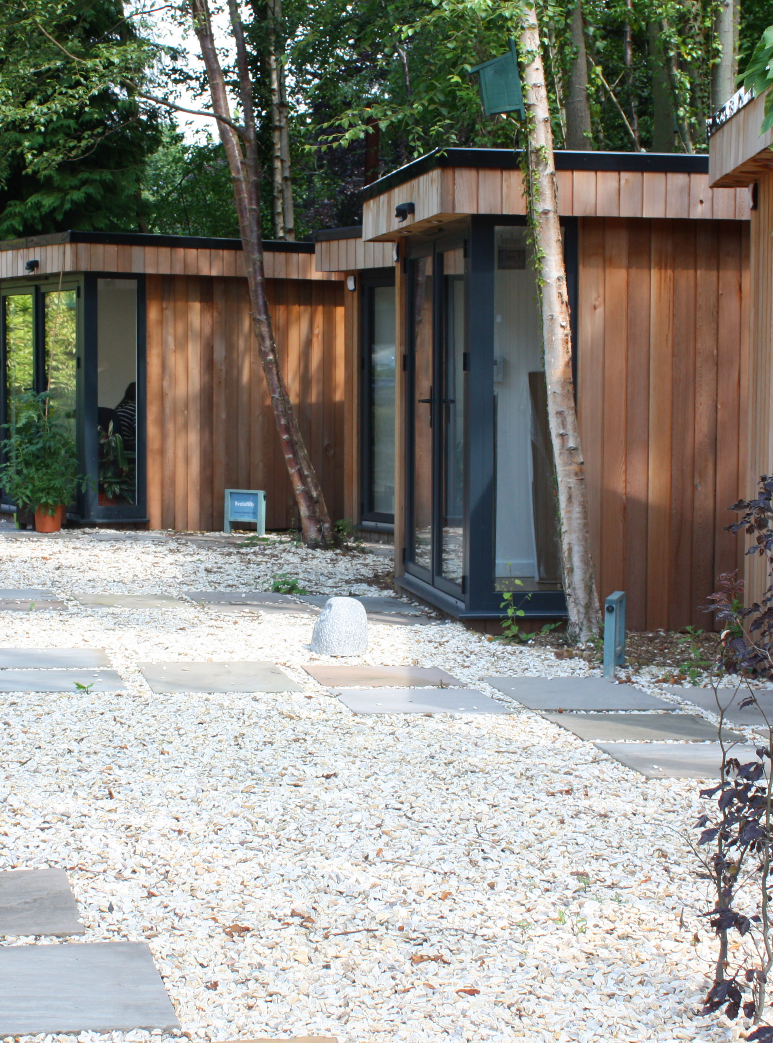
Smart Towns and Villages
LEAD PARTNER ROLE
Coordination
Financial management
Reporting
Communication
Training
Policies & Procedures
In short, accepts overall responsibility for ensuring implementation of entire project

Slide 55

Smart Towns and Villages
OTHER THINGS TO BEAR IN MIND
Take this time to build your partnership:
  be clear on who is doing what
  build a framework for communications and for M&E.
Don’t bite off more than you can chew: can you really deliver on this scale?
Think about finance: can you manage the cash flows?
Have clarity of purpose; your project must always consider its focus on building peace and prosperity for the region.
Notes:
Take this time to build your partnership: be clear on who is doing what; build a framework for communications;
Speak to other potential applicants: try not to cover the same patch; continue to learn from each other and share best practice.
Don’t bite off more than you can chew: can you really deliver on this scale, or might a project partner role or a small grants be better for you?
Think about finance: can you manage the cash flows required for projects of this size?
Have clarity of purpose: Collaborative Health and Social Care, but it must have a laser-sharp focus on peace-building and good relations.
Think about how you are going to monitor your targets.

Slide 56

TIMESCALES

Slide 57
Smart Towns and Villages
WHAT NEXT?
Pre-Development Support
Concept Note
Feedback
Further Support
Now available for Area 2.4 of the PEACEPLUS Programme
Downloadable from website – complete and return as soon as you can (due 26th April 2023)
Aim to provide feedback within 15 working days
Further support will depend upon both the fit and quality of what is outlined in the concept note
ANY QUESTIONS: Contact paul.cowie@urbanforesight.org
Notes:
Pre-Development Support: Now available for Area 4.1, Collaborative Health and Social Care
Concept Note: Downloadable from website – complete and return as soon as you can – please come in sooner if you can as you will get faster feedback.
Feedback: You’ll receive comments within 15 working days.
Support: Further support will depend upon both the fit and quality of what is outlined in the concept note
Any Questions: drop me an email

Slide 58

Smart Towns and Villages
IN DUE COURSE…
The following documents will be made available and should be consulted before completing the formal application form:
PEACEPLUS Cooperation Programme
The Programme Manual
Guide for Applicants
Call for Applications to Area 2.4
The Programme Overview is available
Notes:
In due course, call documents, programme rules, and a guide for applicants will all be made available.
These will be issued once the Cooperation Programme has been signed off. All should be consulted before completing the formal application form.
In the meantime, the Programme Overview is available on the SEUPB website.

Slide 59

Questions?

Slide 60
Thanks for listening

