Slide 1
Investment Area 2.2
Innovation Challenge Fund
PEACEPLUS Programme

Slide 2
PEACEPLUS Programme
Investment Area 2.2 – Innovation Challenge Fund
Introduction & Housekeeping – Paul Boylan, SEUPB
Welcome & Overview of PEACEPLUS Programme – Declan McGarrigle Interim Director of PEACEPLUS Development
Overview of Policy Interests from Northern Ireland – Keith Forster, Director of Strategic Policy, Dept. for Economy
Overview of Policy Interests from Ireland – David O’Neill, Assistant Principal, Ireland-UK Unit, Dept. of Enterprise, Trade and Employment
Pre-Application Support & Concept Note – Fiona Rooney, Pinnacle Growth Group
Questions and Answers
Notes:
**HOLDING SLIDE - AGENDA**
Good morning and thank you for joining us today.
We are delighted to welcome you to our thirteenth pre-application workshop for the PEACEPLUS Programme – Area 2.2 Innovation Challenge Fund
Similar support will continue be offered for the other areas of the Programme in the following weeks and months. Keep a look at our website and social channels for all updates.
Before we get into the main content of today’s workshops, I’ll take you briefly take you through the agenda…..
Then I will move onto providing an overview of Area 2.2, the Innovation Challenge Fund Programme.
Fiona Rooney will take you through the steps in building a strong proposal, and provide some broad parameters as to how things might roll out over the next six months.
There will also be an opportunity to ask questions at the end of the presentations and todays session, so please keep hold of your questions until the Q&A section. All answers will be added to the FAQs on our website.

Slide 3
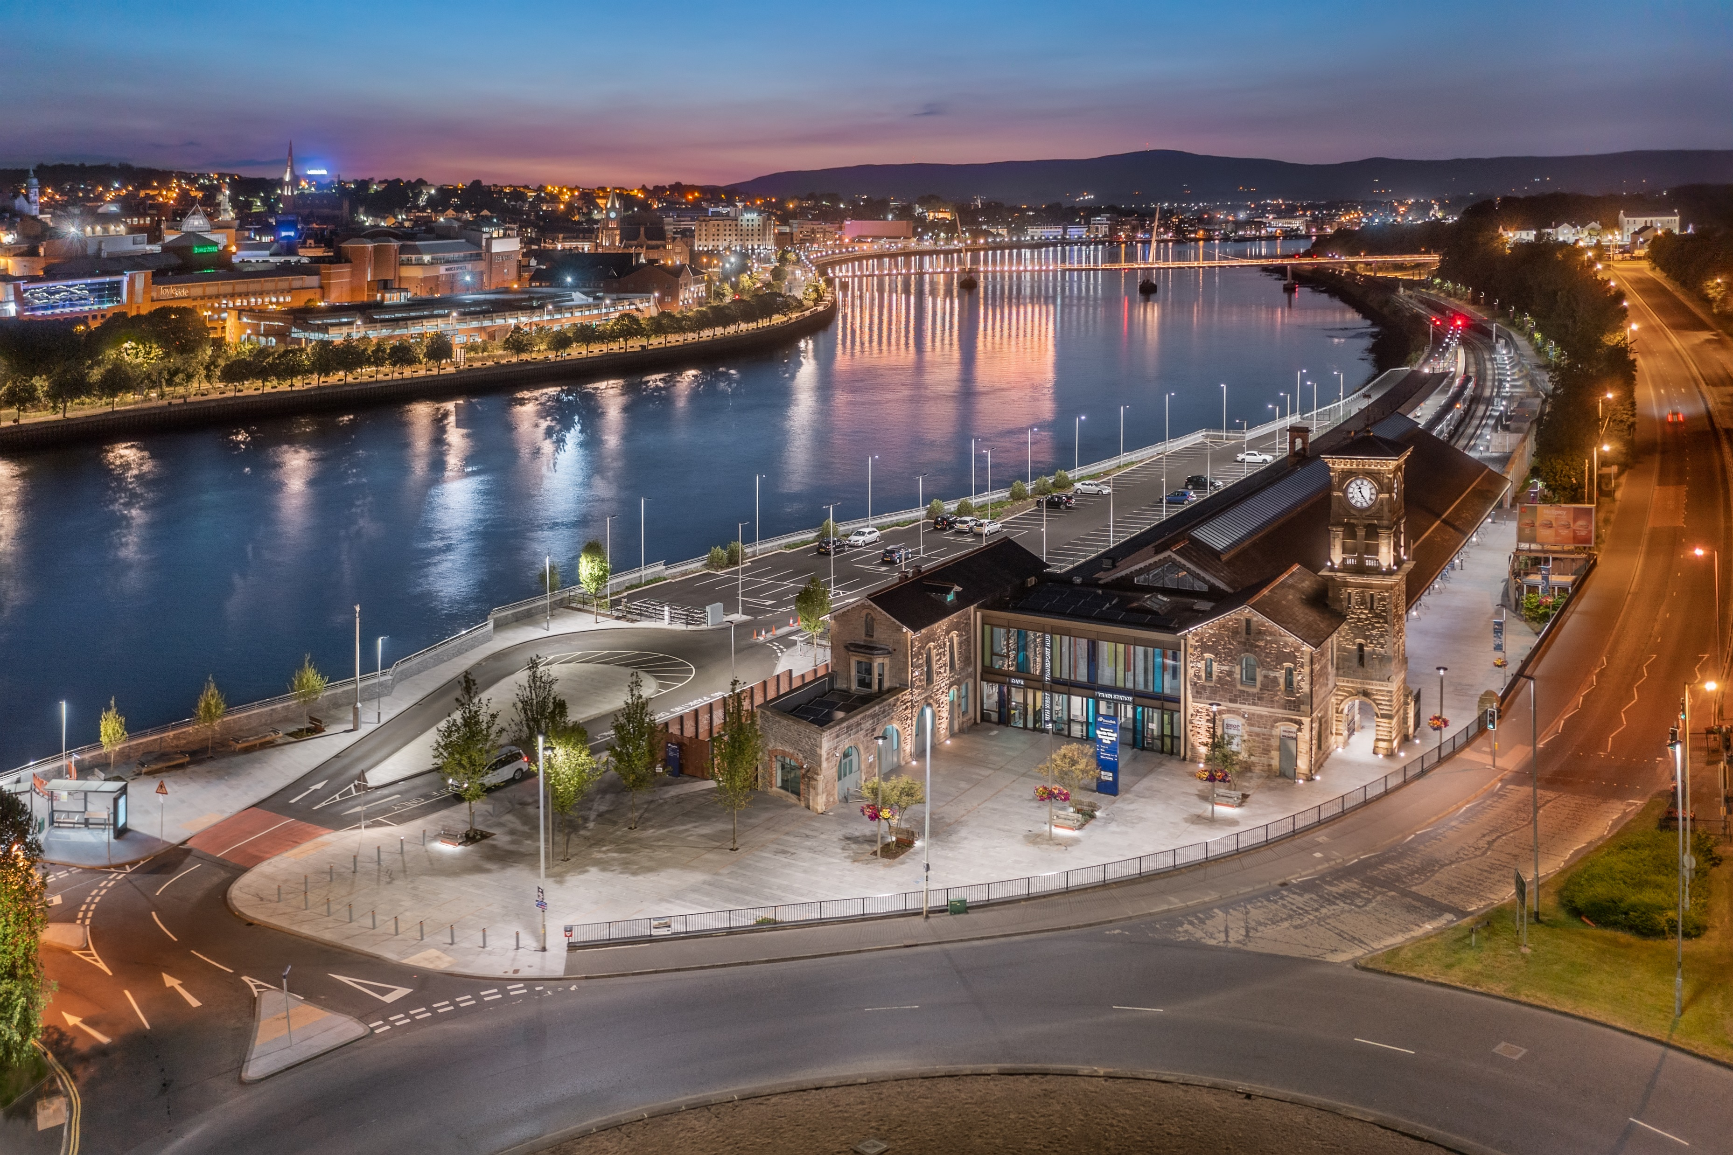
PEACEPLUS Programme
Declan McGarrigle, SEUPB
Interim Director PEACEPLUS

Slide 4
PEACEPLUS Context: How did we get here?
Support of the NI Executive, the Government of Ireland, the UK Government and the European Union.
Building upon previous PEACE & INTERREG programmes.
Renewed focus on peace and reconciliation.
Ensuring all projects contribute to cross-border and economic and territorial development.
Notes:
We have reached this point through a detailed process of collaboration with the Northern Ireland Executive, the Government of Ireland, the UK government, and the EU.
Together, we have drafted a new Programme that will contribute to a more peaceful, prosperous and stable society in Northern Ireland and the border region of Ireland. We believe it will leave a significant and lasting legacy.
It is an exciting programme which builds on the legacy of all previous PEACE and INTERREG programmes.
PEACEPLUS funding is distinct. It will fund activities that promote peace and reconciliation and contribute to cross-border economic and territorial development.

Slide 5
How was PEACEPLUS Developed?
Intensive review, research and public engagement
Stakeholder engagement
Public events – including specific events with young people
Survey submissions
Public consultation (2021)
Bi-laterals with government north-south (ongoing)
Notes:
So how was PEACEPLUS developed?
It has been a long road in getting to this point, but, given the scale and scope of the Programme, it has been well worth it.
The SEUPB commenced the PEACEPLUS development process in 2019. Since then, there has been considerable preparatory work, research, and stakeholder engagement.
This has included: public events, survey submissions, public consultation, and ongoing bi-lateral meetings with Governments north-south.

Slide 6
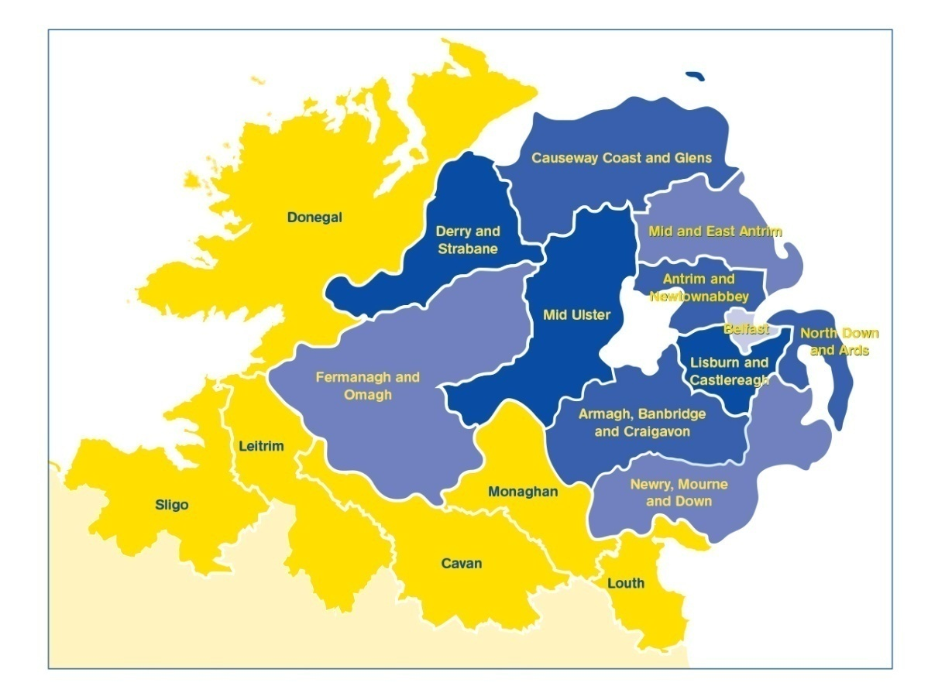
PEACEPLUS (2021-2027)
Programme area: Northern Ireland & the border counties of Ireland
Programme value: €1.144 billion
Six themes, 22 investment areas
Participation from partners outside the area
Notes:
The Programme will:
continue to take the opportunities and address the needs arising from the peace process in order to boost economic growth and stimulate social and economic regeneration; and,
and
promote social inclusion, particularly for those at the margins of economic and social life.
The value of the programme, over seven years, is €1.144bn
The ERDF contribution (80%) has been matched by the UK and Irish governments. This means that applicants can apply for 100% of their project value.
It is a wide-ranging Programme with six themes and 22 investment areas.
All investment areas have a sharp focus on the peace impacts and legacy they will leave.
Cross-community and cross-border collaboration is key to the programme, and all projects must have demonstrable peace impacts.
Commission rules allow for participation with partners outside the area of Northern Ireland and the Six Borders Counties. If you are considering partners from outside the region, what matters is that the benefits of the project are significant for the Programme area.

Slide 7
PEACEPLUS
Peace
Prosperity

Slide 8
Programme Overview:
Where does Innovation Challenge Fund Programme fit in?
Theme 1
Building Peaceful and Thriving Communities
€250m
Theme 2
Delivering Socio- Economic Regeneration & Transformation
€170m
Theme 3
Empowering and Investing in Our Young People
€123m
Theme 4
Healthy and Inclusive Communities
€172m
Theme 5
Supporting a Sustainable Future
€303m
Theme 6
Building and Embedding Partnership and Collaboration
€52m
Thematic Areas
1.1 Co-designed Local Community Peace Action Plans
1.2 Empowering Communities
1.3 Building Positive Relations
1.4 Reimaging Communities
2.1 Programme Area SME Development and Transition
2.2 Programme Area Innovation Challenge Fund
2.3 Programme Area Skills Programme
2.4 Smart Towns and Villages
3.1 Shared Learning Together Education Programme
3.2 PEACEPLUS Youth Programme
3.3 Youth Mental Health
4.1 Collaborative Health and Social Care
4.2 Rural Regeneration and Social Inclusion
4.3 Victims and Survivors
5.1 Biodiversity, Nature Recovery and Resilience
5.2Marine and Coastal Management
5.3 Water Quality and Catchment Management
5.4 Water Quality Improvement Programme
5.5 Geothermal
5.6 Transport
6.1 Strategic Planning
6.2 Maintaining and Forging Relationships between Citizens
Investment Areas

Slide 9
Project Lifecycle
PREDEVELOPMENT
Elaboration of project idea, concept note, partner search
Call
PROJECT DEVELOPMENT AND APPLICATION
PROJECT CLOSURE
Project assessment and selection
Strategy and content, responsibilities, application requirements
Modification assessment and selection.
Monitoring achievement.
Final reporting, post-project activities, use of results
PROJECT IMPLEMENTATION
CONTRACTING AND START-UP
Letter of Offer, Partnership Agreement, kick off, detailed planning, conditions
Coordination of activities, reporting, monitoring, modifications, evaluation, financial management, communication
Notes:
Pink diamonds: Some key points where programme committees have a role in.
All projects, regardless of the type (from previous slide) have the same project lifecycle

Slide 10
PEACEPLUS – Innovation Challenge Fund Programme
Theme 2. Delivering Socio-Economic Regeneration and Transformation (€170m)
2.1 SME Development and Transition
2.2 Innovation Challenge Fund
2.3 Programme Area Skills Development
2.4
Smart Towns and Villages

Slide 11
Keith Forster, Department for the Economy

Slide 12
NI’s 10x Economic Vision
10x Economic Vision sets out NI’s economic policy priorities.
Places innovation at heart of economic policy.
Triple bottom line – 3 pillars for success – innovation, inclusivity and sustainability.
Innovation workstream established to develop policy and an action plan for decade ahead.
More inclusive
More innovative
More sustainable

Slide 13
Innovation Policy Priorities
Our Vision focuses on a decade of innovation to drive success.
Innovation will drive productivity, competitiveness and create high value jobs as well as positive spillover effects.
Want innovation to be inclusive and benefit all our people, businesses and places.
We want to encourage a culture of innovation and an entrepreneurial spirit fostered by high levels of collaboration across our innovation ecosystem and an innovative public sector that leads by example.

Slide 14
Alignment with PEACEPLUS objectives
Alignment with call 2.2’s focus on R&D&I in key growth sectors.
Many of the key programme growth sectors align with NI’s clusters and technologies of strength including
Life and Health Sciences;
Advanced Manufacturing;
Agri-Food;
Digital ICT and Creative Industries (Cyber and AI)
Opportunities to work together to deliver shared objectives within call.
Will be exploring opportunities for North/South collaboration as part of our innovation action plan development.

Slide 15
Innovation Objectives - Targets
10x measurement framework developed end 2023 – sets out high level innovation targets. Will be developing actions to help drive performance against these.
Objective | Northern Ireland is to have a high performance driven by innovation underpinned by high levels of collaboration across business, academia, government and civil society By 2030 - increase total R&D expenditure by 55% from base line of £1,167m (2020)
Contributing | By 2030 Inncrease the number of R&D performing businesses in NI | By 2030 55% of NI businesses surveyed in the Innovation Survey to be innovation active firms | By 2030 Increase the number of NI businesses receiving Innovation Recognition | By 2030/31 Increase proportion of individuals leaving NI HE institutions with first degrees and post graduate qualifications in narrow STEM subjects

Slide 16
Innovation Framework
Policy framework developed to deliver ambitious vision for innovation.
Focuses on three key strategic areas with aim for:
More businesses innovating across wider business base
Increased number and scale of IDEs
Increased investment in R&D and more R&D companies
Our work doesn’t exist in silos and is part of a wider policy environment.
Supported by work on sustainability, inclusivity, skills, place and clusters & technologies.
A MORE INNOVATIVE ECONOMY
Strategic
Objectives
Comprehensive Innovation
Innovation Driven Enterprises
Research & Development
Supporting
Themes
and enablers
Sustainability
Inclusivity
Skills
Place (City Deals)
10x Clusters/ Technologies
Funding & Support
Notes:
City Deals £800m in innovation and digital projects

Slide 17
Strategic Objectives – Aim and Rationale
Research and Development
Aim
We will increase the number of R&D active companies in Northern Ireland from 990 (seen in 2020) to 1,440 in 2030 while considering geographic location, sector and company size
Rationale
Increased R&D activity will support those areas of strength where Northern Ireland can be a global leader and, in turn, support our whole economy, providing opportunities for all our people
Innovation Driven Enterprises
Aim
To position Northern Ireland as a world leading place for Innovation Driven Enterprises to establish and prosper
Rationale
Increasing the pipeline in the formation and development of high growth technology driven companies in Northern Ireland will be central to our future competitiveness and prosperity
Comprehensive Innovation
Aim
55% of Northern Ireland businesses to be innovation active firms and 10% to be holders of an Innovate NI Innovation Recognition by 2030
Rationale
Expansion of Innovation needed to more businesses beyond innovative and knowledge intensive sectors and into those sectors who typically innovate less or have lower productivity

Slide 18
NI’s Innovation Priorities – Next Steps
DfE will be working through co-design to develop more detailed policy priorities during 2023/24.
Looking for new and emerging opportunities for increased collaboration – e.g. PEACEPLUS.
Will look to understand how we can better avail of funding opportunities and get more of our businesses innovating and investing in R&D.
Will be working with partners – local, North/South and UK – to develop a 10x Innovation Action Plan for the short, medium and long term.

Slide 19
More Information
Contact Information
Email: 10xinnovationworkstream@economy-ni.gov.uk
Thank you

Slide 20
PEACEPLUS Pre-application workshop for Investment Area 2.2 Overview of Policy Interests from Ireland
David O’Neill Ireland-UK Unit, DETE
23 March 2023

Slide 21
Enterprise Innovation
Support for SMEs
Trade and Investment
Company and Corporate Law
Consumer and Competition
IP Policy
Workplace and Skills

Slide 22
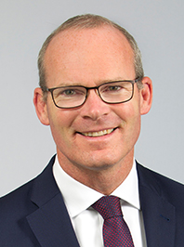
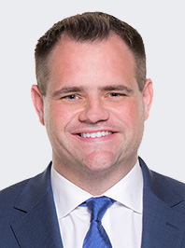
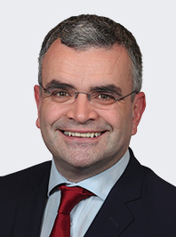
Our Ministers
Simon Coveney – Minister for Enterprise, Trade and Employment
Neale Richmond – Minister of State for Employment Affairs and Retail Business
Dara Calleary – Minister of State for Trade Promotion, Digital and Company Regulation

Slide 23
DETE Mission Statement
The Department of Enterprise, Trade and Employment’s mission is to lead on the creation and maintenance of high quality and sustainable full employment across all regions of the country by championing enterprise across government, by supporting a competitive business base to incentivise work, enterprise, trade, and investment and by promoting fair and competitive markets.
Our Vision is to make Ireland the best place to succeed in business across all
regions of our country, with vibrant enterprises, more high quality
employment, growing trade, fair workplaces and higher productivity.

Slide 24
Draft DETE Statement of Strategy 2023-2025
Since 2020, the Department has been working to achieve the commitments and priorities set out in the Programme for Government: Our Shared Future.
Draft Strategy based around 6 Strategic Goals:
➢ Goal 1: Maintain full employment and ensure sustainable and regionally balanced economic development.
➢ Goal 2: Advance the green and digital transitions to ensure the competitiveness and sustainability of Irish-based enterprise.
➢ Goal 3: Promote safety, better pay and conditions, more secure jobs and gender equality in the workplace.
➢ Goal 4: Enhance our business regulatory environment and Ireland’s attractiveness as a place to do business.
➢ Goal 5: Deepen and extend Ireland’s global business and trade in a responsible, fair and sustainable manner supportive of high living standards and grow further the all-island economy.
➢ Goal 6: Build an innovative and agile Department with a strong public service ethos driving effective and responsible policy implementation.

Slide 25
Project Ireland 2040 and DETE
Project Ireland 2040 is the government’s long-term overarching strategy to make Ireland a better country for all and to build a more resilient and sustainable future.
The availability of competitively priced world class infrastructure, including energy, water and wastewater, transport, telecommunications and related services, is critical to support enterprise development and economic growth.
To align Ireland’s infrastructure investment, as set out under Project Ireland 2040, with enterprise needs, DETE is working with its agencies to map infrastructure priorities for enterprise and is engaging with relevant Government Departments to drive delivery of these priorities.
With regard to the border counties of Ireland, the delivery of enterprise infrastructure priorities will support economic development within the border region by facilitating enterprise growth, supporting employment opportunities and improving accessibility to the region.
The Department is also engaging with relevant Government Departments and regulators to influence policy and regulatory reform in areas such as planning and environmental licencing to support efficient infrastructure delivery and enterprise development.

Slide 26
Enterprise White Paper
The White Paper on Enterprise 2022-2030, published in December 2022, sets out Ireland’s industrial policy for the medium-to long-term, building on Ireland’s economic strengths of being an open economy with strong trade links and high levels of foreign direct investment and possessing a resilient labour market.
The vision set out in the White Paper on Enterprise is for Irish-based enterprise to succeed through competitive advantage founded on sustainability, innovation and productivity, and delivering rewarding jobs and livelihoods.
7 priority enterprise policy objectives were identified. These are:
1. Integrating decarbonisation and net zero commitments
2. Placing digital transformation at the heart of enterprise policy
3. Advancing Ireland’s FDI and trade value proposition
4. Strengthening the Irish-owned exporting sector
5. Enabling locally trading sectors to thrive
6. Stepping up enterprise innovation
7. Building on strengths and opportunities

Slide 27
Enterprise White Paper cont.
The White Paper on Enterprise recognises the importance of having the right framework conditions in place to facilitate enterprise competitiveness. These framework conditions include infrastructure, cost of doing business, skills and talent, access to finance, taxation and regulation.
An implementation plan is currently being devised and will be completed in Q1 2023. This plan will commit relevant Government Departments, agencies and offices to timetabled deliverables of the 15 targets set out in the White Paper.

Slide 28
Ireland-UK Unit
North-South Coordination
Brexit Coordination
Responsible for DETE’s role as Accountable Department for INTERREG VA and Peace Plus
Two themes under PEACEPLUS: INVESTMENT AREA 2.1 – SME Development & Transition INVESTMENT AREA 2.2 – Innovation Challenge Fund

Slide 29
Impact 2030
Ireland’s Research and Innovation Strategy, launched by Minister for Further and Higher Education, Research, Innovation and Science, Simon Harris on 18 May 2022.
One of the 5 pillars of Impact 2030 is focussed on innovation driving enterprise success.
Ireland’s enterprise RDI performance has expanded significantly over the last 30 years, with an estimated 1,800 R&D-active enterprises spending over €3.4 billion a year.
However, there is a significant gap between the innovation performance of enterprise in Ireland as between Foreign Direct Investment (FDI) and indigenous firms.
Impact 2030 seeks to address this by supporting enterprise-led RDI, driving start-ups, competitiveness, productivity and high performance in the Irish economy, enabling the business sector to contribute to Ireland’s economic and societal resilience and transformation.

Slide 30
Enterprise Innovation in DETE
In addition to working with DFHERIS to reflect enterprise innovation policy in Impact 2030, DETE also implements its policy by supporting RDI programmes.
In 2023, the Department of Enterprise, Trade and Employment has allocated €158.1 million to the Enterprise Ireland Research, Development and Innovation programme – this will fund:
o in-company R&D supports;
o collaboration between industry and Research Performing Organisations;
o and commercialisation of research.
Collaboration is key to building a vibrant innovative business. The Innovation Voucher initiative provides vouchers worth €5,000 to small businesses to introduce them to innovation, linking them with a network of knowledge providers, North and South of the border.

Slide 31
Enterprise Innovation in DETE cont.
Another example of collaboration is the industry facing portal that are our Technology Gateways. They provide sector specific support to industry in terms of accessing grants and research in Ireland’s Technological Universities and Institutes of Technology. Examples in the border region:
o WiSAR Lab - Wireless Sensor Technologies – Letterkenny
o Precision Engineering, Materials and Manufacturing research – Sligo
o CREDIT - Centre for Renewables and Energy - Dundalk
The impact of the EI RDI Programme is evident, analysis shows that companies who avail of EI supports to engage in RDI perform significantly better that those who perform RDI without EI supports. In addition to helping companies engage in RDI, the EI RDI Programme has the clear effect of helping companies to do so at a greater scale and ambition than if the company had ‘gone it alone’.
Through Ireland’s Smart Specialisation Strategy, 2022 - 2027, we will drive increased levels of innovation performance in enterprise across our regions and maximise opportunities for innovation diffusion across regions and sectors.

Slide 32
Thank you all for your time today

Slide 33
Innovation Challenge Fund
Overview of Area 2.2
Fiona Rooney – Pinnacle Growth Group

Slide 34
Innovation Challenge Fund
Specific Objective
“To enhance cross-border research and innovation capacities and the uptake of advanced technologies in a manner which delivers economic regeneration and transformation.”
Resulting in:
“Higher levels of demonstrable commercially focused research, development and innovation in the Programme Area, which will deliver new products and or processes and a correlated increase in Programme Area productivity and export levels.”

Slide 35
What does Innovation Challenge Fund seek to achieve?
This investment area will support high level, commercially focused research, development and innovation with key Programme Area Growth sectors; resulting in increased productivity and higher export levels; and sustainable employment.
How?
Through building upon available knowledge and building on existing results and practices.
Developing new solutions that go beyond the existing practices, or adapt and implement already developed solutions.

Slide 36
Innovation Challenge Fund
Who?
Cross-border consortia groups comprising stakeholders who wish to collaborate on high level innovation projects, which will deliver local and national benefits.
National, regional and local authorities;
Regional and local development agencies, chambers of commerce;
Universities, colleges, higher education, research institutions;
Non-governmental organisations (NGOs);
Sectoral agencies and business support organisations;
Voluntary sector organisations;
Other relevant public-like organisations contributing to the development of the programme area;
Private sector – specifically micro, small, and medium-sized enterprises (SMEs1) and large companies.
A partnership able to develop and implement the project within the project’s lifetime (4 years).

Slide 37
Budget and Grant Rate
Total Budget available for Investment Area 2.2 is €65 million
(Inclusive of €52 million ERDF and €13 million governmental match funding).
100% of eligible project costs can be sought.
Notes:
Action 1: Research, development and innovation projects: High-level cross-border research development and innovation projects, capable of demonstrating commerciality, which will contribute to Programme Area growth sectors including Life and Health Sciences; Renewable / Bio Energy; Advanced Manufacturing; Agri-food; Cyber Security; and Artificial Intelligence;
Action 2: Advanced technologies applications: Initiatives that support the application of advanced technologies across other sectoral areas; including the development of technology hubs, which assist enterprises of all scales to develop new products and or processes.

Slide 38
Innovation Challenge Fund
Scope and Range
The scope may include:
Action 1: Research, development and innovation
Action 2: Advanced technologies

Slide 39
Innovation Challenge Fund
Scope and Range
Areas include:
Research, development and Innovation growth sectors including;
Life and Health Sciences
Renewable / Bio Energy
Advanced Manufacturing
Agri-food
Cyber Security
Artificial Intelligence
Advanced Technologies, including;
Initiatives that support the application of advanced technologies across other sectoral areas; including
the development of technology hubs, which assist enterprises of all scales to develop new products and or processes.

Slide 40
Innovation Challenge Fund
Measuring Change
Your project must result in enhance cross-border research and innovation capacities and the uptake of advanced technologies in a manner which delivers economic regeneration and transformation. In addition, PEACEPLUS requires you to consider, integrate and demonstrate how this project contributes to a more peaceful, prosperous and stable society in N. Ireland and the border counties of Ireland.

Slide 41
Innovation Challenge Fund
Indicators
Output indicators
Result indicator
• 36 Research organisations participating in joint research projects
• 96 Enterprises support (Micro, Small, Medium & Large)
• 96 Enterprises with non-financial support
82 Enterprises (SMEs) introducing new products or process innovation solutions.

Slide 42
Innovation Challenge Fund
Indicative Actions
Innovation Challenge Fund initiatives:
Support collaborative initiatives in key growth sectors, which will have a positive impact on entrepreneurial activity and/or productivity and the innovative capability of enterprise;
Enhance the productivity and new produced development opportunities of Programme Area enterprises to sustain and increase employment levels across the Programme Area;
Increase the levels of automation and enable Programme Area enterprises to respond to new technological opportunities across a range of key sectors; and
Increase the level of accessible innovation focused facilities across the Programme Area; including those which can be utilised by local start-ups and are tech and digital-focused.

Slide 43
Innovation Challenge Fund
Indicative Actions
Innovation Challenge Fund Non-financial initiatives:
Operating at scale through the development and management of collaborative networks operating on a local, national and international basis, including industry clusters;
Engaging in commercially led innovation, which will result in the development of new products and or more efficient processes;
Transitioning to a low carbon and circular economy through the development and introduction of sustainable manufacturing practices through education awareness and incentive programmes;
Delivering LEAN / productivity improvements or transition to / utilise the latest digitisation and Industry 4.0 tools to enable increased levels of productivity and competitiveness, while driving continuous economic improvement and performance, and access to global markets;
Support for SMEs to meet challenges, adapt and thrive within a post COVID-19 economy and in response to the increasing cost of doing business.

Slide 44
PRE-APPLICATION SUPPORT & CONCEPT NOTE

Slide 45
Prepare and Plan in Advance
Explore and share ideas with potential partners
Learn, early on, if Area 2.2 is or is not for you, and be signposted elsewhere
Opportunities of getting support in advance of the call
Tell us about your idea and receive feedback
Find out if this is the right investment area for you
Receive advice on how your outline idea might be strengthened
Notes:
Pre-development support includes:
This is the chance to tell us about your idea and receive feedback;
Receive advice on how your outline idea might be strengthened;
Find out if this is the right investment area for you;
Learn, early on, if Area 2.2 is or is not for you, and be signposted elsewhere;
For those with strong concept notes, we will have one-to-ones to discuss how the project can be further developed.

Slide 46
Innovation Challenge Fund
Concept Note (CN)
From today, any organisation interested in Area 2.2 may complete and submit a Concept Note for comment, advice, and support.
The Concept Note:
covers some (but not all) of the questions that will be in the application-proper;
will help you put in place the foundations of your project so you are better prepared when the call opens;
is not a formal application;
is not scored
Notes:
The Concept Note is available from today.
If the idea shows promise you will be offered further support.
My contact email is on the Concept Note.
The Concept Note:
covers some (but not all) of the questions that will be in the application-proper
will help you put in place the foundations of your project so you are better prepared when the call opens
is not a formal application and so is not scored

Slide 47
Innovation Challenge Fund
____________________________________________
HOW TO BUILD A STRONG PROPOSAL
Notes:
For the next ten slides or so, I will focus on the concept note and some of the key questions it asks.
As I said earlier, the concept note does constitute part of the formal application process, although we do envisage that this should be a valuable step in making an application, and – should you choose to proceed – the work you put in at this stage will make for stronger, more robust project built on sound foundations.

Slide 48
Innovation Challenge Fund
Concept Note
The uncompleted form is short, 3 pages, with 4 page guidance.
Provide high level project details and answer 6 questions, each between 300-500 words.
Advice is available pre- and post-completion.
Please complete and return it no later than 4th May 2023 to: fiona.rooney@pinnaclegrowth.group
Notes:
The uncompleted form is short, 3 pages, with four pages of guidance.
You are invited to provide high level project details and answer five questions in up to 500 words.
Advice is available pre- and post-completion.
Please complete and return it no later than DATE to fiona.rooney@pinnaclegrowth.group
My role is to review, respond, and follow up (online meetings) with those that are strong.
I’ll work closely with JS and respond to everyone. The sooner you can send me your note the better.

Slide 49
Innovation Challenge Fund
Concept Note: Question 1
About Your Project
How has need been identified for your project?
How does your project align with what PEACEPLUS, and in particular Area 2.2, is trying to achieve? [your project will enhance cross-border research and innovation capacities and the uptake of advanced technologies in a manner which delivers economic regeneration and transformation resulting in increased productivity and higher export levels; and sustainable employment across the Programme area]
Actions/Projects:
- Research, development and innovation
- Advanced technologies
To note, supported projects should:
Make use of available knowledge and builds on existing results and practises
Demonstrate new solutions that go beyond the existing practise in the sector/programme area/participating countries or adapt and implement already developed solutions.
Notes:
The basic details on the form should be self-explanatory. I will not touch on those today.
Today, I will take you through the six main questions on the form.
Question one is about your project.
In this section I want to know:
How your project aligns with what area 2.2 of PEACEPLUS is trying to achieve
How has need been identified for this project?

Slide 50
Innovation Challenge Fund
Concept Note: Question 1 cont’d.
About Your Project
The extent to which your project has been informed by including the following:
The innovation or advanced technology solutions you propose to develop and how this differs from alternative solutions.
The specific challenge you intend to address and who would benefit from it in the short and longer term.
Any work you have already done to counter this need, e.g. focusing on developing an existing capability or creating a new one.

Slide 51
Innovation Challenge Fund
Concept Note: Question 2
Outputs and Results
How will your project result in a joint research project?
The output indicators are:
36 research organisations participating in joint research projects
96 Enterprises supported (of which are: micro, small, medium & large).
96 Enterprises with non-financial support.
Note: An enterprise and research organisation is counted once regardless how many times it receives support from operations in the same specific objective.
2. How many people will be engaged in your project?
At a Programme level for this Investment Area, the result indicator is:
82 enterprises (small and medium) to introduce new products or process innovation solutions
Note: An enterprise and research organisation is counted once regardless how many times it receives support from operations in the same specific objective.
3. How will you reach the enterprises and keep them involved?
4. How will you monitor participation and evaluate impact?
Notes:
At a Programme level for this Investment Area, the output indicators are:
36 research organisations participating in joint research projects. Your project’s target will contribute to this output indicator. Note: A joint research project includes at least one research organisation and another partner (such as an enterprise). A research organisation is considered once regardless how many times it receives support from operations in the same specific objective).
96 Enterprises supported (of which are: micro, small, medium & large). Your project’s target will contribute to this output indicator. Note: (Counts all entreprises that receive monetary or in-kind support)
96 Enterprises with non-financial support. Your project’s target will contribute to this output indicator. Note: Research projects will include at least one research organisation and enterprise jointly participating in cross-border research activity.
In all output indicator cases, an enterprise is counted once regardless how many times it receives support from operations in the same specific objective.
How many people will be engaged in your project?
At a Programme level for this Investment Area, the result indicator is:
82 enterprises (small and medium) to introduce new products or process innovation solutions. Your project’s target will contribute to this result indicator. Note: Beneficiaries must relate to the new solutions developed and implemented upon the output indicator and can only be counted once they receive the course of the intervention, service or initiative i.e., an episode of care. The size of the enterprise supported is measured at the time of the application: micro enterprise, small enterprise, medium enterprise.

Slide 52
Innovation Challenge Fund
Concept Note: Question 3
Cross Community and Cross Border
What geographical area/s will your project cover?
How your project is cross-border on the basis of:
Using staff from both sides of the border;
Being open to users on either side of the border;
Using a shared approach / design on both sides of the border.

Slide 53
Innovation Challenge Fund
Concept Note: Question 4
No result in duplication or displacement of existing provision
Have the issues of duplication and displacement been considered for your project?
Is your project likely to impact upon and/or complement similar existing or planned provision?
How will these issues be avoided or mitigated?

Slide 54
Innovation Challenge Fund
Concept Note: Question 5
Proposed team, partnership and implementing arrangements
About the team that will manage the project.
Suitably qualifications and experience
Necessary organisational capacity to manage a multi-annual, large-scale EU project with multiple stakeholders?
Have the main project partners worked together in partnership on similar projects in the past?
Have you considered the risks that may impact on the ability of your project to deliver its outputs or achieve its full impact?
Practices in place for project implementation and to manage risk?
Identified any major tools and mechanisms you will use to secure a successful project outcome?
How will the project team deliver outcomes and impact beyond the life of the project?
Who will own any I.P. Rights?

Slide 55
Innovation Challenge Fund
Concept Note: Question 6
Value for Money
1. How staff positions advertised at the appropriate grade, competitive tendering processes applied etc; and
2. Use this section to provide detail on the budget requested, the assumptions applied and how it demonstrates economical use of public resources.
What the funding will be spent on and how are costs distributed between consortium partners, if applicable
How you and any project partners will fund their contribution to the project and ensure that this is in place
How you will fund and resource any post-project activities

Slide 56
Innovation Challenge Fund
Lead Partner Role
Coordination
Financial management
Reporting
Communication
Training
Policies & Procedures
In short, accepts overall responsibility for ensuring implementation of entire project
Notes:
I want to take a moment to underline the extent of the Lead Partner Responsibilities.
A Lead Partner will be an organisation who can handle the governance associated with a project of this size and value and can manage the outputs and results for the beneficiaries concerned.
In order to do that, they will be responsible for:
Coordination – submit application; assume responsibility for smooth implementation of entire project; coordinate all partners and activities.
Financial management – ensures budget control, eligible and timely claims, sufficient cashflow, fund allocation to partners, accepts risk in the event of ineligibility and/or failure to meet targets
Reporting – Coordinates record keeping, oversees monitoring and evaluation, maintains records, ensures timely progress.
Communication – with partners, point of contact with SEUPB and with any other support that is put in place during implementation (for example, liaising with consultant appointed to assist with evaluation)
Training – rolling out any training, be it technical or related to the programme being delivered.
Policies & Procedures – safeguarding, reliable systems, staff support.
In short, the LP accepts overall responsibility for ensuring implementation of entire project, it is significant role.

Slide 57
Other things to bear in mind
Take this time to build your partnership and delivery plan:
be clear on who is doing what
build a framework for project management, communications and monitoring & evaluation.
Don’t bite off more than you can chew: can you really deliver on this scale?
Think about finance: can you manage the cash flows?
Have clarity of purpose: your project must always consider its focus on building peace and prosperity for the region.
Notes:
Take this time to build your partnership: be clear on who is doing what; build a framework for communications;
Speak to other potential applicants: try not to cover the same patch; continue to learn from each other and share best practice.
Don’t bite off more than you can chew: can you really deliver on this scale, or might a project partner role or a small grants be better for you?
Think about finance: can you manage the cash flows required for projects of this size?
Have clarity of purpose: but it must have a laser-sharp focus on peace-building and good relations.
Think about how you are going to monitor your targets.

Slide 58
TIMESCALES

Slide 59
What next?
Further support
Feedback
Concept Note
Pre-Development Support
Further support will depend upon both the fit and quality of what is outlined in the concept note.
Aim to provide feedback within 15 working days.
Downloadable from website – complete and return as soon as you can (4th May 2023).
Now available for Area 2.2 of the PEACEPLUS Programme.
Any Questions:
Fiona.Rooney@pinnaclegrowth.group
Notes:
Pre-Development Support: Now available for Area 2.2, Innovation Challenge Fund
Concept Note: Downloadable from website – complete and return as soon as you can – please come in sooner if you can as you will get faster feedback.
Feedback: You’ll receive comments within 15 working days.
Support: Further support will depend upon both the fit and quality of what is outlined in the concept note
Any Questions: drop me an email

Slide 60
In Due Course…..
In due course, the following documents will be made available and should be consulted before completing the formal application form:
PEACEPLUS Cooperation Programme
The Programme Manual
Guide for Applicants
Call for Applications to Area 2.2
The Programme Overview is available
Notes:
In due course, call documents, programme rules, and a guide for applicants will all be made available.
These will be issued once the Cooperation Programme has been signed off. All should be consulted before completing the formal application form.
In the meantime, the Programme Overview is available on the SEUPB website.

Slide 61
Questions?

Slide 62
Thanks for listening

