Slide 1
Investment Area 2.1
SME Development and Transition
PEACEPLUS Programme

Slide 2
PEACEPLUS Programme
Investment Area 2.1 – SME Development and Transition
Introduction & Housekeeping – Paul Boylan, SEUPB
Welcome & Overview of PEACEPLUS Programme – Declan McGarrigle Interim Director of PEACEPLUS Development
Overview of Policy Interests from Ireland – David O’Neill, Assistant Principal, Ireland-UK Unit, Dept. of Enterprise, Trade and Employment
Overview of Policy Interests from Northern Ireland – Trevor Connolly, Director for Business Engagement, Dept. for Economy
Pre-Application Support & Concept Note – Fiona Rooney, Pinnacle Growth Group
Questions and Answers
Notes:
**HOLDING SLIDE - AGENDA**
Good morning and thank you for joining us today.
We are delighted to welcome you to our twelfth pre-application workshop for the PEACEPLUS Programme – Area 2.1 SME Development and Transition
Similar support will continue be offered for the other areas of the Programme in the following weeks and months. Keep a look at our website and social channels for all updates.
Before we get into the main content of today’s workshops, I’ll take you briefly take you through the agenda…..
Then I will move onto providing an overview of Area 2.1, the SME Development and Transition Programme.
Fiona Rooney will take you through the steps in building a strong proposal, and provide some broad parameters as to how things might roll out over the next six months.
There will also be an opportunity to ask questions at the end of the presentations and todays session, so please keep hold of your questions until the Q&A section. All answers will be added to the FAQs on our website.

Slide 3
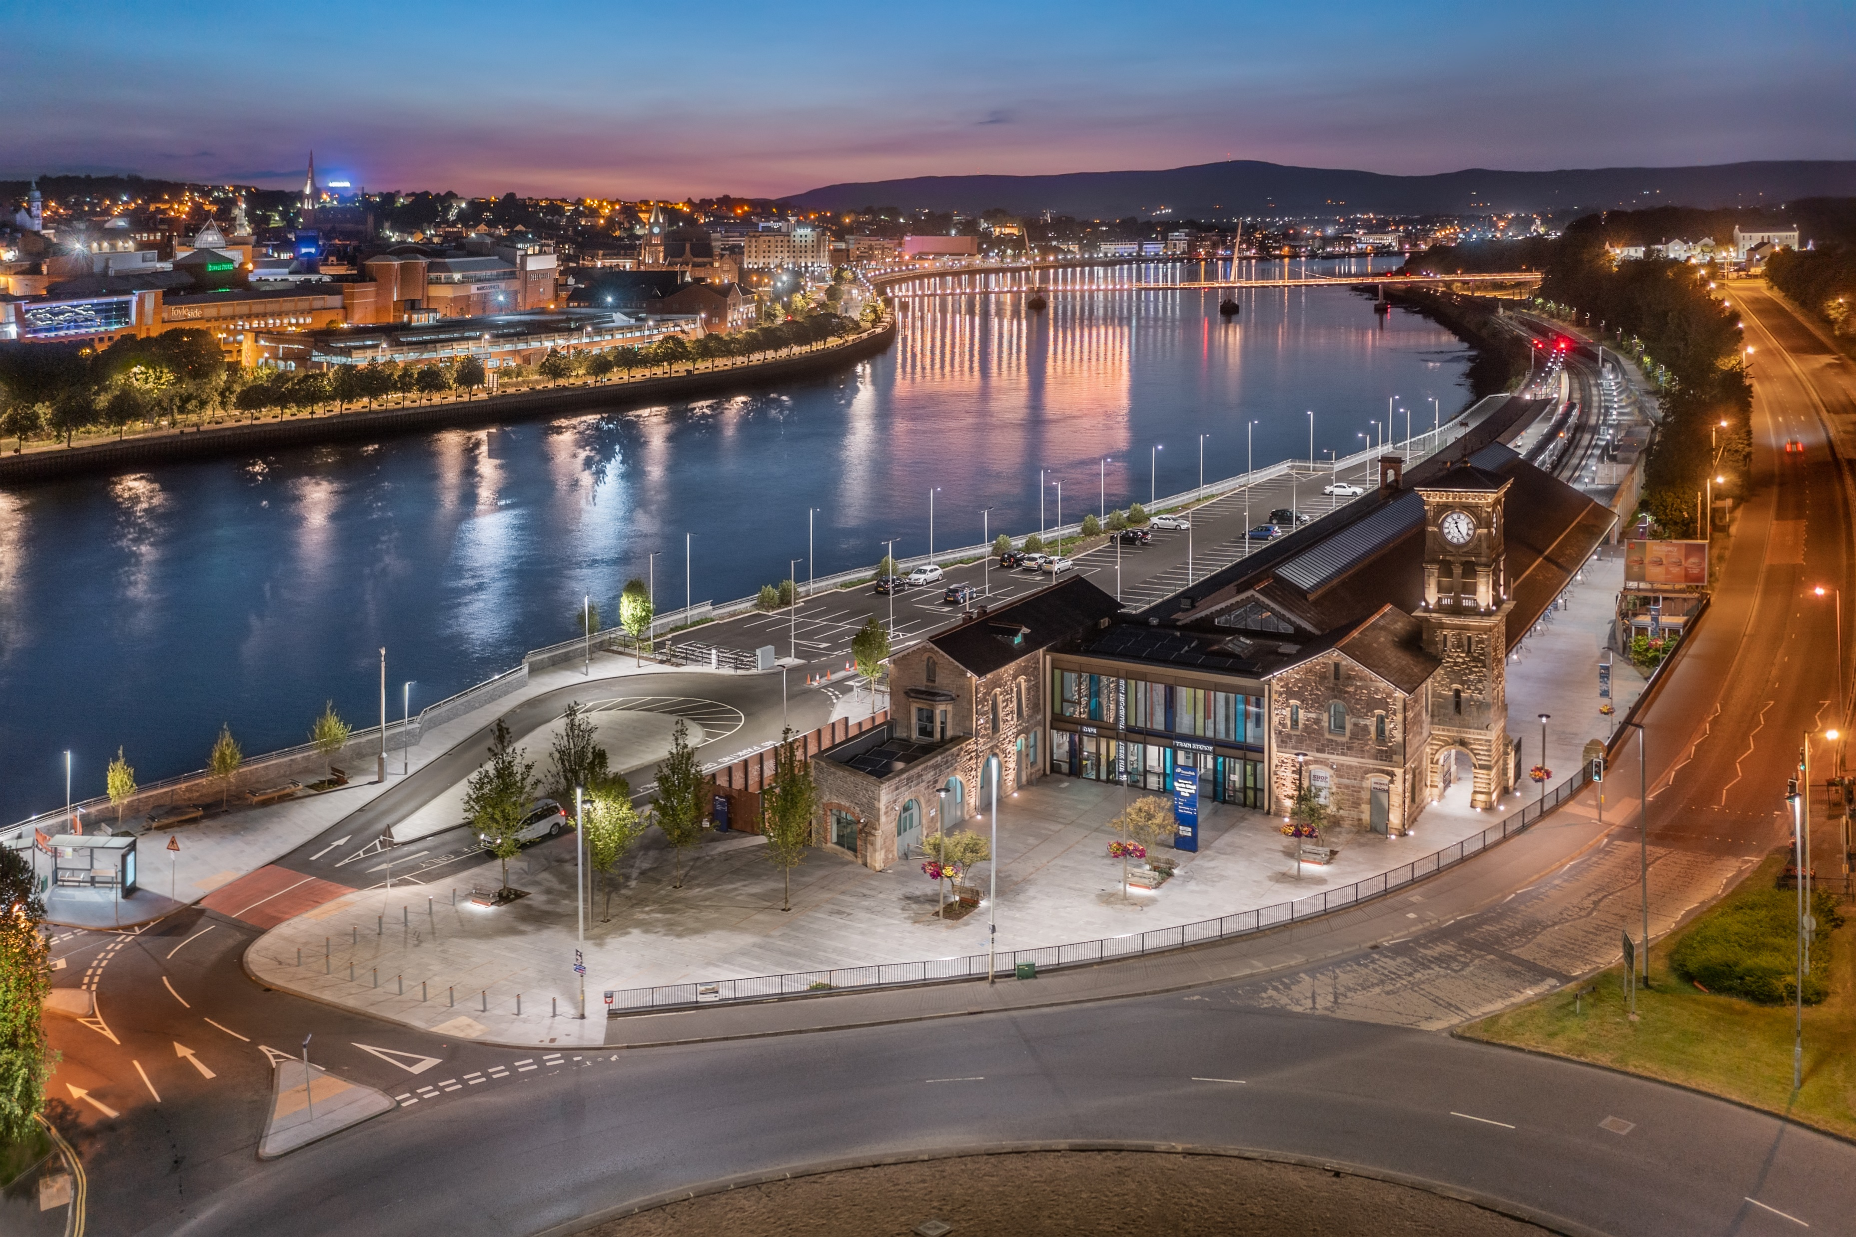
PEACEPLUS Programme
Declan McGarrigle, SEUPB
Interim Director PEACEPLUS

Slide 4
PEACEPLUS Context: How did we get here?
Support of the NI Executive, the Government of Ireland, the UK Government and the European Union.
Building upon previous PEACE & INTERREG programmes.
Renewed focus on peace and reconciliation.
Ensuring all projects contribute to cross-border and economic and territorial development.
Notes:
We have reached this point through a detailed process of collaboration with the Northern Ireland Executive, the Government of Ireland, the UK government, and the EU.
Together, we have drafted a new Programme that will contribute to a more peaceful, prosperous and stable society in Northern Ireland and the border region of Ireland. We believe it will leave a significant and lasting legacy.
It is an exciting programme which builds on the legacy of all previous PEACE and INTERREG programmes.
PEACEPLUS funding is distinct. It will fund activities that promote peace and reconciliation and contribute to cross-border economic and territorial development.

Slide 5
How was PEACEPLUS Developed?
Intensive review, research and public engagement
Stakeholder engagement
Public events – including specific events with young people
Survey submissions
Public consultation (2021)
Bi-laterals with government north-south (ongoing)
Notes:
So how was PEACEPLUS developed?
It has been a long road in getting to this point, but, given the scale and scope of the Programme, it has been well worth it.
The SEUPB commenced the PEACEPLUS development process in 2019. Since then, there has been considerable preparatory work, research, and stakeholder engagement.
This has included: public events, survey submissions, public consultation, and ongoing bi-lateral meetings with Governments north-south.

Slide 6
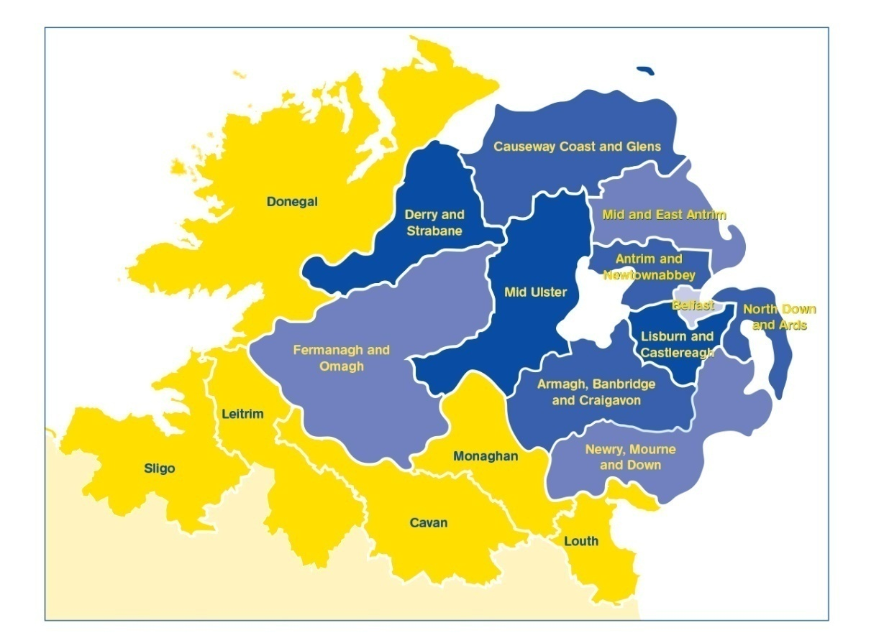
PEACEPLUS (2021-2027)
Programme area: Northern Ireland & the border counties of Ireland
Programme value: €1.144 billion
Six themes, 22 investment areas
Participation from partners outside the area
Notes:
The Programme will:
continue to take the opportunities and address the needs arising from the peace process in order to boost economic growth and stimulate social and economic regeneration; and,
and
promote social inclusion, particularly for those at the margins of economic and social life.
The value of the programme, over seven years, is €1.144bn
The ERDF contribution (80%) has been matched by the UK and Irish governments. This means that applicants can apply for 100% of their project value.
It is a wide-ranging Programme with six themes and 22 investment areas.
All investment areas have a sharp focus on the peace impacts and legacy they will leave.
Cross-community and cross-border collaboration is key to the programme, and all projects must have demonstrable peace impacts.
Commission rules allow for participation with partners outside the area of Northern Ireland and the Six Borders Counties. If you are considering partners from outside the region, what matters is that the benefits of the project are significant for the Programme area.

Slide 7
PEACEPLUS
Peace
Prosperity

Slide 8
Programme Overview:
Where does SME Development and Transition fit in?
Theme 1
Building Peaceful and Thriving Communities
€250m
Theme 2
Delivering Socio- Economic Regeneration & Transformation
€170m
Theme 3
Empowering and Investing in Our Young People
€123m
Theme 4
Healthy and Inclusive Communities
€172m
Theme 5
Supporting a Sustainable Future
€303m
Theme 6
Building and Embedding Partnership and Collaboration
€52m
Thematic Areas
1.1 Co-designed Local Community Peace Action Plans
1.2 Empowering Communities
1.3 Building Positive Relations
1.4 Reimaging Communities
2.1 Programme Area SME Development and Transition
2.2 Programme Area Innovation Challenge Fund
2.3 Programme Area Skills Programme
2.4 Smart Towns and Villages
3.1 Shared Learning Together Education Programme
3.2 PEACEPLUS Youth Programme
3.3 Youth Mental Health
4.1 Collaborative Health and Social Care
4.2 Rural Regeneration and Social Inclusion
4.3 Victims and Survivors
5.1 Biodiversity, Nature Recovery and Resilience
5.2Marine and Coastal Management
5.3 Water Quality and Catchment Management
5.4 Water Quality Improvement Programme
5.5 Geothermal
5.6 Transport
6.1 Strategic Planning
6.2 Maintaining and Forging Relationships between Citizens
Investment Areas

Slide 9
Project Lifecycle
PREDEVELOPMENT
Elaboration of project idea, concept note, partner search
Call
PROJECT DEVELOPMENT AND APPLICATION
PROJECT CLOSURE
Project assessment and selection
Strategy and content, responsibilities, application requirements
Modification assessment and selection.
Monitoring achievement.
Final reporting, post-project activities, use of results
PROJECT IMPLEMENTATION
CONTRACTING AND START-UP
Letter of Offer, Partnership Agreement, kick off, detailed planning, conditions
Coordination of activities, reporting, monitoring, modifications, evaluation, financial management, communication
Notes:
Pink diamonds: Some key points where programme committees have a role in.
All projects, regardless of the type (from previous slide) have the same project lifecycle

Slide 10
PEACEPLUS – SME Development and Transition Programme
Theme 2. Delivering Socio-Economic Regeneration and Transformation (€170m)
2.1 SME Development and Transition
2.2 Innovation Challenge Fund
2.3 Programme Area Skills Development
2.4
Smart Towns and Villages

Slide 11
PEACEPLUS Pre-application workshop for Investment Area 2.1 Overview of Policy Interests from Ireland
David O’Neill Ireland-UK Unit, DETE
23 March 2023

Slide 12
Support for SMEs
Enterprise Innovation
Trade and Investment
Company and Corporate Law
Consumer and Competition
IP Policy
Workplace and Skills

Slide 13
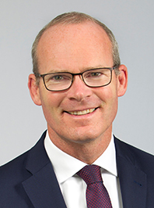
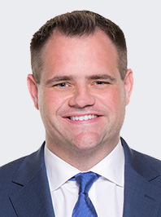
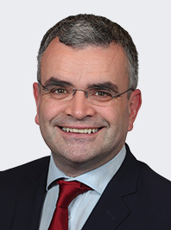
Our Ministers
Simon Coveney – Minister for Enterprise, Trade and Employment
Neale Richmond – Minister of State for Employment Affairs and Retail Business
Dara Calleary – Minister of State for Trade Promotion, Digital and Company Regulation

Slide 14
DETE Mission Statement
The Department of Enterprise, Trade and Employment’s mission is to lead on the creation and maintenance of high quality and sustainable full employment across all regions of the country by championing enterprise across government, by supporting a competitive business base to incentivise work, enterprise, trade, and investment and by promoting fair and competitive markets.
Our Vision is to make Ireland the best place to succeed in business across all
regions of our country, with vibrant enterprises, more high quality
employment, growing trade, fair workplaces and higher productivity.

Slide 15
Draft DETE Statement of Strategy 2023-2025
Since 2020, the Department has been working to achieve the commitments and priorities set out in the Programme for Government: Our Shared Future.
Draft Strategy based around 6 Strategic Goals:
➢ Goal 1: Maintain full employment and ensure sustainable and regionally balanced economic development.
➢ Goal 2: Advance the green and digital transitions to ensure the competitiveness and sustainability of Irish-based enterprise.
➢ Goal 3: Promote safety, better pay and conditions, more secure jobs and gender equality in the workplace.
➢ Goal 4: Enhance our business regulatory environment and Ireland’s attractiveness as a place to do business.
➢ Goal 5: Deepen and extend Ireland’s global business and trade in a responsible, fair and sustainable manner supportive of high living standards and grow further the all-island economy.
➢ Goal 6: Build an innovative and agile Department with a strong public service ethos driving effective and responsible policy implementation.

Slide 16
Project Ireland 2040 and DETE
Project Ireland 2040 is the government’s long-term overarching strategy to make Ireland a better country for all and to build a more resilient and sustainable future.
The availability of competitively priced world class infrastructure, including energy, water and wastewater, transport, telecommunications and related services, is critical to support enterprise development and economic growth.
To align Ireland’s infrastructure investment, as set out under Project Ireland 2040, with enterprise needs, DETE is working with its agencies to map infrastructure priorities for enterprise and is engaging with relevant Government Departments to drive delivery of these priorities.
With regard to the border counties of Ireland, the delivery of enterprise infrastructure priorities will support economic development within the border region by facilitating enterprise growth, supporting employment opportunities and improving accessibility to the region.
The Department is also engaging with relevant Government Departments and regulators to influence policy and regulatory reform in areas such as planning and environmental licencing to support efficient infrastructure delivery and enterprise development.

Slide 17
Enterprise White Paper
The White Paper on Enterprise 2022-2030, published in December 2022, sets out Ireland’s industrial policy for the medium-to long-term, building on Ireland’s economic strengths of being an open economy with strong trade links and high levels of foreign direct investment and possessing a resilient labour market.
The vision set out in the White Paper on Enterprise is for Irish-based enterprise to succeed through competitive advantage founded on sustainability, innovation and productivity, and delivering rewarding jobs and livelihoods.
7 priority enterprise policy objectives were identified. These are:
1. Integrating decarbonisation and net zero commitments
2. Placing digital transformation at the heart of enterprise policy
3. Advancing Ireland’s FDI and trade value proposition
4. Strengthening the Irish-owned exporting sector
5. Enabling locally trading sectors to thrive
6. Stepping up enterprise innovation
7. Building on strengths and opportunities

Slide 18
Enterprise White Paper cont.
The White Paper on Enterprise recognises the importance of having the right framework conditions in place to facilitate enterprise competitiveness. These framework conditions include infrastructure, cost of doing business, skills and talent, access to finance, taxation and regulation.
An implementation plan is currently being devised and will be completed in Q1 2023. This plan will commit relevant Government Departments, agencies and offices to timetabled deliverables of the 15 targets set out in the White Paper.

Slide 19
Ireland-UK Unit
North-South Coordination
Brexit Coordination
Responsible for DETE’s role as Accountable Department for INTERREG VA and PEACEPLUS
Two Investment Areas under PEACEPLUS Theme 2 : INVESTMENT AREA 2.1 – SME Development & Transition INVESTMENT AREA 2.2 – Innovation Challenge Fund

Slide 20
SME Growth and Transition in DETE
The 2020 Programme for Government committed to the delivery of a National SME Growth Plan.
The Tánaiste established an SME and Entrepreneurship Taskforce with thematic subgroups focusing on areas of Entrepreneurship, Productivity, Digitalisation and Competitiveness, Internationalisation, and Clustering and Networks
The report published in January 2021 provided commentary on a broad range of measures to help SMEs and entrepreneurs to start up, scale up and access foreign markets, as well as recommendations aimed at helping SMEs to become more productive and ready for the transition to a digital, green economy.
An Implementation Group was established to examine the recommendations and determine where it was considered significant progress could be made. These include:
• Access to Finance
• Digital Transformation
• Increasing first time exporters
• Enhanced assistance for high-potential businesses
• Clustering and networks
SME management skills
Reducing the regulatory burden in SMEs
Delivery of a single portal for business information and assistance
Ensuring comprehensive enterprise agency coverage for SMEs
Promoting SME participation in public procurement

Slide 21
SME Growth and Transition in DETE cont.
Throughout 2021 and 2022, significant engagement took place across the Department and wider Government and Agencies towards the advancement of the priorities, with progress updates provided regularly to the Taskforce.
In December 2022, a Memo was brought to Government to report on the progress, which included:
The extension of the LEO mandate to work with companies with the potential to export and who have grown to more than 10 employees;
Reducing the regulatory burden on small businesses through the rollout of the SME Test;
The launch of the new Skills for Better Business tool to help small businesses improve SME management skills;
An improved portal for business information and assistance which has recently gone live;
A new clustering framework;
A range of new instruments launched in 2022 to improve access to finance and digitalisation
The work of the Taskforce in 2023, will be supported by the White Paper on Enterprise. The previously identified priorities remain relevant with the group agreeing that Climate action, SMEs and transition should be considered as an additional as priority measure for future progress.

Slide 22
Thank you all for your time today

Slide 23
PEACEPLUS Programme 2021-2027 Investment Area 2.1 SME Development and Transition Trevor Connolly, Director for Business Engagement

Slide 24
10X Vision - Next Steps for Implementation
10X outlines a long term, transformative vision for a more innovative, inclusive and sustainable NI economy.
Following a public consultation last October DfE published the 10X Vision: Next Steps for Implementation. We will now focus on the following 3 pillars to deliver 10X:
Triple Bottom Line – delivering on 10X will require focus on our three core priorities: innovation, inclusion and sustainability.
Focus – in order to deliver 10X and transform our economy we will need to focus our resources on maximising our areas of competitive advantage and using the resources we have to deliver on the triple bottom line.
Scale – transformation of our economy will require us to be ambitious and deliver on a scale which we have never achieved before.

Slide 25
10X Vision - Next Steps for Implementation
Innovation
Increase total R&D expenditure by 55%
Increase the number of R&D performing businesses by 450
Increase number of innovation active firms to 55% of NI businesses
10% of NI businesses receiving Innovation Accreditation.
Increase proportion of individuals leaving NI HE institutions with first degrees and post-graduate qualifications in narrow STEM subjects from 24% to 27%.
Inclusion
Increase Northern Ireland Household Disposable Income above the SAE average while maintaining NI as one of the top performing SAEs in relation to the Gini-coefficient (a measure of income equality).
Close the employment gap between men and women; people with disabilities and people without; and most deprived area of NI and the least deprived area of NI;
Increase the proportion of the working age population with qualifications at level 3 and above from 57.2% (2020) to 70%-75%.
Sustainability
80% electricity consumption from renewable sources.
Greenhouse gas emissions 48% lower than baseline.
Double the size of NI’s low carbon and renewable energy economy to more than £2bn turnover.

Slide 26
10X Technologies and Sectors
The 10X Economic Vison will be realised by focusing on the core technologies and clusters where NI can be a global leader within the next decade.
Technologies include cybersecurity, software, robotics, artificial intelligence, zero carbon tech, digitisation, food supply chain/safety and virtual production.
Sectors where we have potential world class competitive advantage include: Life and Health Sciences, Advanced Manufacturing, Agri-Tech, Digital ICT, Low Carbon and Screen Industries.

Slide 27
Developing a draft NI Entrepreneurship Strategy
The Department is developing a draft Entrepreneurship Strategy for NI.
Emerging themes:
SME Support.
More and better Innovation Driven Enterprises (IDEs).
Enhance our Entrepreneurial cultural ambition.
Enhance our Access to Finance support.
Develop home market advantage/ leverage support for IDEs from Corporates.
All of the above underpinned by focussing support on diverse founders: female entrepreneurs, non-university graduates, black and ethnic minority people, entrepreneurs with a disability and those from socially deprived backgrounds.

Slide 28
Draft Strategy – Emerging themes (1/2)
SME Support.
Post RPA, Councils are responsible for local economic development, social enterprise and supporting female entrepreneurs.
Councils are developing their Enterprise Support Service, funded by SPF.
Catalyst, CAFRE, Enterprise NI, FE Colleges, Invest NI, InterTradeIreland.
More and better Innovation Driven Enterprises (IDEs).
Delivery of 10x Innovation workstream.
MIT Regional Entrepreneurship Accelerator Programme (REAP).
Backbone Organisation, Proof of Concept, Business Accelerator.
Enhance our Entrepreneurial cultural ambition.
Global Entrepreneurship Monitor (GEM).Total Entrepreneurial Activity (TEA) rate in NI is 5.4% compared to UK average of 7.5%.
The rate of registered business births / deaths is lower in NI than rest of UK.
Aim: to embed innovation and entrepreneurship as part of our education system in schools, FE colleges and the Universities.

Slide 29
Draft Strategy – Emerging themes (2/2)
Enhance our Access to Finance support.
British Business Bank (BBB): new £70m funding recently launched.
Invest NI is reviewing its provision of debt and equity support.
Develop home market advantage.
Support for both SMEs and IDEs using buying power from central and local government.
Leverage support for IDEs from Corporates.
Corporate Social Responsibility.
Support to start-ups and IDEs from existing NI corporates.
Access to customers, technical support, mentoring.

Slide 30
Draft Strategy - alignment with Investment Area 2.1
It is anticipated that the Investment Area 2.1 will build upon existing investment to support SMEs:
to operate at scale through cross-border collaboration.
engage in commercially led innovation.
effectively transition to engage in the low carbon, circular economy.
support SMEs to deliver productivity improvements or transition to the latest digital tools.

Slide 31
Thank you
Notes:
GEM provides international benchmark data for entrepreneurial activity in Northern Ireland, on a comparable basis.

Slide 32
SME Development and Transition
Overview of Investment Area 2.1
Fiona Rooney – Pinnacle Growth Group

Slide 33
SME Development and Transition
Specific Objective
“enhance growth and competitiveness of SMEs and increase job creation.”
Resulting in:
“the development of a stronger, more innovative and collaborative Programme Area SME base, delivering higher levels of productivity, exports and sustainable employment”
Notes:
Taking you straight in to the specific objective of Area 2.1: This objective is to enhance growth and competitiveness of SMEs and increase job creation
It will result in the development of a stronger, more innovative and collaborative Programme Area SME base, delivering higher levels of productivity, exports and sustainable employment.
This should be achieved in line with the EU specific objectives: Enhancing sustainable growth and competitiveness of SMEs and job creation in SMEs, including by productive investments. .

Slide 34
What does SME Development and Transition Programme seek to achieve?
The investment area will build upon existing investment to support SMEs to operate at scale through cross-border collaboration; engage in commercially led innovation; effectively transition to engage in the low carbon, circular economy; deliver productivity improvements or transition to the latest digital tools; and strengthen the Programme Area.
How?
Promoting innovation and collaboration to increase productivity and the ability to export and employ highly skilled individuals.
Notes:
The investment area will build upon existing investment to support SMEs to operate at scale through cross-border collaboration; engage in commercially led innovation; effectively transition to engage in the low carbon, circular economy; support SMEs to deliver productivity improvements or transition to the latest digital tools; and strengthen the Programme Area SME base for maximum engagement in a post COVID-19 economic landscape and where the increasing cost of doing business is a significant challenge for companies.
The SME Development Transition Programme will include a focus upon those sectors most impacted by the COVID-19 pandemic.It will ensure complementarity with other regional initiatives including existing statutory support programmes and cluster initiatives.

Slide 35
SME Development and Transition
Who?
A suitable cross-border partnership with the capacity to deliver on all of the outputs, results and actions detailed is required.
A partnership able to develop solutions which deliver higher levels of productivity, exports and sustainable employment in the Programme area.
A partnership able to develop and implement the project within the project’s lifetime (4 years).
Notes:
There are great opportunities for SMEs in the Programme Area to develop partnerships which result in a stronger, more innovative and collaborative ecosystem. Through cross-border collaboration and engagement in commercially led innovation, SMEs will deliver higher levels of productivity and boost the transition to engage in the low carbon, circular economy. The support provided to facilitate such collaboration to SMEs will deliver productivity improvements, exports and sustainable employment, strengthening the Programme Area.

Slide 36
Budget and Grant Rate
Total Budget available for Investment Area 2.1 is €25 million
(Inclusive of €20 million ERDF and €5 million governmental match funding).
100% of eligible project costs can be sought.
Notes:
The Programme will fund the following types of actions:
SME support: Detailed SME capability assessment and mentoring programming to increase capacity in target areas, including sustainable development practices; new product and or process development; digitisation; and post COVID-19 recovery and adaption planning;
Research and Innovation (R&I) for product and/or process development: Cross-border collaborative research and innovation projects centred around core areas, including sustainable manufacturing, to develop new products and/or processes designed to increase competitiveness;
Clusters: Creation and management of innovative focused collaborative, cross-border clusters;
Academic-industry collaboration: Cross-border academic and industry collaborative projects; and
Scaling networks: Creation and management of support for scaling networks in key growth sectors.

Slide 37
SME Development and Transition
Scope and Range
The scope may include:
SME support; capability assessment and mentoring programming to increase capacity in target areas, including sustainable development practices; new product and or process development; digitisation; and post COVID-19 recovery and adaption planning;
Cross-border collaborative Research and Innovation projects for product and/or process
Creation and management of innovative focused collaborative, cross-border clusters
Cross-border academic and industry collaborative projects; and
Creation and management of support for scaling networks in key growth sectors.
Notes:
The Programme will fund the following types of actions:
SME support: Detailed SME capability assessment and mentoring programming to increase capacity in target areas, including sustainable development practices; new product and or process development; digitisation; and post COVID-19 recovery and adaption planning;
Research and Innovation (R&I) for product and/or process development: Cross-border collaborative research and innovation projects centred around core areas, including sustainable manufacturing, to develop new products and/or processes designed to increase competitiveness;
Clusters: Creation and management of innovative focused collaborative, cross-border clusters;
Academic-industry collaboration: Cross-border academic and industry collaborative projects; and
Scaling networks: Creation and management of support for scaling networks in key growth sectors.

Slide 38
SME Development and Transition
Measuring Change
Your project must result in regional based partnerships. Projects should encompass all actions and deliver a significant proportion of output indicators sought within this Investment Area. Proposals will also look to technological improvements on a cross border basis and address local issues of strategic importance to the region. In addition, PEACEPLUS requires you to consider, integrate and demonstrate how this project contributes to a more peaceful, prosperous and stable society in N. Ireland and the border counties of Ireland.
Notes:
Projects are encouraged to encompass all actions and demonstrate a regional based partnership, ensuring delivery across the entire Programme Area, and which has the competence to engage with all target growth sectors and deliver a significant proportion of output indicators sought within this call.
It is envisaged that proposals will also look to technological improvements on a cross border basis and address local issues of strategic importance to the region.

Slide 39
SME Development and Transition
Indicators
Output indicators
Result indicator
37 enterprises supported by grants.
2 projects for innovation networks across borders
1,907 enterprises supported.
1,879 enterprises with non-financial support
1,430 SMEs introducing product or process innovation

Slide 40
SME Development and Transition
Indicative Actions
SME Development and Transition Initiatives:
Initiatives designed to deliver cross-community and cross-border collaborative approaches to contribute to the development of a stronger, more innovative and collaborative Programme Area SME base
Development and implementation of support that facilitates the SMEs in delivering higher levels of productivity, exports and sustainable employment
Build upon existing collaborative cross-border relationships and service provision.
Supporting SMEs by creating innovation networks and clusters.
Notes:
Action 1 will provide monetary support in the form of grants to enterprises with a focus on:
Support for SMEs (including where appropriate micro-businesses and start-ups) to operate at scale through the development and management of collaborative networks operating on a local, national and international basis, including industry clusters;
Support for SMEs to engage in commercially led innovation, which will result in the development of new products and or more efficient processes;
Support for SMEs to transition to a low carbon and circular economy through the development and introduction of sustainable manufacturing practices through education awareness and incentive programmes;
Support to help SMEs deliver LEAN / productivity improvements or transition to / utilise the latest digitisation and Industry 4.0 tools to enable increased levels of productivity and competitiveness, while driving continuous economic improvement and performance, and access to global markets; and
Support for SMEs to meet challenges, adapt and thrive within a post COVID-19 economy and in response to the increasing cost of doing business.
The focus throughout the document on the post-COVID economy appears to be outdated. While still recovering from the pandemic, there is a renewed focus now on helping companies respond to the cost of living crisis and consequential impact on the cost of doing business. That should be focussed on more so than the post-COVID economy,
Agree we could extend it to cost of living also.

Slide 41
PRE-APPLICATION SUPPORT & CONCEPT NOTE

Slide 42
Prepare and Plan in Advance
Explore and share ideas with potential partners
Learn, early on, if Area 2.1 is or is not for you, and be signposted elsewhere
Opportunities of getting support in advance of the call
Tell us about your idea and receive feedback
Find out if this is the right investment area for you
Receive advice on how your outline idea might be strengthened
Notes:
Pre-development support includes:
This is the chance to tell us about your idea and receive feedback;
Receive advice on how your outline idea might be strengthened;
Find out if this is the right investment area for you;
Learn, early on, if Area 2.1 is or is not for you, and be signposted elsewhere;
For those with strong concept notes, we will have one-to-ones to discuss how the project can be further developed.

Slide 43
SME Development and Transition
Concept Note (CN)
From today, any organisation interested in becoming a Lead Partner under Area 2.1 may complete and submit a Concept Note for comment, advice, and support.
The Concept Note:
covers some (but not all) of the questions that will be in the application-proper;
will help you put in place the foundations of your project so you are better prepared when the call opens;
is not a formal application;
is not scored
Notes:
The Concept Note is available from today.
If the idea shows promise you will be offered further support.
My contact email is on the Concept Note.
The Concept Note:
covers some (but not all) of the questions that will be in the application-proper
will help you put in place the foundations of your project so you are better prepared when the call opens
is not a formal application and so is not scored

Slide 44
SME Development and Transition
____________________________________________
HOW TO BUILD A STRONG PROPOSAL
Notes:
For the next ten slides or so, I will focus on the concept note and some of the key questions it asks.
As I said earlier, the concept note does constitute part of the formal application process, although we do envisage that this should be a valuable step in making an application, and – should you choose to proceed – the work you put in at this stage will make for stronger, more robust project built on sound foundations.

Slide 45
SME Development and Transition
Concept Note
The uncompleted form is short, 4 pages, with 3 pages guidance.
Provide high level project details and answer 7 questions, each between 300-500 words. With question 7 only requiring and answer if applicable.
Advice is available pre- and post-completion.
Please complete and return it no later than 4th May 2023 to: fiona.rooney@pinnaclegrowth.group
Notes:
The uncompleted form is short, 4 pages, with three pages of guidance.
You are invited to provide high level project details and answer 7 questions in up to 500 words.
Advice is available pre- and post-completion.
Please complete and return it no later than DATE to fiona.rooney@pinnaclegrowth.group.
My role is to review, respond, and follow up (online meetings) with those that are strong.
I’ll work closely with [Name] and respond to everyone. The sooner you can send me your note the better.

Slide 46
SME Development and Transition
Concept Note: Question 1
About Your Project
How has need been identified for your project?
How does your project align with what PEACEPLUS, and in particular Area 2.1, is trying to achieve? [promote innovation and collaboration to increase productivity and the ability to export and employ highly skilled individuals]
To note, supported projects should:
Contribute to the development of a stronger, more innovative and collaborative Programme Area SME base.
Deliver higher levels of productivity, exports and sustainable employment.
Build upon existing collaborative cross-border relationships and service provision.
3. The extent to which your project proposal will also look to technological improvements on a cross border basis and address local issues of strategic importance to the region.

Slide 47
SME Development and Transition
Concept Note: Question 2
Outputs and Results
How will your project result in a jointly developed solution?
At a Programme level for this Investment Area, the output indicators are:
37 enterprises supported by grants. Your project’s target will contribute to this output indicator.
2 projects for innovation networks across borders
1,907 enterprises supported (of which; micros, small, medium)
1,879 enterprises with non-financial support
How many people will be engaged in your project?
At a Programme level for this Investment Area, the result indicator is:
for 1,430 SMEs introducing product or process innovation. Your project’s target will contribute to this result indicator.
Note: An enterprise is counted once regardless how many types of support (e.g. grants and non-financial support) receives from operations in the same specific objective.

Slide 48
SME Development and Transition
Concept Note: Question 3
Cross Community and Cross Border
Describe you project design and how your project is cross-border?
On the basis of:
How your project has ability to provide the scope of services required across the Programme area.
How you will ensure meaningful participation from all programme areas.
How the cross-border co-operation added value will be demonstrated.
How you have examined synergies with other existing provisions, e.g. including the Shared Island Fund, Shared Prosperity Fund and City Deals strategy, and how the proposal will complement these investments.
The engagement and collaboration have you conducted to demonstrate co-design with SMEs and address real, practical needs and requirements.

Slide 49
SME Development and Transition
Concept Note: Question 4
Demonstrate how your project will not result in duplication or displacement of existing provision
Have the issues of duplication and displacement been considered for your project?
Is your project likely to impact upon and/or complement similar existing or planned provision?
How will these issues be avoided or mitigated?

Slide 50
SME Development and Transition
Concept Note: Question 5
Proposed team, partnership and implementing arrangements
About the team that will manage the project.
How they are suitably qualified and experienced to deliver on this project?
Are there any identified skills or knowledge gaps?
Have you the necessary organisational capacity to manage a multi-annual, large-scale EU project with multiple stakeholders?
Have you considered the risks that may impact on the ability of your project to deliver its outputs or achieve its full impact?
What practical arrangements do you have in place to support smooth project implementation and to manage risk?

Slide 51
SME Development and Transition
Concept Note: Question 6
Value for Money
Showing that the appropriate inputs used in carrying out the project have been obtained at the least cost. For example:
How staff positions are advertised at the appropriate grade, competitive tendering processes applied etc; and
provide detail on the budget requested, the assumptions applied and how it demonstrates the economical use of public resources.
Notes:
Question 6 is all about VfM
CN asks you to provide a high-level budget.
We will assess the extent to which it is coherent and proportionate?
By time of application, financial allocation per budget line must be in line with the work plan.
Consider and describe your project’s:
Economy Measures: Show the project is appropriately costed, for example, staff positions advertised at the appropriate grade, competitive tendering processes applied, etc. Please use this section to provide detail on the budget requested, the assumptions applied, and how it demonstrates economical use of public resources.
Efficiency and Effectiveness Measures: Use this section to rationalise the inputs for your project in terms of how well they will deliver the stated outputs, results and overall objective of the project.
Exit Strategy: Provide detail on the exit strategy for this project, including evidence of the durability of the outputs and results of the project (i.e., the long-lasting effect of the achievements beyond the duration of the project activity). Please outline the strategy proposed to secure the long-term impact of the project (e.g., mainstreaming / sustaining the project / rolling out of results).

Slide 52
SME Development and Transition
Concept Note: Question 7 (if applicable)
‘Open Project’ model (if applicable)
The PEACEPLUS programme is including some simplification and enabling mechanisms.
As a Lead Partner is that you do not have to know all the partners during the preparations stage, which gives more flexibility and enables a quicker start of the project.
Lead Partner and Project Partners submit the application and oversee the overall project management. The core-partnership pass on the programme rules to sub-partners.
Key partnership and a budgetary framework
Sub-partners join at a later stage and become fully-fledged project partners
Notes:
Open projects are characterised by the following features;
Key partnership and a budgetary framework with place-holders; i.e., future sub partners (beneficiaries) not decided at the application stage. The Partners agrees on eligible types of future sub-partners, and the key partnership select the most promising ones.
The selected sub-partners join at a later stage and become fully-fledged project partners (beneficiaries), but with one major advantage: the key partnership ensures that most of the administrative load linked to application and reporting is removed from the shoulders of the sub-partners.
Lead Partner and Project Partners submit the application and oversee the overall project management. The application has to clearly describe in which work packages or for which activities this will be applied.
Approval of the project is conditional, which means the initial partnership commits itself to setting up clear rules and cooperation agreements for sub-partners and presenting these documents to the Joint Secretariat for approval. Upon approval of the documents, the initial partnership is allowed to select and admit SMEs as sub partners.
These SMEs join the partnership and become beneficiaries, albeit with significantly reduced obligations in terms of administration. SME as beneficiary signs the partnership agreement only with the Lead Partner.
Assistance can be made available during the call opening and closing to assist you with the development of this model.

Slide 53
SME Development and Transition
Concept Note: Question 7 (if applicable)
‘Open Project’ model (if applicable)
Approval of the project is conditional.
Assistance can be made available during the call opening and closing to assist you with the development of this model.
The use of this mechanism should be limited to situations where it will add value
The core-partnership must have enough capacity and experience in EU funded projects to deliver the project and support the sub-partners.
The sub-partners must contribute to the project aims, delivery and the achievement of performance framework outputs and results of the project.
Lead, partners & sub-partners must use and record information on the Jems system.
Notes:
Open projects are characterised by the following features;
Key partnership and a budgetary framework with place-holders; i.e., future sub partners (beneficiaries) not decided at the application stage. The Partners agrees on eligible types of future sub-partners, and the key partnership select the most promising ones.
The selected sub-partners join at a later stage and become fully-fledged project partners (beneficiaries), but with one major advantage: the key partnership ensures that most of the administrative load linked to application and reporting is removed from the shoulders of the sub-partners.
Lead Partner and Project Partners submit the application and oversee the overall project management. The application has to clearly describe in which work packages or for which activities this will be applied.
Approval of the project is conditional, which means the initial partnership commits itself to setting up clear rules and cooperation agreements for sub-partners and presenting these documents to the Joint Secretariat for approval. Upon approval of the documents, the initial partnership is allowed to select and admit SMEs as sub partners.
These SMEs join the partnership and become beneficiaries, albeit with significantly reduced obligations in terms of administration. SME as beneficiary signs the partnership agreement only with the Lead Partner.
Assistance can be made available during the call opening and closing to assist you with the development of this model.

Slide 54
SME Development and Transition
Concept Note: Question 7 (if applicable)
‘Open Project’ model (if applicable)
The only sub-partners that are eligible are micro and small and medium enterprises in line with the outputs.
As a sub-partner it can be advantageous not to have to cooperate from the start of the entire preparation process and receive support from experienced project partners for the delivery and reporting of the project.
Sub-partners can count towards the achievement of the output indicators Enterprises supported by grants (RCO02) and Enterprises supported (RCO01) and contribute towards the result indicator of the Investment Area.
Other models may be considered
Notes:
Open projects are characterised by the following features;
Key partnership and a budgetary framework with place-holders; i.e., future sub partners (beneficiaries) not decided at the application stage. The Partners agrees on eligible types of future sub-partners, and the key partnership select the most promising ones.
The selected sub-partners join at a later stage and become fully-fledged project partners (beneficiaries), but with one major advantage: the key partnership ensures that most of the administrative load linked to application and reporting is removed from the shoulders of the sub-partners.
Lead Partner and Project Partners submit the application and oversee the overall project management. The application has to clearly describe in which work packages or for which activities this will be applied.
Approval of the project is conditional, which means the initial partnership commits itself to setting up clear rules and cooperation agreements for sub-partners and presenting these documents to the Joint Secretariat for approval. Upon approval of the documents, the initial partnership is allowed to select and admit SMEs as sub partners.
These SMEs join the partnership and become beneficiaries, albeit with significantly reduced obligations in terms of administration. SME as beneficiary signs the partnership agreement only with the Lead Partner.
Assistance can be made available during the call opening and closing to assist you with the development of this model.

Slide 55
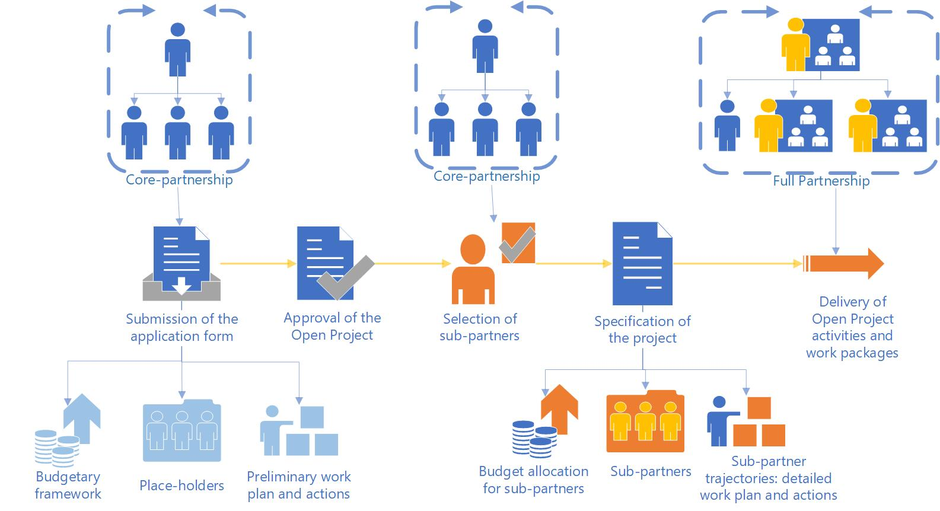
SME Development and Transition
Concept Note: Question 7 (if applicable)
‘Open Project’ model (if applicable)
Notes:
Open projects are characterised by the following features;
Key partnership and a budgetary framework with place-holders; i.e., future sub partners (beneficiaries) not decided at the application stage. The Partners agrees on eligible types of future sub-partners, and the key partnership select the most promising ones.
The selected sub-partners join at a later stage and become fully-fledged project partners (beneficiaries), but with one major advantage: the key partnership ensures that most of the administrative load linked to application and reporting is removed from the shoulders of the sub-partners.
Lead Partner and Project Partners submit the application and oversee the overall project management. The application has to clearly describe in which work packages or for which activities this will be applied.
Approval of the project is conditional, which means the initial partnership commits itself to setting up clear rules and cooperation agreements for sub-partners and presenting these documents to the Joint Secretariat for approval. Upon approval of the documents, the initial partnership is allowed to select and admit SMEs as sub partners.
These SMEs join the partnership and become beneficiaries, albeit with significantly reduced obligations in terms of administration. SME as beneficiary signs the partnership agreement only with the Lead Partner.
Assistance can be made available during the call opening and closing to assist you with the development of this model.

Slide 56
SME Development and Transition
Concept Note: Question 7 (if applicable)
‘Open Project’ model (if applicable)
The flexibility that an Open Project provides must not be used for:
Supporting sub-projects or micro-projects: all the activities of a project (including those delivered by the sub-partners) must contribute in a coherent and cohesive way to the project as a whole.
Replacing or avoiding procurement: sub-partners in an open project are not way to get services, but project partners to enhance the project and contribute to the aims and performance framework of the project.
Notes:
Open projects are characterised by the following features;
Key partnership and a budgetary framework with place-holders; i.e., future sub partners (beneficiaries) not decided at the application stage. The Partners agrees on eligible types of future sub-partners, and the key partnership select the most promising ones.
The selected sub-partners join at a later stage and become fully-fledged project partners (beneficiaries), but with one major advantage: the key partnership ensures that most of the administrative load linked to application and reporting is removed from the shoulders of the sub-partners.
Lead Partner and Project Partners submit the application and oversee the overall project management. The application has to clearly describe in which work packages or for which activities this will be applied.
Approval of the project is conditional, which means the initial partnership commits itself to setting up clear rules and cooperation agreements for sub-partners and presenting these documents to the Joint Secretariat for approval. Upon approval of the documents, the initial partnership is allowed to select and admit SMEs as sub partners.
These SMEs join the partnership and become beneficiaries, albeit with significantly reduced obligations in terms of administration. SME as beneficiary signs the partnership agreement only with the Lead Partner.
Assistance can be made available during the call opening and closing to assist you with the development of this model.

Slide 57
SME Development and Transition
Lead Partner Role
Coordination
Financial management
Reporting
Communication
Training
Policies & Procedures
In short, accepts overall responsibility for ensuring implementation of entire project
Notes:
I want to take a moment to underline the extent of the Lead Partner Responsibilities.
A Lead Partner will be an organisation who can handle the governance associated with a project of this size and value and can manage the outputs and results for the beneficiaries concerned.
In order to do that, they will be responsible for:
Coordination – submit application; assume responsibility for smooth implementation of entire project; coordinate all partners and activities.
Financial management – ensures budget control, eligible and timely claims, sufficient cashflow, fund allocation to partners, accepts risk in the event of ineligibility and/or failure to meet targets
Reporting – Coordinates record keeping, oversees monitoring and evaluation, maintains records, ensures timely progress.
Communication – with partners, point of contact with SEUPB and with any other support that is put in place during implementation (for example, liaising with consultant appointed to assist with evaluation)
Training – rolling out any training, be it technical or related to the programme being delivered.
Policies & Procedures – safeguarding, reliable systems, staff support.
In short, the LP accepts overall responsibility for ensuring implementation of entire project, it is significant role.

Slide 58
TIMESCALES

Slide 59
What next?
Further support
Feedback
Concept Note
Pre-Development Support
Further support will depend upon both the fit and quality of what is outlined in the concept note.
Aim to provide feedback within 15 working days.
Downloadable from website – complete and return as soon as you can (4th May 2023).
Now available for Area 2.1 of the PEACEPLUS Programme.
Any Questions:
Fiona.Rooney@pinnaclegrowth.group
Notes:
Pre-Development Support: Now available for Area 2.1, SME Development and Transition
Concept Note: Downloadable from website – complete and return as soon as you can – please come in sooner if you can as you will get faster feedback.
Feedback: You’ll receive comments within 15 working days.
Support: Further support will depend upon both the fit and quality of what is outlined in the concept note
Any Questions: drop me an email

Slide 60
In Due Course…..
In due course, the following documents will be made available and should be consulted before completing the formal application form:
PEACEPLUS Cooperation Programme
The Programme Manual
Guide for Applicants
Call for Applications to Area 2.1
The Programme Overview is available
Notes:
In due course, call documents, programme rules, and a guide for applicants will all be made available.
These will be issued once the Cooperation Programme has been signed off. All should be consulted before completing the formal application form.
In the meantime, the Programme Overview is available on the SEUPB website.

Slide 61
Questions?

Slide 62
Thanks for listening

