Slide 1
Investment Area 5.3
Catchment Management
PEACEPLUS Programme

Slide 2
Workshop Overview
Welcome & Housekeeping | Bethany Waterhouse-Bradley, SEUPB
Overview of the PEACEPLUS Programme | Declan McGarrible, Director of PEACEPLUS Development
Overview of Policy Interests – Ireland | Eimear O’Keeffe, DHLGH
Overview of Policy Interests – Northern Ireland | Silke Hartmann, DAERA
Questions and Answers
Overview of IA 5.3, Pre-application Support and the Concept Note | Eimear Bush, SEUPB
Questions and Answers
Networking Opportunities

Slide 3
The PEACEPLUS Programme
Declan McGarrigle, Director of PEACEPLUS Development
SEUPB

Slide 4

How did we get here?
Support of the NI Executive, the Government of Ireland, the UK Government and the European Union.
Building upon previous PEACE & INTERREG programmes.
Renewed focus on peace and reconciliation.
Ensuring all projects contribute to cross-border and economic and territorial development.
The Peace Bridge Derry-Londonderry

Slide 5
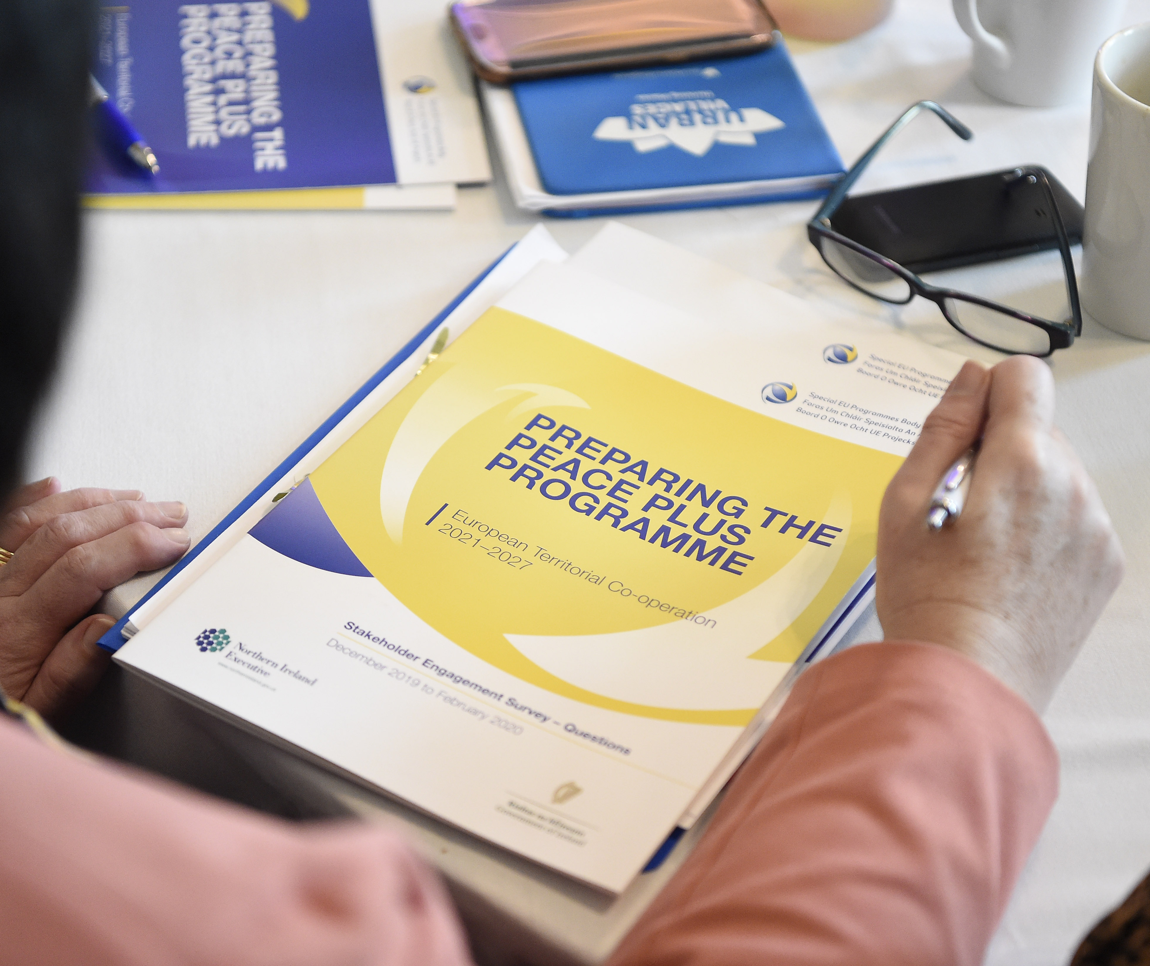
How was PEACEPLUS Developed?
Intensive review, research and public engagement
Stakeholder engagement
Public events – including specific events with young people
Survey submissions
Public consultation (2021)
Bi-laterals with government north-south (ongoing)

Slide 6
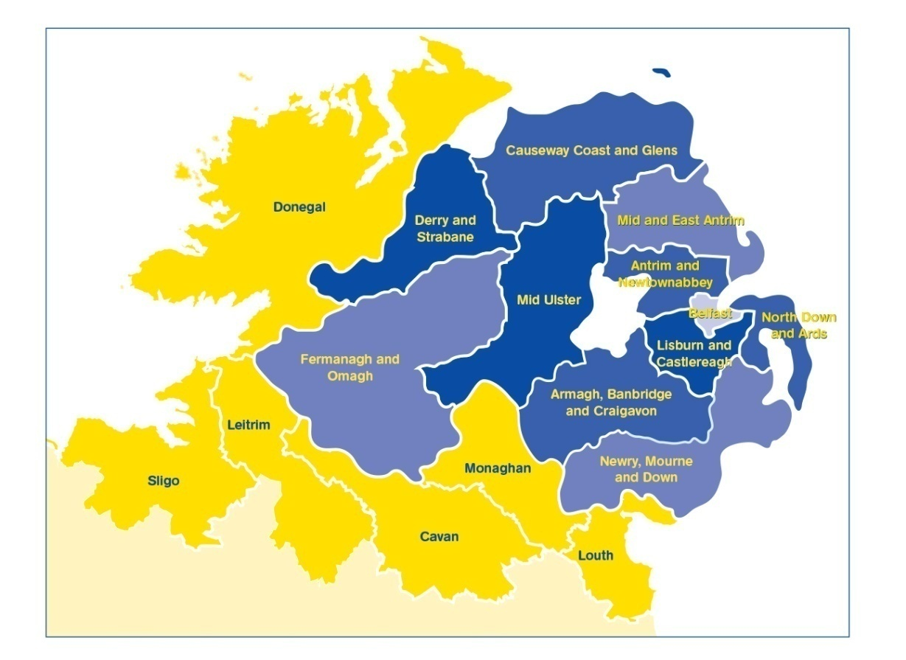
PEACEPLUS
2021-2027
Programme area: Northern Ireland & the border counties of Ireland
Programme value: €1.144bn
Six themes, 22 investment areas
Participation from partners outside the area

Slide 7
PROGRAMME OVERVIEW:
Where does Catchment Management fit in?
Theme 1
Building Peaceful and Thriving Communities
€250m
Theme 2
Delivering Socio- Economic Regeneration & Transformation
€170m
Theme 3
Empowering and Investing in Our Young People
€123m
Theme 4
Healthy and Inclusive Communities
€172m
Theme 5
Supporting a Sustainable Future
€303m
Theme 6:
Building and Embedding Partnership and Collaboration
€52m
Thematic Areas
1.1 Co-designed Local Community Peace Action Plans
1.2 Empowering Communities
1.3 Building Positive Relations
1.4 Reimaging Communities
2.1 Programme Area SME Development and Transition
2.2 Programme Area Innovation Challenge Fund
2.3 Programme Area Skills Programme
2.4 Smart Cities, Towns and Villages
3.1 Shared Learning Together Education Programme
3.2 PEACEPLUS Youth Programme
3.3 Youth Mental Health
4.1 Collaborative Health and Social Care
4.2 Rural Development and Regeneration
4.3 Victims and Survivors
5.1 Biodiversity, Nature Recovery and Resilience
5.2Marine and Coastal Management
5.3 Water Quality and Catchment Management
5.4 Water Quality Improvement Programme
5.5 Geothermal
5.6 Transport
6.1 Strategic Planning
6.2 Maintaining and Forging Relationships between Citizens
Investment Areas

Slide 8
The Project Lifecycle
PREDEVELOPMENT
Elaboration of project idea, concept note, partner search
Call
PROJECT DEVELOPMENT AND APPLICATION
PROJECT CLOSURE
Project assessment and selection
Strategy and content, responsibilities, application requirements
Final reporting, post-project activities, use of results
Modification assessment and selection.
Monitoring achievement
PROJECT IMPLEMENTATION
CONTRACTING AND START-UP
Coordination of activities, reporting, monitoring, modifications, evaluation, financial management, communication
Letter of Offer, Partnership Agreement, kick off, detailed planning, conditions
Notes:
Pink diamonds: Some key points where programme committees have a role in.
All projects, regardless of the type (from previous slide) have the same project lifecycle

Slide 9
Theme 5:
Building a Sustainable and Better Connected Future
At the forefront of the previous INTERREG Programme
Creating places where people want to live, visit and invest
Sustainability that works for everyone – contributing to a thriving environment where businesses and people can flourish

Slide 10
PEACEPLUS – Environment Programme
Theme 5: Supporting a Sustainable and Better Connected Future
5.1 Biodiversity, Nature Recovery and Resilience
5.2 Marine and Coastal Management
5.3 Water Quality and Catchment Management
5.4 Water Quality Improvement Programme
5.5 Geothermal Energy Demonstration Programme
5.6 Enhanced Sustainable Travel Connectivity

Slide 11
5.3 Catchment Management
Cross border collaborative approach to management and improvement of water quality to address the requirements of the Water Framework Directive.
Actions focused on cross border catchments (freshwater bodies in cross border river basins) located within the Programme Area.
Indicative actions in this area are: Catchment Management Strategies and Pilots of Nature-Based Solutions
Actions should be complemented by initiatives which facilitate behaviour and mindset change in landowners.

Slide 12
5.3 Catchment Management
Indicators
Output Indicator
Result Indicator
3 Jointly Developed Solutions
1 Strategy and action plan jointly developed
3 Solutions taken up by organisations
1 Strategy and action plan taken up by organisations

Slide 13
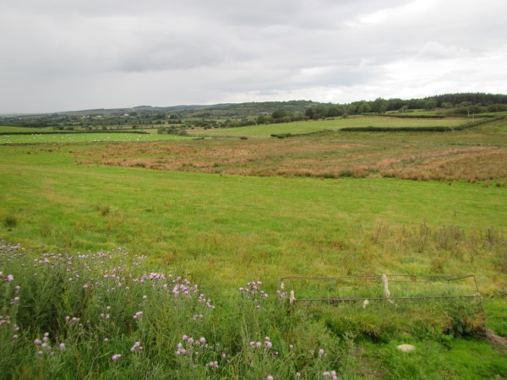
5.3 Catchment Management
Total funding award for this investment area is 21million Euro
Funding circa 4 projects in this investment area
Projects will run from 2024-2027

Slide 14
Water Policy Interests from Ireland
PEACEPLUS Workshop – Call 5.3
Dungannon – 29th March 2023
- presented by Eimear O’Keeffe (Water Policy Advisor, Water Division)

Slide 15
Overview
Water Framework Directive
River Basin Management Plan
WFD Status
Water Quality Trends
Water Quality – our most significant pressures
    Agriculture
Implementation of Measures – Ongoing work
Catchments & Priority Areas for Action - maps

Slide 16
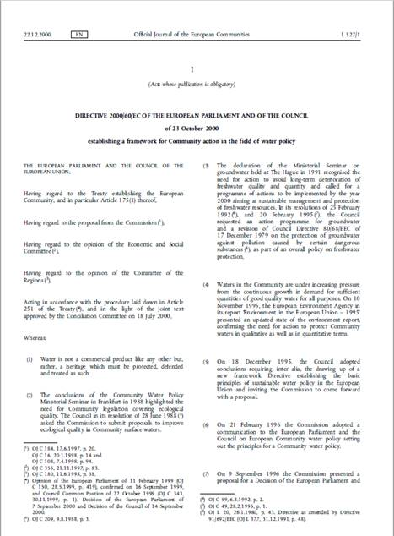
EU Water Framework Directive
(2000/60/EC)
Primary Objectives:
Prevent the deterioration of surface water & groundwater status.
Protect, enhance & restore all surface water & groundwater bodies to achieve at least Good Ecological Status (GES) or Good Ecological Potential (GEP).
Protect & enhance all artificial & heavily modified water bodies to achieve at least Good Ecological Potential & Good surface water chemical status.
Notes:
The WFD is the most important piece of legislation for water quality.
It was transposed into Irish Law in 2003

Slide 17
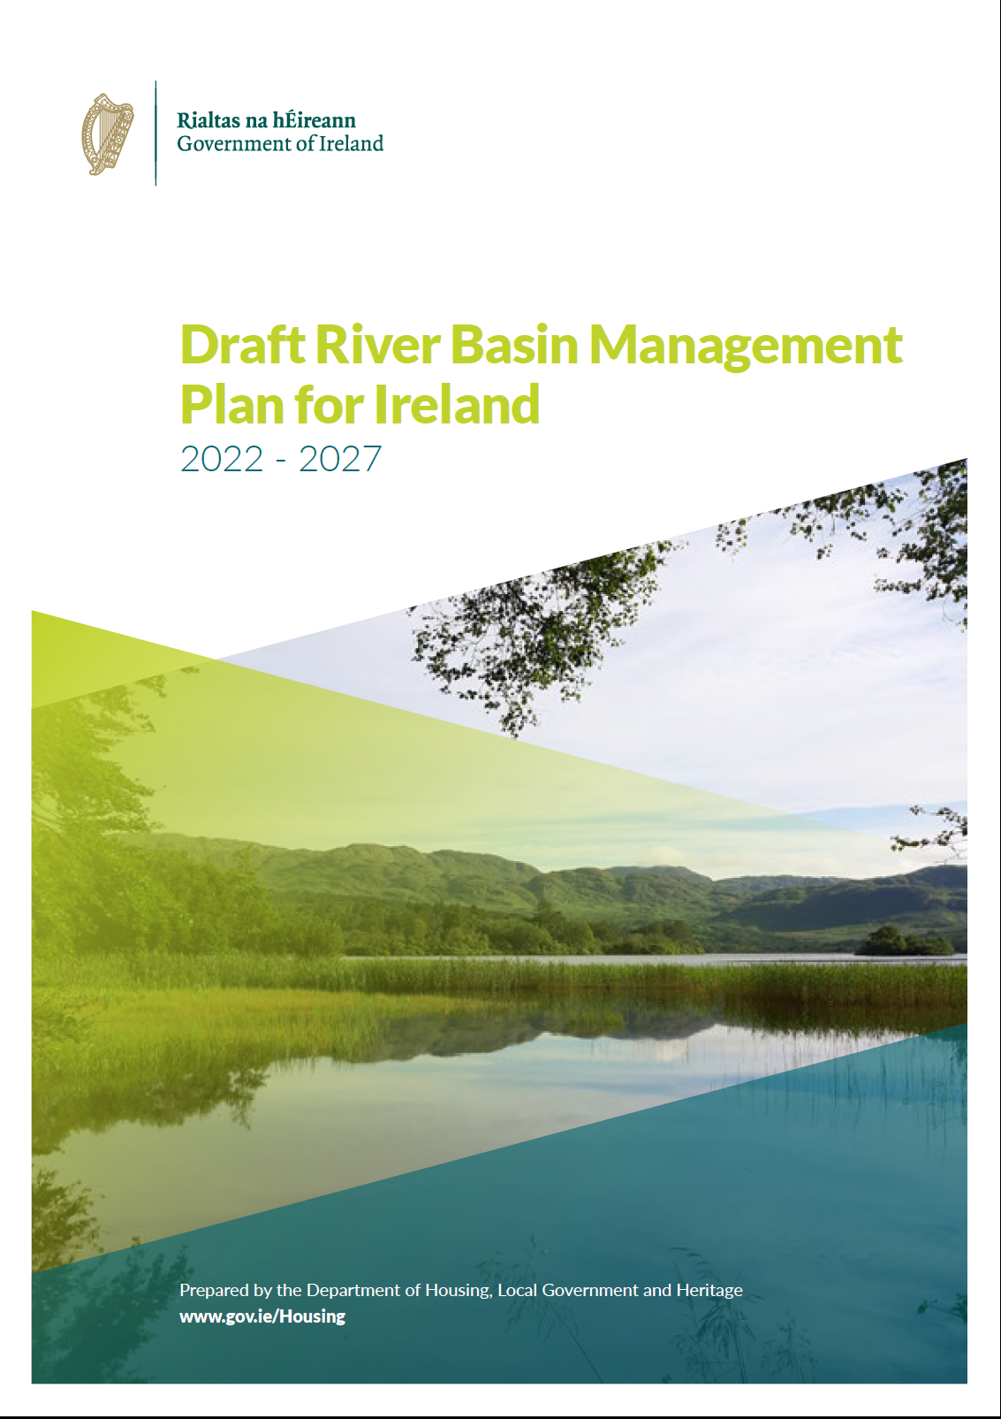
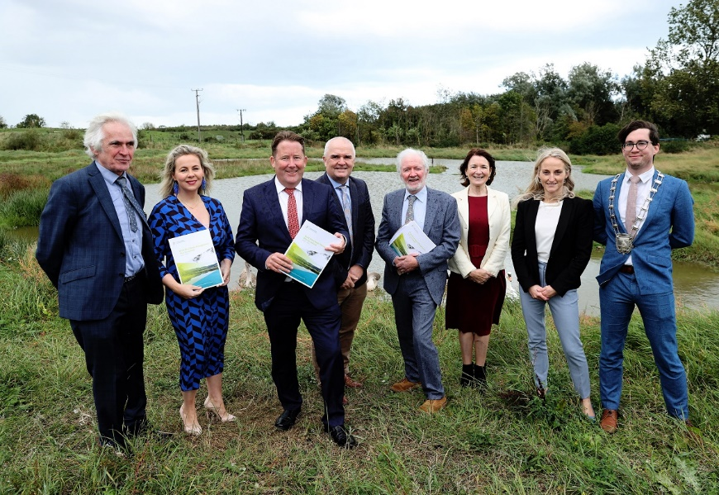
Third River Basin Management Plan
River Basin Management Plan sets out measures aimed to achieve WFD objectives
RBMP is structured in 6 year cycles
3rd Cycle RBMP (2022-2027) will be published shortly
Notes:
Under the WFD, each Member State is required to develop a RBMP.
The Plan identifies pressures on waterbodies and sets out measures that need to be implemented to achieve the water quality objectives.

Slide 18
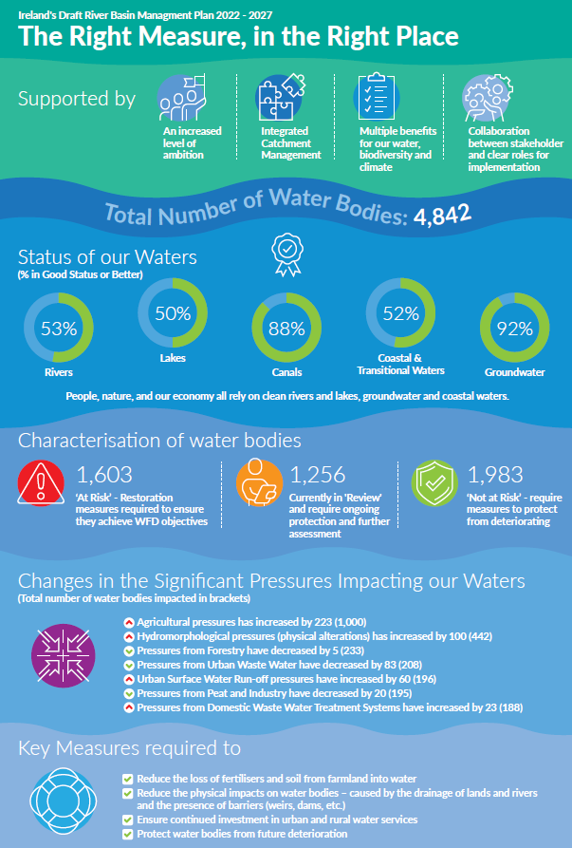
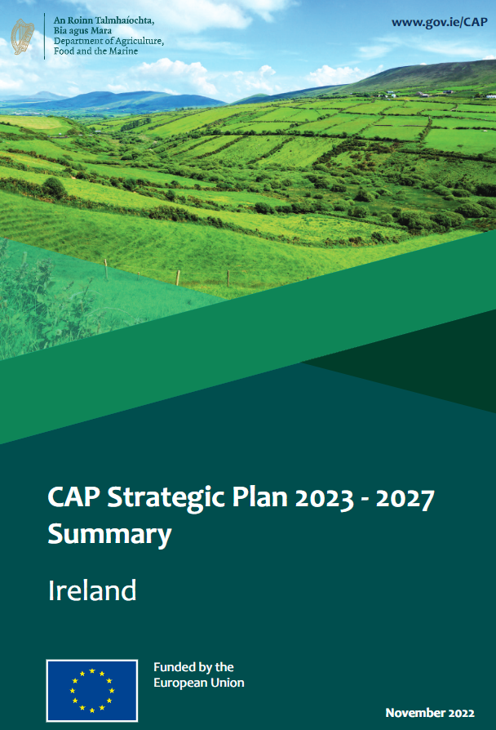
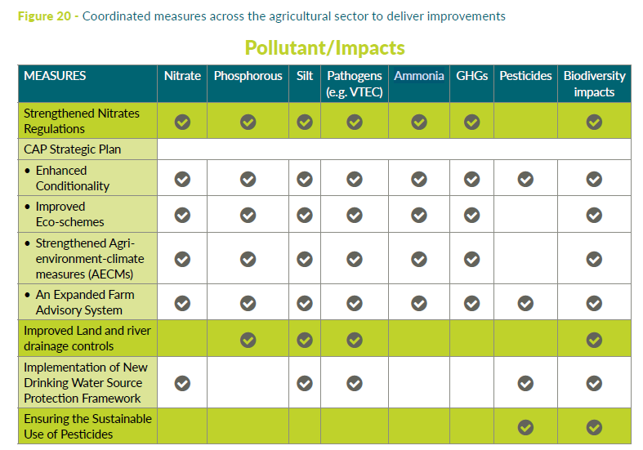
Third River Basin Management Plan
Main Goals
Reduce excessive agricultural nutrient & sedimentation losses (nitrate, phosphate, ammonia).
Preventing instream habitat damage from land drainage/river channel drainage.
Reduction/elimination of point source pollution from farms
Eliminating exceedances of pesticide standards in drinking water supplies.
Protecting & restoring valuable & sensitive high-status water catchments.
Notes:
The 3rd RBMP is based on implementing the “right measure in the right place”. This approach is also being adopted by the agricultural sector e.g. CSP and the NAP.
To protect & restore water quality there are a number of goals that must be met: (1-5)
A coordinated response is required to deliver significant improvements in the 3rd cycle. CSP and the NAP will have a critical role to play in this regard.

Slide 19
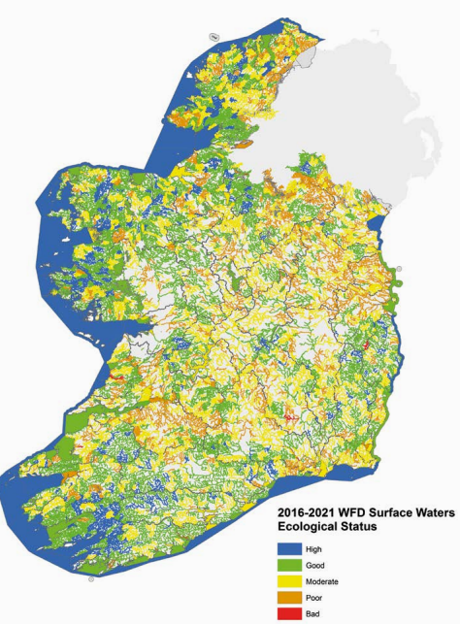
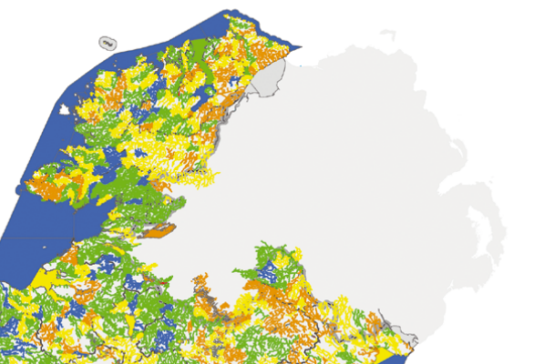
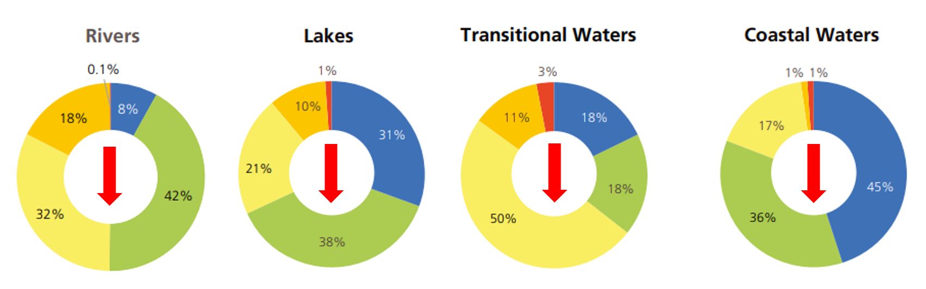
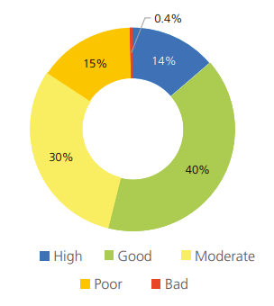
Water Quality Status in Ireland (2016-2021)
WFD Status Summary
Proportion of all SW bodies in each ecological status class 2016 - 2021
EPA Water Quality Report 2016-2021
Notes:
The latest EPA report shows that over half (54%) of our surface waters are in satisfactory ecological health (i.e. good or high ecological status)
i.e. almost half (46%) of all surface water bodies in Ireland are not as ecologically healthy or resilient as they should be.
Rivers – 50% at high or good ecological status - 1% decline
Lakes – 69% at high or good ecological status - 2.7% decline
Estuaries/transitional waters – 36% at high or good ecological status - 15.7% decline
Coastal Water – 81% at high or good ecological status - 9.5% decline
Overall, there has been a net decline in water quality status since the last assessment (2013-2018)
Lots of information in the EPA’s Water Quality Report – link under map for info.

Slide 20
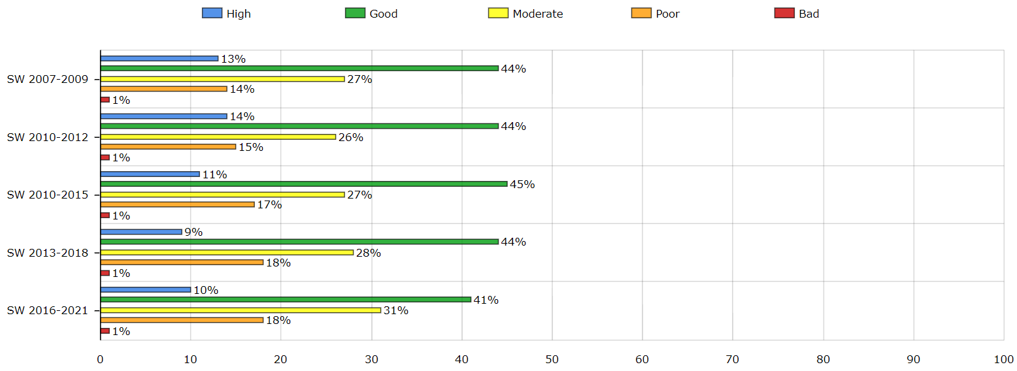
Trends in Surface Water Quality Status
% at High & Good ↓
% at Moderate, Poor & Bad ↑
www.catchments.ie
Notes:
This chart illustrates SW bodies only.
As you can see “high status WB” – 13% to 10%
Good – 44% to 41%
Moderate – 27% to 31%
Poor – 14% to 18%
Bad – remains relatively stable
Overall the trends are going in the wrong direction. % at high & good reducing and % at Moderate, poor and bad are increasing.

Slide 21
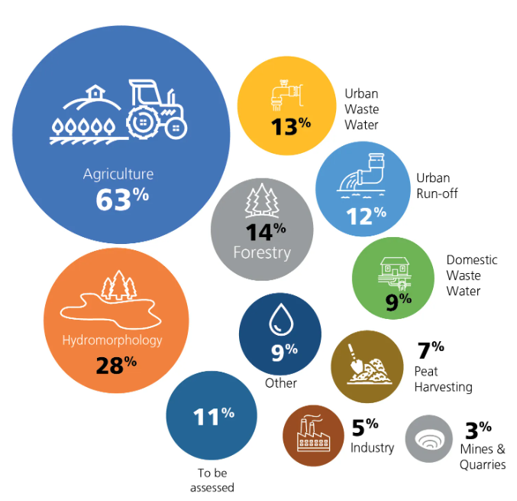
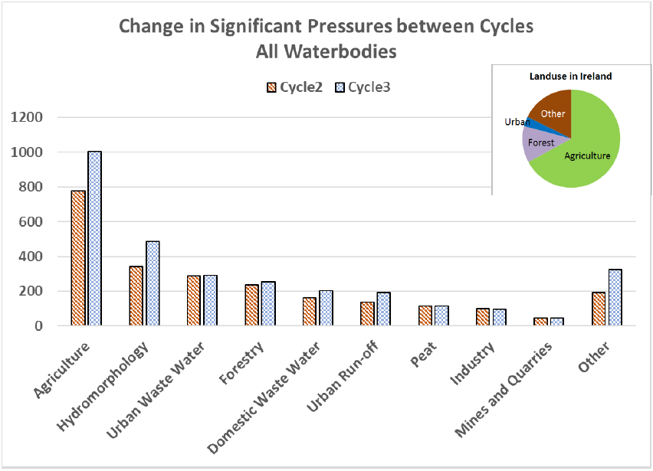
Water Quality: our most significant pressures
Change in significant pressures between cycles for all water bodies
EPA Water Quality Report 2016-2021
Notes:
- 1603 water bodies are impacted (out of 4842)
Agriculture has been identified as the largest pressure on WBs, but is also the most widespread land-use
As you can see from the chart, the no of WBs where agriculture is a significant pressure has increased from the 2nd cycle into the 3rd cycle.
It should also be noted that a high proportion of pressures caused by hydromorphology are from the Ag sector.

Slide 22
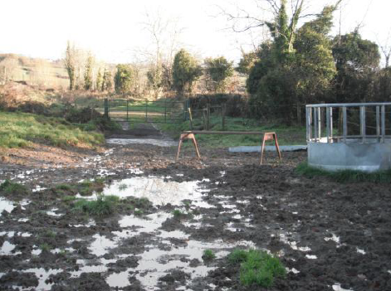
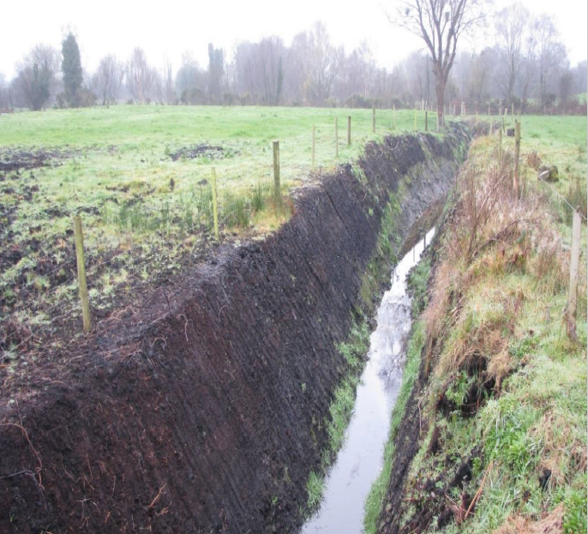
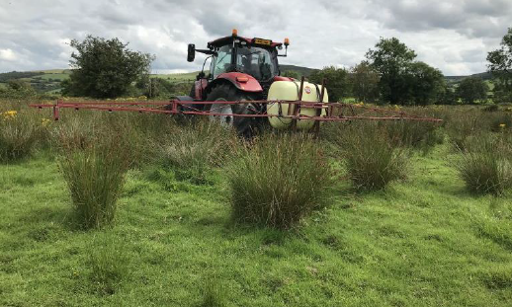
Impacts to Water from Agriculture
Nutrient & sediment runoff
Phosphorous
Sediment
Phosphorous
Ammonia
Sediment
Chemicals
Notes:
Drainage in peaty soils will lead to phosphorous, ammonia and sediment losses to watercourses, reduced biodiversity and carbon sequestration.
Poaching of land around feeders in poorly draining soils causes run-off of nutrient & sediment which are at risk of entering watercourses.
Application of chemicals/pesticides may also pose a risk to water quality. The most commonly detected substance is MCPA, used in the control of rushes in grassland. It was detected at low levels in over half of rivers in latest report.

Slide 23
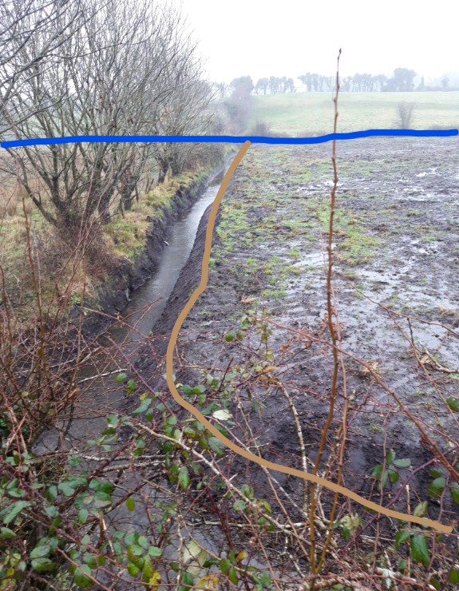
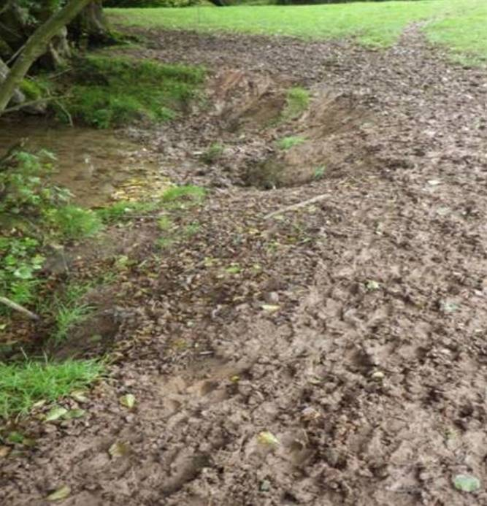
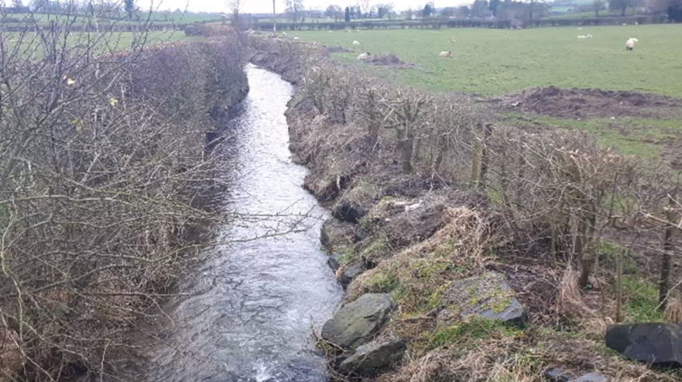
Impacts to Water from Agriculture
Hydromorphology
Land Drainage
Poaching
Dredging & bank modification
Notes:
Poaching:
Breakdown of river bank, changes to flow of the river, no habitat in riparian zone, loss of nutrient and sediment into the river.
Dredging and bank modification
Changes to flow of the river, damage to the river bed, increased sedimentation
Land drainage
Newly created land drains, increased sedimentation, direct pathway to watercourse.

Slide 24
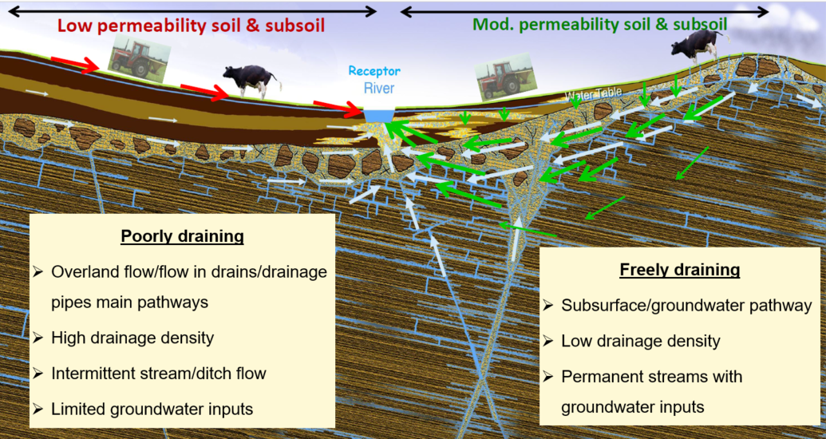
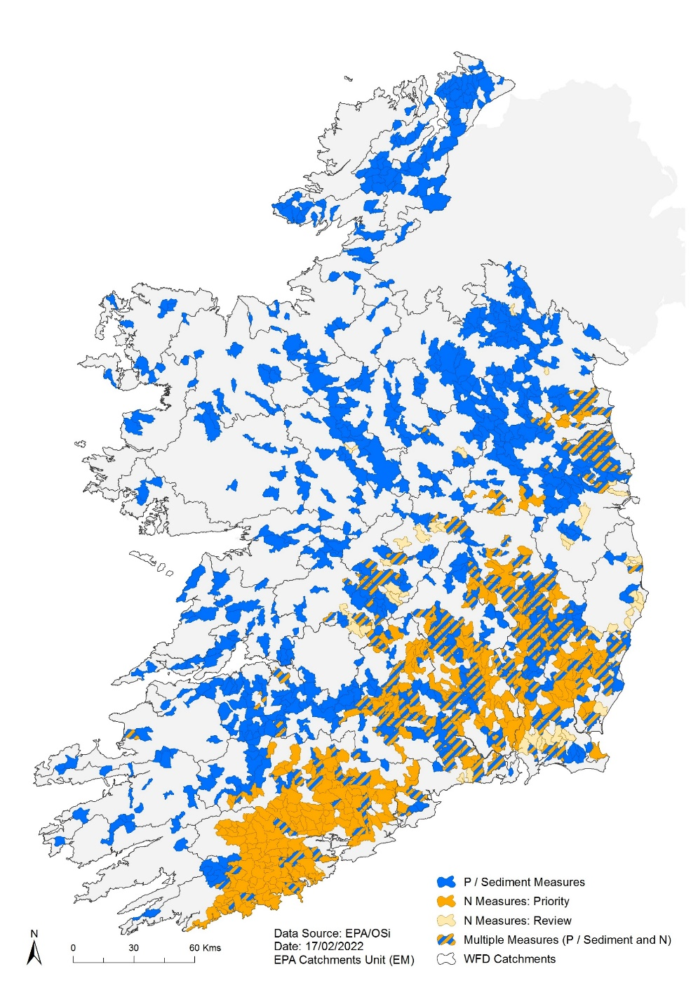
Impacts to Water from Agriculture
EPA Pollution Impact Potential Maps
Notes:
Looking more closely at nutrients and their impact. It’s important to know that N and P behave very differently in the landscape.
EPA Pollution Impact Potential Maps [PIP–N (orange) and PIP-P (blue)] will help you to identify these areas.
Border counties - High risk for phosphorous loss – poorly draining soils – overland flow dominant – usually in areas of low intensity farming
In these areas – you need to break the pathway (interception measures/NBS)

Slide 25
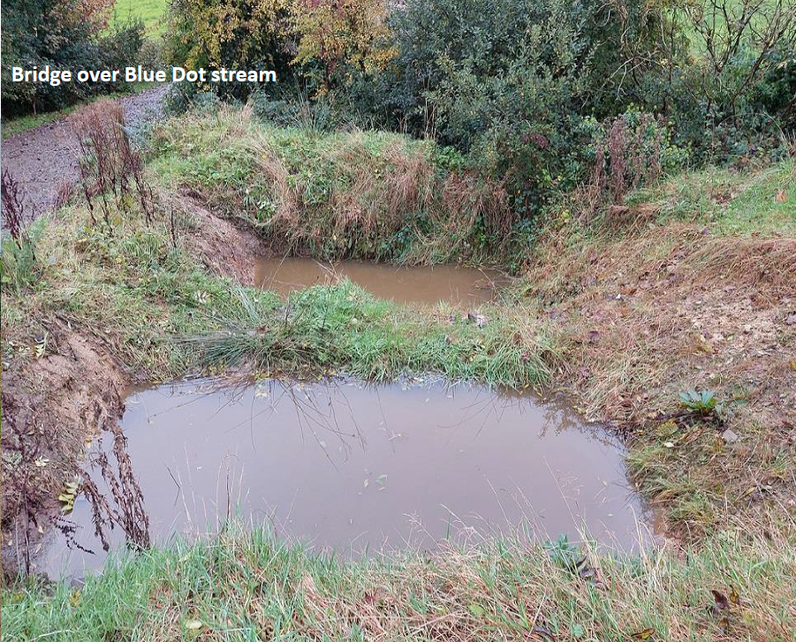
Implementation of Measures – Ongoing work
LAWPRO work in Areas for Action
Blue Dot Programme (High Status objective waterbodies)
National Federation for Group Water Schemes (NFGWS)
River’s Trust
Water EIP (& other EIP projects)
Waters of Life (& other LIFE projects)
Silt pond: Duhallow IRD & Blue Dot Programme (Photo - D. Daly)
Notes:
There are a large number of projects ongoing around the country. Measures are, and have been implemented across a number of projects in Ireland to date. This call will allow strategic collaboration for cross-border implementation of measures for multiple benefits.
Information on each of these available on-line.

Slide 26
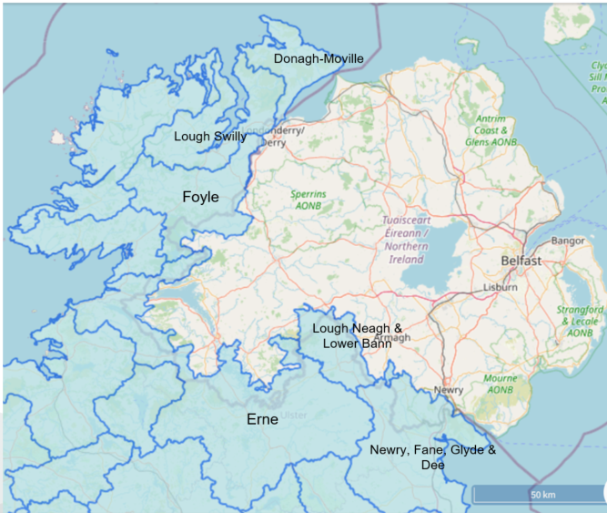
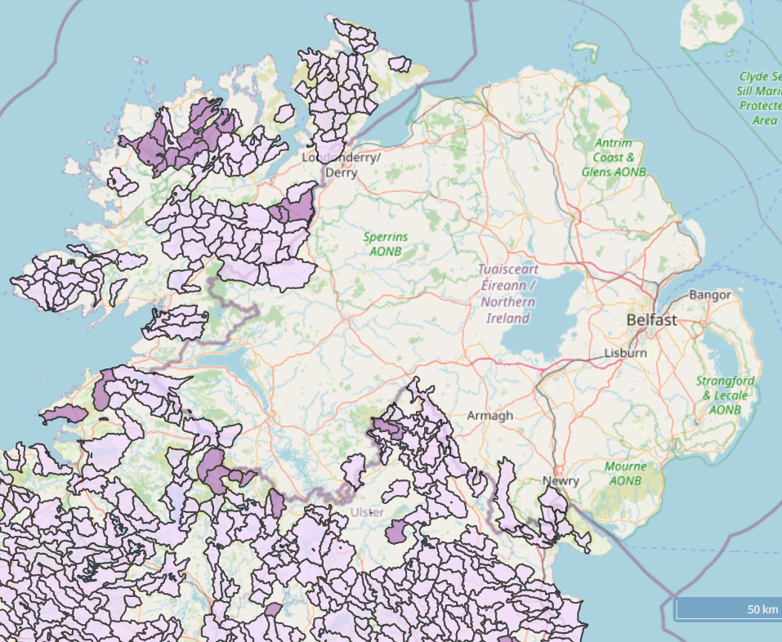
Catchments & Priority Areas for Action
Lough Macnean
https://lawaters.ie/priority-areas-for-action/
https://gis.epa.ie/EPAMaps/Water
https://www.catchments.ie/data/#/?_k=8o3o9x
Notes:
Here is a map of the border catchments, which has been taken from EPA maps. In particular, the Erne catchment and Lough Macnean have been listed in annex 4 of the call, where Agricultural pressures have been identified. These are also high risk of P loss, where pathways interception measures are needed to reduce nutrient loss to water.
You can find more information on each of these catchments through catchments.ie (link above).
The map on the right shows the Priority Areas for Action, which are the areas that LAWPRO (local Authorities Water Programme) are working. You can find more information on the PAAs via LAWPROs website (link under map)
Information on each of these available on-line.

Slide 27
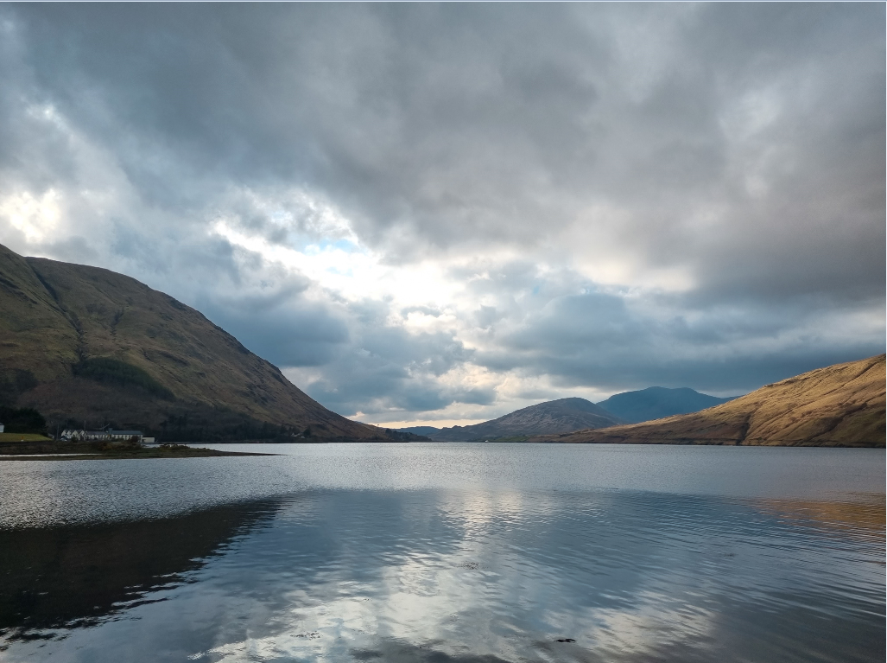
We have a water quality issue
“The right measure in the right place”
Measures need to be targeted
- to achieve more, with less
- for multiple benefits
Notes:
Take home message

Slide 28
Web Resources
1. Catchment assessments (whole story for each catchment)
https://www.catchments.ie/updated-draft-catchment-assessments-published-by-epa/
2. EPA map viewer (all data, water theme)
https://gis.epa.ie/EPAMaps/Water
3. Get EPA GIS data (waterbodies, catchments, water quality, significant pressures, high status objective waterbodies)
https://gis.epa.ie/GetData/Download
4. More on the PIP maps
https://www.catchments.ie/next-generation-pollution-impact-potential-maps-launched/
https://www.catchments.ie/ifa-smart-farming-sources-and-solutions-the-link-between-our-soils-water-quality-and-how-to-use-the-pip-maps-on-catchments-ie/ifa-how-to-use-pip-maps/
5. Further information on the right measures is available in a new user-friendly handbook developed by the National Federation of Group Water Schemes:
https://nfgws.ie/wp-content/uploads/2019/06/Handbook-mitigation-actions-November-2020.pdf
6. EPA Water Quality Report 2016 – 2021:
https://www.epa.ie/publications/monitoring--assessment/freshwater--marine/EPA_WaterQualityReport2016_2021.pdf
7. LAWPRO – Areas for Action - https://lawaters.ie/priority-areas-for-action/

Slide 29
Overview of policy interest from Northern Ireland
Silke Hartmann
Principal Scientific Officer – Integrated Catchment Planning
silke.hartmann@daera-ni.gov.uk
NIEA Water Management Unit
Integrated Catchment Planning Team
catchmentplanning@daera-ni.gov.uk

Slide 30
Outline
Key interventions for IA 5.3
Policy drivers in Northern Ireland
Available information and links
IA 5.3
Policies
Info
30

Slide 31

Investment area 5.3
Water quality and catchment management
Nature based solutions:
A pilot/pilots for nature-based solutions or innovative nature- based solutions to restore catchments
Use and transboundary movement of nutrients (soil, organic manures, chemical fertilisers,digestate, sewage sludge) in cross border
catchments
Behaviour change:
Initiatives which result in a measurable change in behaviours/ mind set of landowners
Develop/ enhance community focused environmental learning resources
Increase amenity value – nature recovery networks
IA5.3
Policies
Info
Notes:
2 main topics: nature-based solutions; transboundary movement of nutrients and how they are utilized
2 supporting topics, which can only be carried out in the areas of the main project: behaviour change; community focused learning resources; increase in amenity value e.g. nature recovery networks

Slide 32
Overview of policies
UN sustainable development goals
Programme for Government
Climate Change Act (NI) 2022
Environment Strategy
River Basin Management Plan
Water Policy
Policies
UN SDG
PfG
CC Act
ES
RBMP
WP

Slide 33

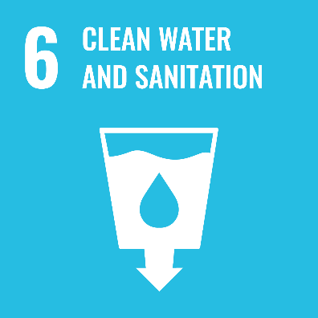
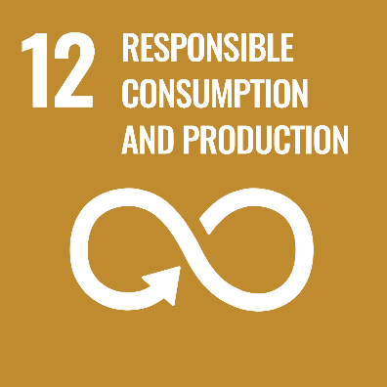
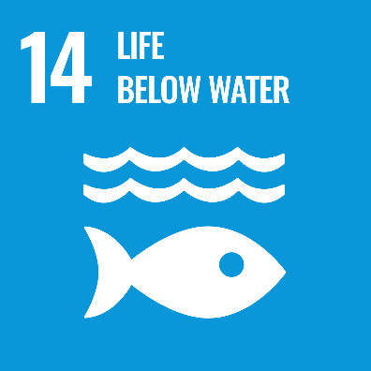
UN sustainable development goals
Improve water quality by reducing pollution
Protect + improve water-related ecosystem including wetlands, rivers, aquifers and lakes
Implement integrated resources management, including trans-boundary co-operation; all by 2030
sustainable management + efficient use of natural resources (e.g. water) -2030
management of chemicals/ wastes - reduce release to water; reduce impacts - 2020
Prevent + reduce marine pollution in particular from land-based activities, including nutrient pollution - 2025
Policies
UN SDG
PfG
CC Act
ES
RBMP
WP
Notes:
The 2030 Agenda for Sustainable Development, adopted by all United Nations Member States in 2015, provides a shared blueprint for peace and prosperity for people and the planet, now and into the future. At its heart are the 17 Sustainable Development Goals (SDGs), which are an urgent call for action by all countries - developed and developing - in a global partnership. They recognize that ending poverty and other deprivations must go hand-in-hand with strategies that improve health and education, reduce inequality, and spur economic growth – all while tackling climate change and working to preserve our oceans and forests.

Slide 34
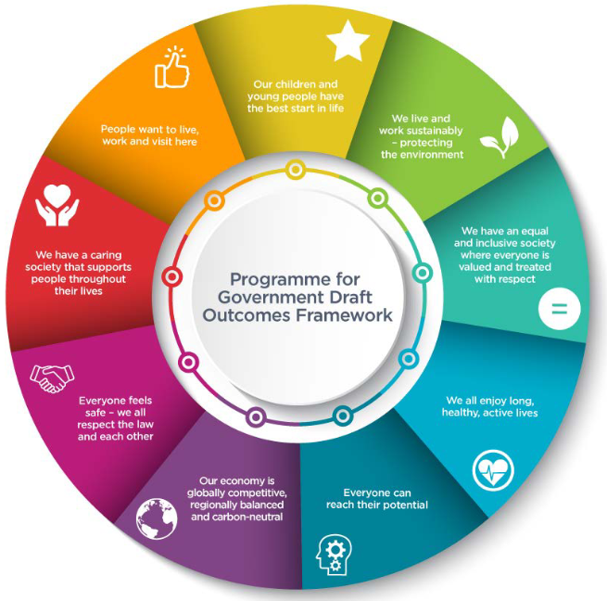


Programme for Government Northern Ireland
DAERA contributes to several outcomes
Policies
UN SDG
PfG
CC Act
ES
RBMP
WP
Notes:
The draft outcomes for the Programme for Government in Northern Ireland was published in 2021.
One outcome deals clearly with environment: We live and work sustainably – protecting the environment.
However, it also links to other outcomes like:
We all enjoy long, healthy, active lives.
Our economy is globally competitive, regionally balanced and carbon-neutral.
People want to live, work and visit here.
Due to the collapse of the assembly the Programme of Government is still in draft.
One of the previous indicators was soluble reactive phosphorus (SRP) concentrations in rivers

Slide 35
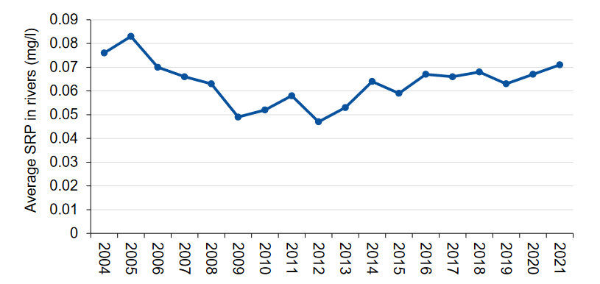
Soluble Reactive Phosphorus (SRP) rivers
2021
c = 0.071 mg/l
2012
c_{lowest} = 0.047 mg/l
2012 -2021: 51 % increase
statistically significant increasing trend
Policies
UN SDG
PfG
CC Act
ES
RBMP
WP
Notes:
Due to the collapse of the assembly the Programme of Government is still in draft.
One of the previous indicators was soluble reactive phosphorus (SRP) concentrations in rivers
The SRP figures show that from the low of 0.047 mg/l reported in 2012, levels of SRP in the 93 Surveillance Rivers have increased to 0.071 mg/l in 2021.
This represents an increase of 51% and is a statistically significant increasing trend.
Improvements achieved in the period 2004 to 2011 have all but been reversed by the increasing SRP levels since 2012. In 2021, levels exceeded those reported in 2006 (0.070mg/l).

Slide 36
Climate Change Act (Northern Ireland) 2022
Binding targets for reduction of methane (by 46 %) and carbon (100 %) by 2050
Eutrophic surface water bodies emit methane – can increase methane emissions
Northern Ireland’s surface water bodies are eutrophic:
  > 50 % rivers
  > 80 % lakes
  44 % marine (transitional & coastal) water bodies
Requirement for all proposals and policies - desirable to use and support nature-based projects to
  Provide environmental benefits
  Promote human well-being and biodiversity
Policies
UN SDG
PfG
CC Act
ES
RBMP
WP
Notes:
The Climate Change Act (NI) 2022 sets binding targets for reduction of methane (by 46 %) and carbon (100 %) by 2050.
Eutrophic surface water bodies emit methane gas and have the potential to increase methane emissions by 30 to 90 %. Research published in Nature estimates the methane gas emissions are equivalent to 18 to 33 % of annual CO₂ emissions from burning fossil fuel. Over half of Northern Ireland’s rivers, more than 80 % of lakes and 44 % of coastal and transitional water bodies are eutrophic.

Slide 37
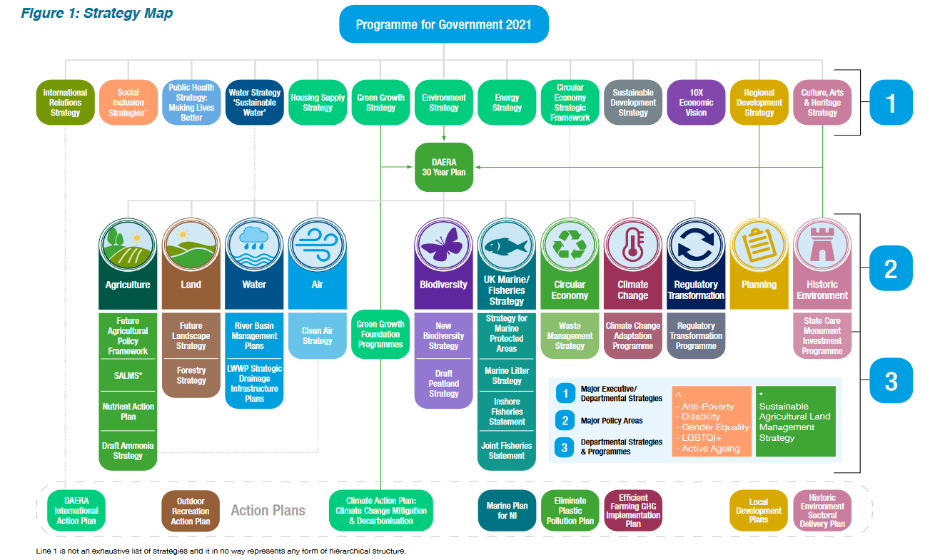
Environment Strategy
Policies
UN SDG
PfG
CC Act
ES
RBMP
WP
Notes:
Environment Strategy will form the basis for a coherent and effective set of interventions that can deliver real improvements in the quality of the environment.
Under the water theme it includes the river basin management plan.

Slide 38
River Basin Management Plan
December 2021 (data ~ 2015 – 2020):
Classification status | Water body type | 2015 | 2021
Surface water ecology | Rivers Lakes Transitional & coastal | 32 % at ‘good or better’ status | 31 % at ‘good or better’ status
Improvements are off-set by deteriorations
Classification status | Water body type | 2015 | 2021
Groundwater chemistry | Groundwater | 68 % at ‘good’ status | 71 % at ‘good’ status
~half of groundwater bodies have no monitoring, hence default status is good
Dependency on 3rd party borehole owners, as currently no public water supply from groundwater (apart from one on Rathlin Island off the north coast)
Policies
UN SDG
PfG
CC Act
ES
RBMP
WP
Notes:
The Water Framework Directive Statistics Report 2021 shows that only 31 % of surface water bodies (rivers, lakes, marine) are at good ecological status almost unchanged from 2015 (32 %). However, this stagnation masks that the ecology of a number of surface water bodies did improve, but this was offset by deteriorations.
71 % of groundwater bodies have a good chemical status in 2021, up slightly from 68 % in 2015. However, it should be noted that approximately half of Northern Ireland’s groundwater bodies have no monitoring, as Northern Ireland Environment Agency mostly depends on the good-will of 3rd party borehole owners for sample collection. Unmonitored groundwater bodies are reported as good status by default as per the directive. Northern Ireland Environment Agency continuously tries to grow the monitoring network, but there is the potential that new monitoring stations could change the status of a groundwater body to poor.

Slide 39
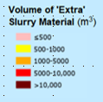
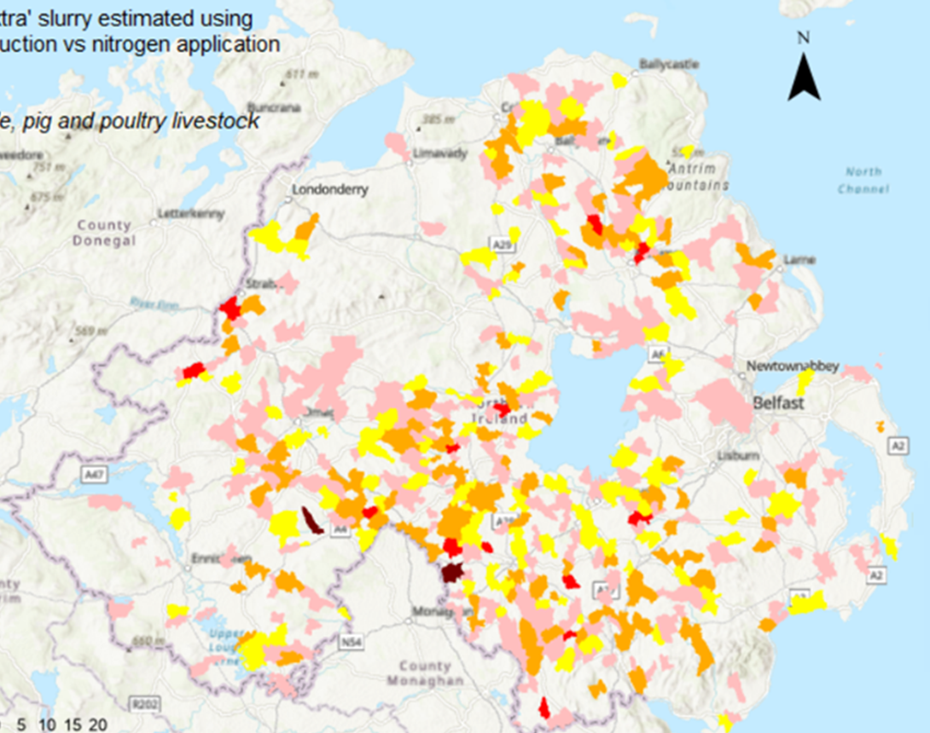



Nutrient pressures
Credit:
Aine Anderson, QUB
Policies
UN SDG
PfG
CC Act
ES
RBMP
WP
Notes:
Volume of ‘extra slurry estimated using nitrogen production versus nitrogen application limits

Slide 40
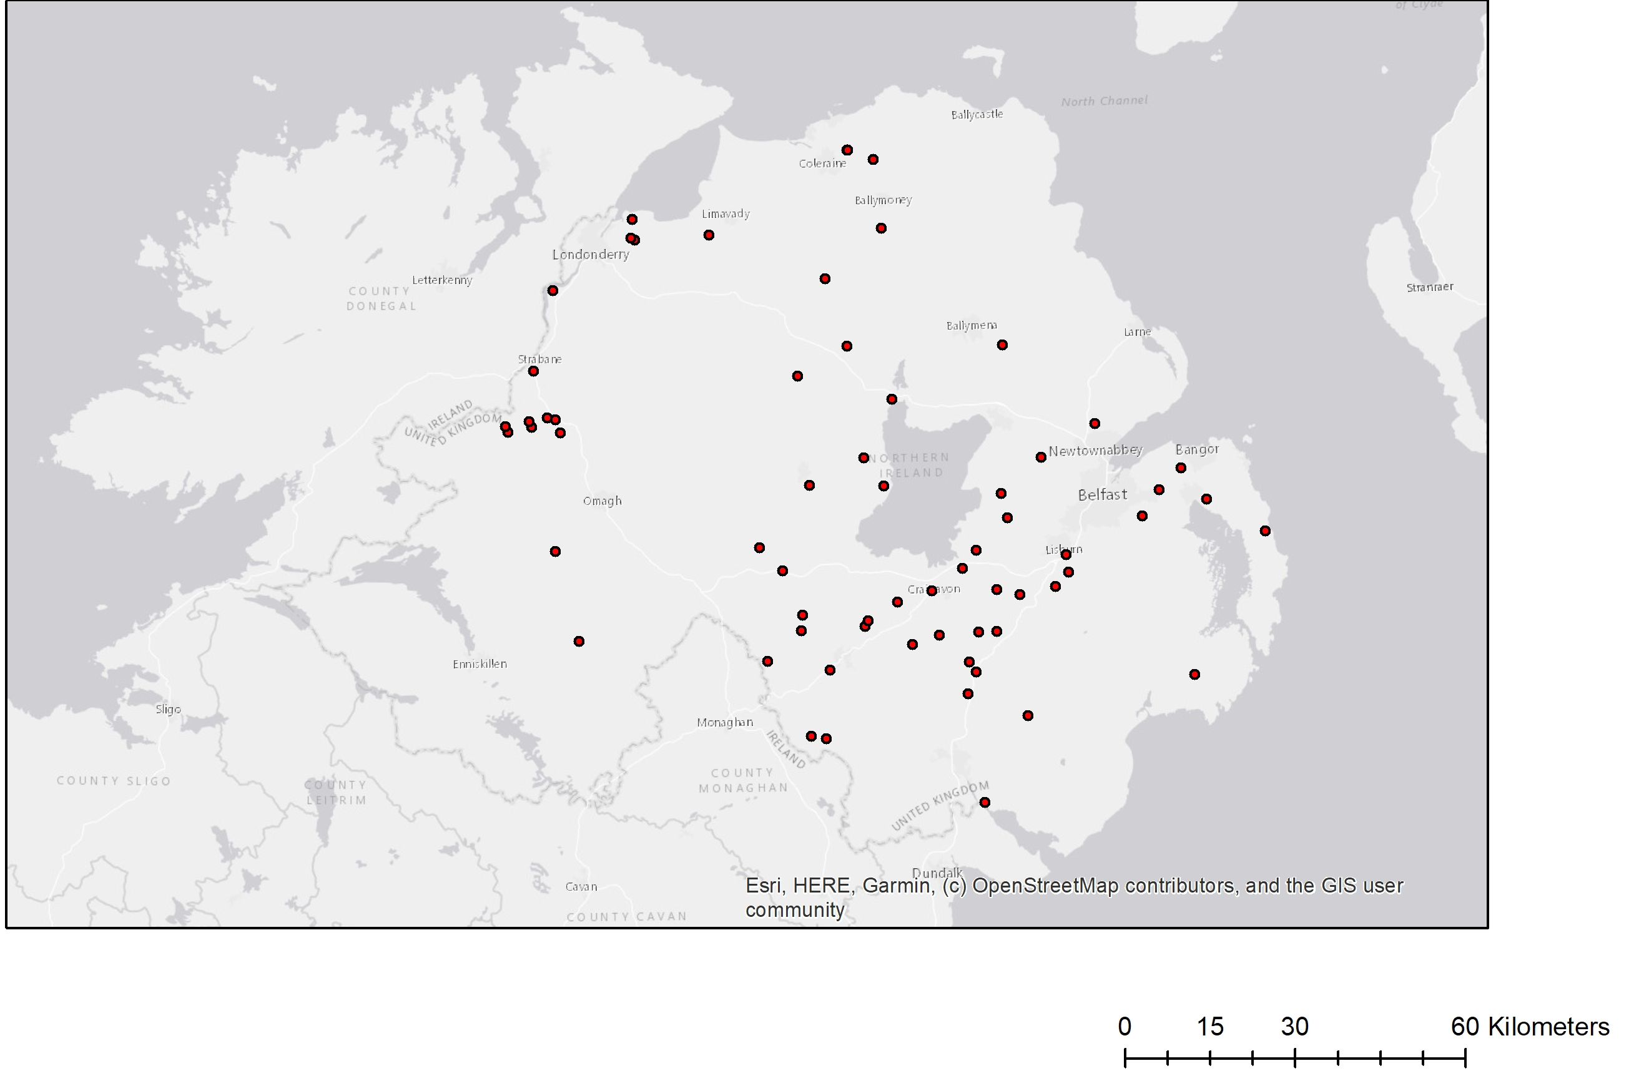
AD plant locations (2021)
Policies
UN SDG
PfG
CC Act
ES
RBMP
WP
Notes:
Volume of ‘extra slurry estimated using nitrogen production versus nitrogen application limits

Slide 41
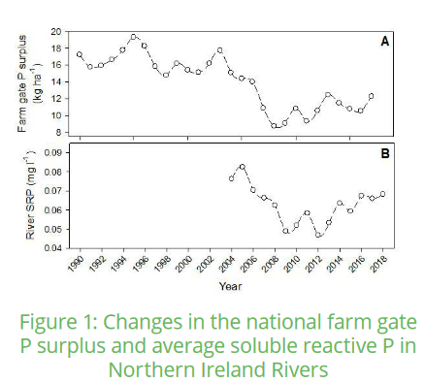
Excess P lost to water environment
https://www.afbini.gov.uk/sites/afbini.gov.uk/files/publications/RePhoKUs%20report%20October%202020x.pdf
Policies
UN SDG
PfG
CC Act
ES
RBMP
WP
Notes:
There is a total loss of 1,530 t of P to waterbodies, 62% of which comes from agriculture.

Slide 42
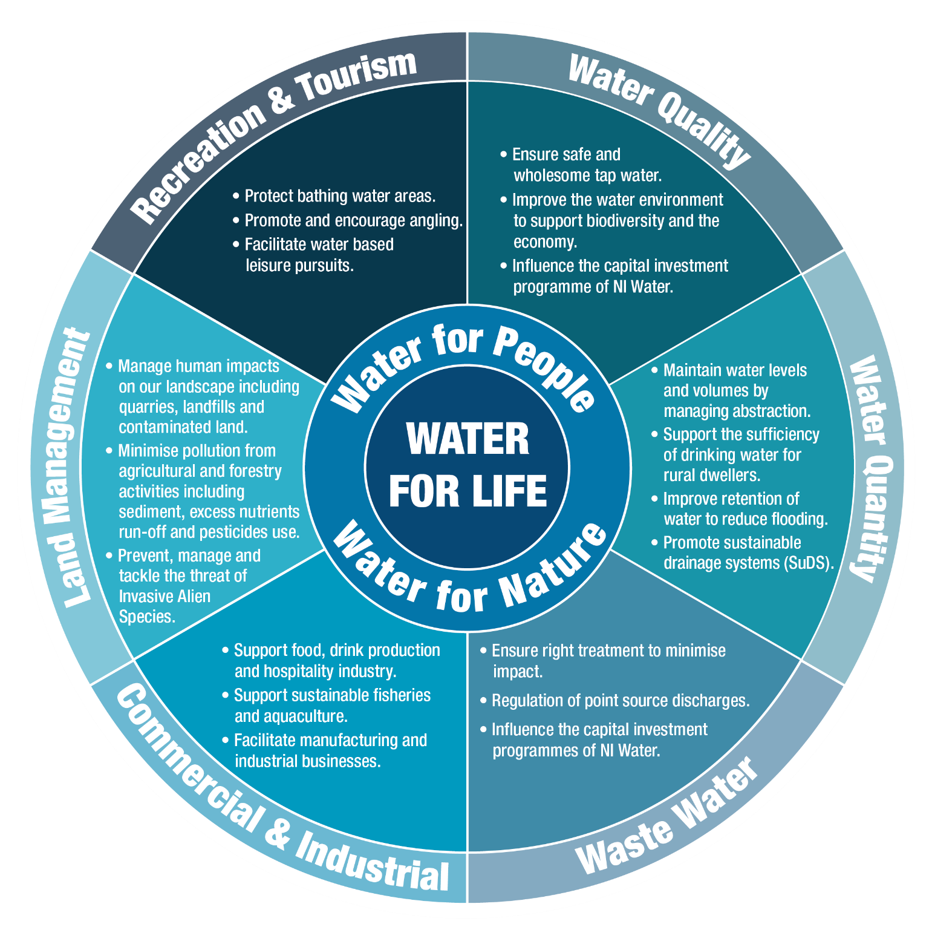
Water Policy
Policies
UN SDG
PfG
CC Act
ES
RBMP
WP
Notes:
This water wheel shows the main themes of DAERA’s draft water policy.
It is centred around: Water for Live – which includes both water for people and water for nature.
The 6 sectors are: water quality, water quantity, waste water, commercial & industrial, land management and – recreation & tourism.

Slide 43

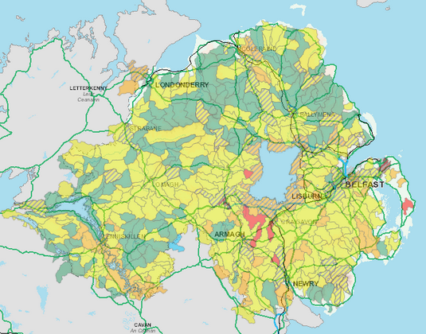

Available information
Data for down load from Open Data
DAERA/ Northern Ireland Environment Agency map viewers
Data layers/ shapefiles with status and element information
request information through SEUPB who will re-direct it to Integrated Catchment Planning team
@
IA5.3
Policies
Info
Notes:
Any group requiring information from us to develop Peace Plus proposals may do so via SEUPB.
We will endeavour to furnish SEUPB with the requested data request within 20 working days.
Please note Data Sharing Agreements (DSAs) may be required which will require prompt return to release the requested data.

Slide 44
Links
UN sustainable development goals
https://sdgs.un.org/goals
draft Programme for Government Northern Ireland
https://www.northernireland.gov.uk/consultations/consultation-programme-government-draft-outcomes-framework-2021
Climate Change Act (Northern Ireland) 2022
https://www.daera-ni.gov.uk/articles/climate-change-act-northern-ireland-2022-key-elements
https://www.legislation.gov.uk/nia/2022/31/enacted
draft River Basin Management Plan
https://www.daera-ni.gov.uk/consultations/consultation-draft-3rd-cycle-river-basin-management-plan-2021-2027
draft Environment Strategy
https://www.daera-ni.gov.uk/consultations/environment-strategy-consultation
IA5.3
Policies
Info

Slide 45

Questions
45
Notes:
This is the end of my presentation. I hope it has helped you to understand the 2021 statistics report better, including the changes we have made to assessment and reporting.
We will now move to the Q&A session.

Slide 46
Agriculture
Notes:
increased use of chemical fertilizers and concentrated feedstuff
integrated ecosystem modelling of Dundrum bay catchment: 80 % of the microbial loading from ruminant sources (Carrigs River)
P flow analysis (RePhokUs project):
> 60 % of P losses to waterbodies are from agriculture
On agriculture: Chemical fertiliser inputs declined dramatically from 2003 and reached its lowest level since records began (ninety years ago) in 2009 (2.5 kg P ha-1 yr-1), but then increased again before levelling off between 4.0 and 5.0 kg P ha-1 yr-1 in 2014-2015 and 2016-2019.
Feedstuff P inputs which declining between 2006 and 2008 have been increasing since then, and are currently at 17 kg P ha-1 yr-1 in 2016-2019. As a result, total P inputs are currently about 22 kg P ha-1 yr-1. This results in higher concentrations in slurry being applied to soils.
Soil sampling in study catchments has shown that there is an oversupply of P to soils. For example in 2017 due to the application of P to soil being 20% higher than crop requirements, 7,300 tonnes of P accumulated in soils across NI. Especially in hydrologically at risk areas catchment studies indicate a link between over-supplied P to soils and higher river SRP concentrations. Despite the implementation of the NAP regulations, slurry applications to agricultural land is still resulting in significant export of P to waterbodies.

Slide 47
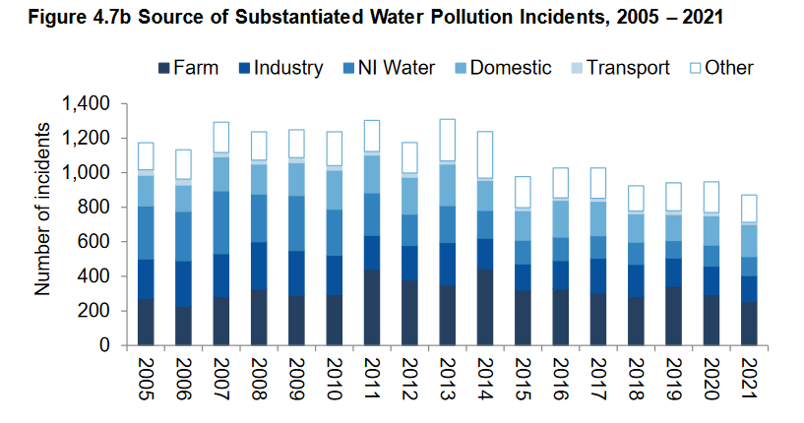
Incomplete implementation of measures
number of farm pollution incidents has not changed significantly
in comparison: pollution incidents related to public water supply utility (NI Water) has reduced over years
Visits of ~200 farms by the Interreg programme identified over 1000 issues suggesting incomplete implementation of measures already identified in previous RBMPs
Notes:
The majority of water body failures are due to excess nutrient and organic pollutants related to agricultural and urban (sewage) land uses. Examples of previous and continuing measures include the Nutrient Action Programme and PC15 & PC21. The low inspection rate of ~1 % makes assessment of compliance and rate of implementation of measures extremely difficult. Visits of ~200 farms by the Source-to-Tap programme identified over 1000 issues suggesting incomplete implementation of measures already identified in previous RBMPs. This is further supported by ongoing pollution incidents linked to farming activities, e.g. fish kills caused by slurry in recent weeks. Similarly, the total amount identified for PC15 was not made available during the 2nd cycle RBMP, resulting in incomplete implementation of the measure.

Slide 48
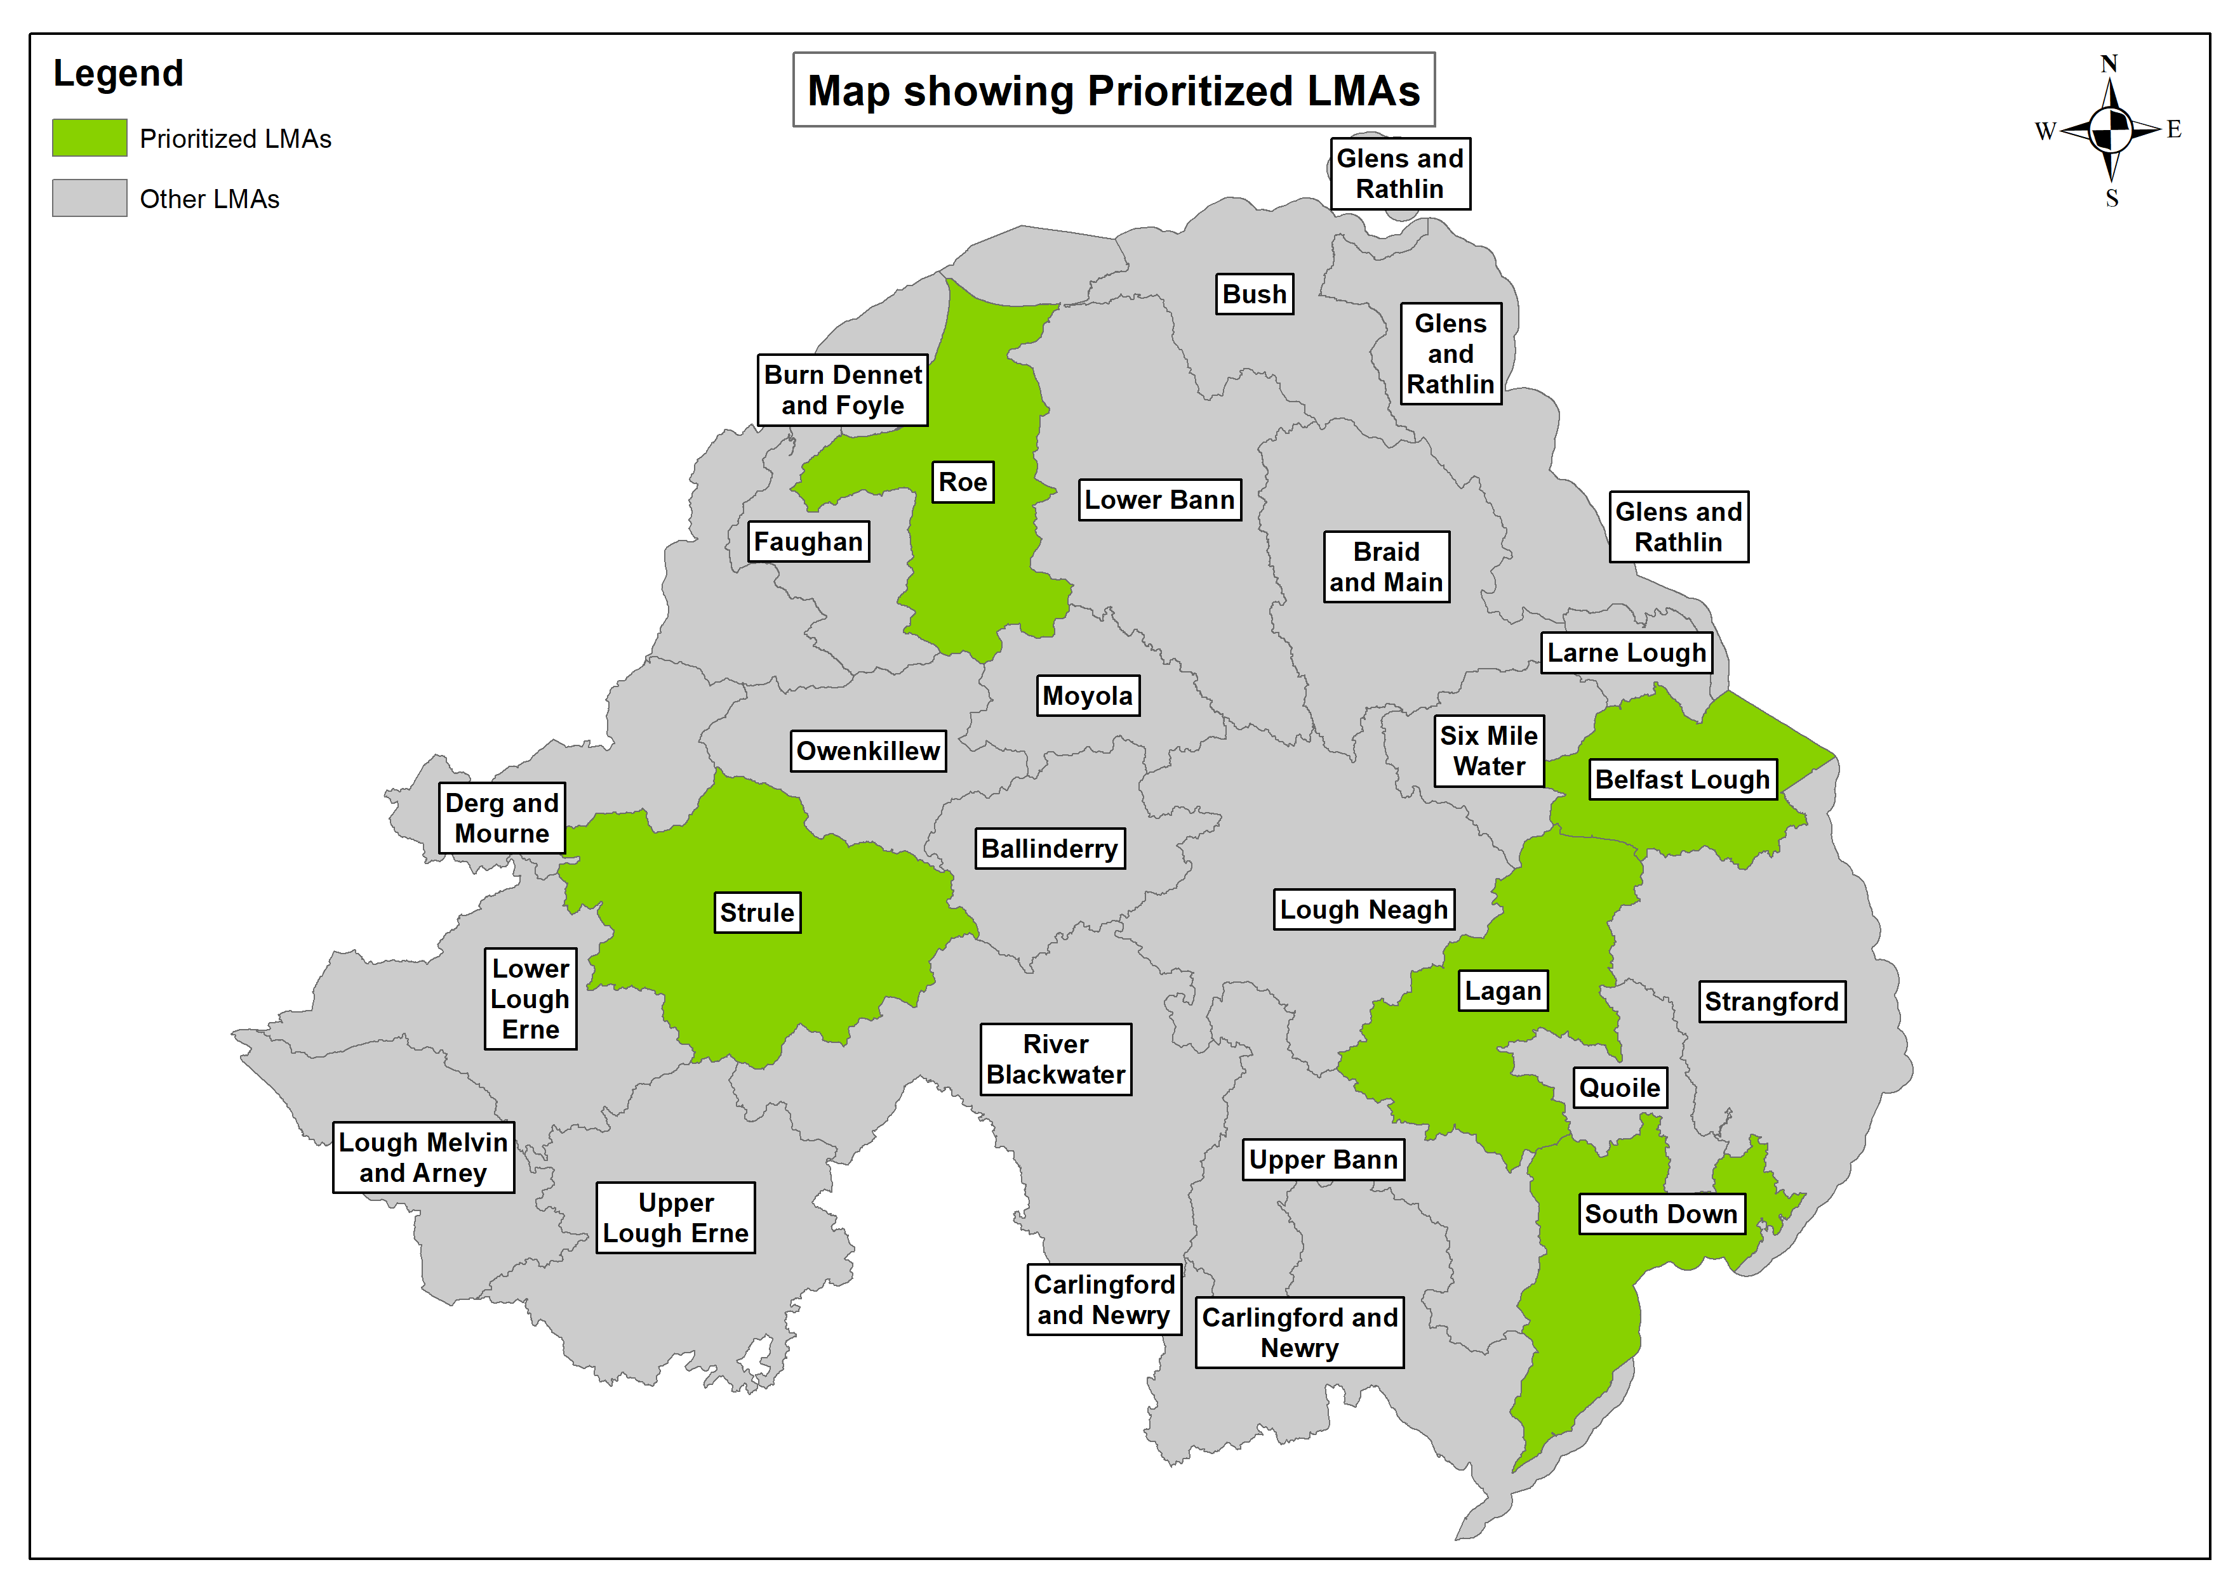
Priority Local Management Areas (LMA)
Notes:
prioritisation of catchments: finite resources - both manpower and funding
time frame of a river basin planning cycle is short – 5 priority LMA identified in order to achieve the full scale of improvements required
matrix approach was used to prioritise our catchments for actions.
considers classification status of the water body; whether the water body improved, deteriorated or remained the same during the last cycle as well as impacts on protected areas related to the water environment.
The priority ranking was then considered within a holistic catchment setting and the five priority LMAs selected.
strategic priorities to support long-term commitments under the Department for Infrastructure-led ‘Living with Water Programme’ to improve catchments whose recovery will take several years, far in excess of a river basin planning cycle also considered

Slide 49
Pre-application Support and the Concept Note
Overview for Investment Area 5.3
Eimear Bush

Slide 50
Pre-Application Support
5.3, Water Quality and Catchment Management
From today, 29th March, any organisation interested in becoming a Lead Partner under Area 5.3 may complete and submit a Concept Note for comment, advice and support.
The Concept Note:
covers some (but not all) of the questions that will be in the application proper;
will help you put in place the foundations of your project so that you are better prepared when the call opens;
Will give an indication if this is the right fund for your project;
is not a formal application;
is not scored.
Notes:
The Peace Programmes Learning Platform is a living archive of the work funded by the EU Peace Programmes over the last three decades.
It showcases the achievements of over 22,500 projects and provides inspiration for the continual integration of communities in post-conflict societies – not just in Northern Ireland but around the world.

Slide 51
Concept Note
5.3, Water Quality and Catchment Management
Is downloadable from https://seupb.eu/PEACEPLUS
Short form, seeking high level project details.
Advice is available pre- and post-completion.
Avoids putting you through an onerous process if full application not for you.
Complete and return no later than 10th May 2023
Email to eimear.bush@seupb.eu
Notes:
Is downloadable from https://seupb.eu/PEACEPLUS
The uncompleted form is short, six pages: three to be completed and three of guidance.
You are invited to provide high level project details and answer six questions, each in up to 300-500 words.
Advice is available pre- and post-completion.
Avoid putting you through an onerous process if not for you
Please complete and return it no later than 10th May 2023 to eimear.bush@seupb.eu

Slide 52
Concept Note, Question 1
Contribution to PEACEPLUS
How has project need been identified, how does it align with the stated objectives of 5.3, how will it enhance peace?
Tell Us:
How your project builds on existing practices and contributes to wider strategies.
How it contributes to the IA objective: a cross-border, collaborative approach to management and improvement of water quality.
How it contributes to the IA result: development and management of cross-border water quality as well as catchment management programmes.
How your project makes a direct contribution to peace and prosperity for the region.
Notes:
objective will enable a cross-border, collaborative approach to management and improvement of water quality to address the requirements of the Water Framework Directive in selected cross-border catchments located within the Programme Area
It will result in the development and management of cross-border water quality** as well as catchment management programmes, designed to enable freshwater bodies in cross-border river basins to achieve good or high status; and an increased percentage of shared waters in the Programme Area with good or high status.
**Water quality includes water quantity and status

Slide 53
Concept Note, Question 1 (continued)
Contribution to PEACEPLUS
Outputs and Results
Tell us how your proposed project will contribute to the output and result indicators for IA 5.3.
Output Indictors:
3 x Jointly developed solutions;
1 x Strategy and Action Plan jointly developed.
Result Indictors:
3 x Solutions taken up or up-scaled by organisations;
1 x Joint strategy and action plan taken up by organisations.
Notes:
Outputs and Results
Tell us how your proposed project will contribute to the output and result indicators for 5.3. At an investment area level, projects should (collectively) achieve the following:
Output Indictors:
3 x Jointly developed solutions;
1 x Strategy and Action Plan jointly developed.
Result Indictors:
3 x Solutions taken up or up-scaled by organisations;
1 x Joint strategy and action plan taken up by organisations.

Slide 54
Concept Note, Question 2
Quality of Project Design
The quality of the project design is about the actions you’ll take to achieve your outputs and results. Two examples of actions might include:
1. A pilot/pilots for nature-based solutions or innovative nature-based solutions to restore catchments including implementation of the necessary conservation measures (e.g. peat restoration, water management measures to reduce runoff, sediment loss, nutrient loss) and co-benefits relating to pesticide losses to waterways and to reduce impacts from flooding, e.g. green infrastructure.
2. Catchment Strategy: An operational strategy for dealing with nutrients (soil, organic manures and chemical fertilisers, digestate, sewage sludge) and transboundary movements in cross-border catchments to include elements such as flow of nutrients, tracking systems, innovative solutions for optimum sustainable utilisation of all nutrients.
Notes:
Tell us about the actions you’ll take to achieve these outputs and results. Examples of actions might include:
A pilot/pilots for nature-based solutions or innovative nature-based solutions to restore catchments including implementation of the necessary conservation measures (e.g. peat restoration, water management measures to reduce runoff, sediment loss, nutrient loss) and co-benefits relating to pesticide losses to waterways and to reduce impacts from flooding, e.g. green infrastructure.
An operational strategy for dealing with nutrients (soil, organic manures and chemical fertilisers, digestate, sewage sludge) and transboundary movements in cross-border catchments to include elements such as flow of nutrients, tracking systems, innovative solutions for (sustainable optimum utilisation).
Initiatives which result in a measurable change in behaviours/ mind set of landowners.
A project legacy initiative which will develop or enhance community-focused environmental learning resources to improve understanding of cross-border catchment from environmental, cultural, social or economic views; and /or improve amenity value through nature recovery networks.

Slide 55
Concept Note, Question 2 (continued)
Quality of Project Design
Two further examples of actions might include:
Initiatives which result in a measurable change in behaviours/ mind set of landowners.
A project legacy initiative which will develop or enhance community-focused environmental learning resources to improve understanding of cross-border catchment from environmental, cultural, social or economic views; and /or improve amenity value through nature recovery networks.
Projects should demonstrate new solutions that go beyond the existing practice in the sector / programme area; or,
Projects might adapt / implement already developed solutions.
Notes:
Tell us about the actions you’ll take to achieve these outputs and results. Examples of actions might include:
A pilot/pilots for nature-based solutions or innovative nature-based solutions to restore catchments including implementation of the necessary conservation measures (e.g. peat restoration, water management measures to reduce runoff, sediment loss, nutrient loss) and co-benefits relating to pesticide losses to waterways and to reduce impacts from flooding, e.g. green infrastructure.
An operational strategy for dealing with nutrients (soil, organic manures and chemical fertilisers, digestate, sewage sludge) and transboundary movements in cross-border catchments to include elements such as flow of nutrients, tracking systems, innovative solutions for (sustainable optimum utilisation).
Initiatives which result in a measurable change in behaviours/ mind set of landowners.
A project legacy initiative which will develop or enhance community-focused environmental learning resources to improve understanding of cross-border catchment from environmental, cultural, social or economic views; and /or improve amenity value through nature recovery networks.

Slide 56
Projects must show how they contribute to some of the following (1-6)
Quantifiable improvements in water quality and quantity;
A decrease in soluble reaction phosphorus (SRP)/ nitrate/ nutrient concentration in selected water bodies across the Programme Area;
An improved understanding and knowledge of nutrient management and biodiversity through cross-border collaboration and the development of new solutions;
Financial savings within the Programme Area agricultural sector;
Decreased public expenditure arising from water treatment costs for public water supply utility; improvement of public health for rural private water supplies; and catchment-based flood-relief/alleviation measures;
Improvement to designated sites through implementation of necessary conservation measures which may include nutrient management;

Slide 57
Projects must show how they contribute to some of the following benefits (7-12):
A reduction in flooding risks within areas identified as vulnerable;
The development of nature-based solutions for catchment management (including a contribution to the conservation of boglands) and spatially targeted buffers;
The development of suitable buffer strips to protect river basins (and incumbent ecosystems) from the threat of agricultural pollutants;
Better public engagement with nature facilitated through the development of nature recovery networks;
Increased resilience of catchments against potential future impacts of climate change; and
Protecting the contribution that high status water bodies make to biodiversity, high natural capital values, and high ecosystem services benefitting public health and wellbeing.

Slide 58
Concept Note, Question 3
5.3, Water Quality and Catchment Management
How is your project cross-border?
What geographical area/s (cross-border catchments) will your project cover? What is the proposed action for this cross-border area?
How your project is cross-border on the basis of:
  How it has been developed and will be implemented.
  Its use of staff from both sides of the border working together for a common goal.
  Community focus on environmental learning from both sides of the border, inclusive of multiple communities.
  Using a shared approach / design on both sides of the border.
  Demonstrates collaboration as clear, measurable outcome.

Slide 59
Concept Note, Question 4
5.3, Water Quality and Catchment Management
Duplication and Displacement
Have issues of duplication and displacement been considered for your project?
What added-value would EU funding bring?
Does your project show an evolution of ideas?
Is your project likely to impact upon and/or complement similar existing or planned provision?
How will you avoid/mitigate unintended consequences?

Slide 60
Concept Note, Question 5
5.3, Water Quality and Catchment Management
Partnership and Implementing Arrangements
Outline the team that will manage the project.
How are they suitably qualified and experienced?
Has the Lead Partner and supporting partners the necessary organisational capacity to manage a multi-annual, large-scale EU project with multiple stakeholders?
Have the main project partners worked together in partnership on similar projects in the past?
How you will be accountable for the smooth project delivery?
How will you adequately resource the project / allocate responsibility for each action?
What practical arrangements do you have in place to identify and manage risk?
Notes:
Tell us, for example;
About the team that will manage the project.
How they are suitably qualified and experienced to deliver on this project.
Has the Lead Partner and/or supporting partners the necessary organisational capacity to manage a multi-annual, large-scale EU project with multiple stakeholders?
Have the main project partners worked together in partnership on similar projects in the past?
How you will be accountable for the smooth project delivery in terms of: measuring, reviewing and evaluating implementation/action plans, and; adequately resourcing strategy development / allocating responsibility for each action.
What practical arrangements do you have in place to identify and manage risk?

Slide 61
Concept Note, Question 6
5.3, Water Quality and Catchment Management
Value for Money
The CN asks for a high-level budget, in completing it ensure:
Staff positions are pitched at the appropriate grade
Appropriate technical and support staff
Competitive tendering processes is planned (where appropriate)
You know how each budget line has been arrived at
Supporting info. on assumptions applied
It demonstrates economical use of public resources
Notes:
Value for money: Economy measures are concerned with showing that the appropriate inputs used in carrying out the project have been obtained at the least cost.

Slide 62
Lead Partner Role
5.3, Water Quality and Catchment Management
The Lead Partner accepts overall responsibility for ensuring implementation of entire project. The role is wide-ranging, detailed and technical; it covers:
Project Coordination
Financial Management
Reporting
Communication
Training
Policies & Procedures
Evaluation
Notes:
I want to take a moment to underline the extent of the Lead Partner Responsibilities.
A Lead Partner will be an organisation who can handle the governance associated with a project of this size and value and can manage the outputs and results for the young people concerned.
In order to do that, they will be responsible for:
Coordination – submit application; assume responsibility for smooth implementation of entire project; coordinate all partners and activities.
Financial management – ensures budget control, eligible and timely claims, sufficient cashflow, fund allocation to partners, accepts risk in the event of ineligibility and/or failure to meet targets
Reporting – Coordinates record keeping, oversees monitoring and evaluation, maintains records, ensures timely progress.
Communication – with partners, point of contact with SEUPB and with any other support that is put in place during implementation (for example, liaising with consultant appointed to assist with evaluation)
Training – rolling out any training, be it technical or related to the programme being delivered.
Policies & Procedures – safeguarding, reliable systems, staff support.
In short, the LP accepts overall responsibility for ensuring implementation of entire project, it is significant role.

Slide 63
Concluding Remarks
5.3, Water Quality and Catchment Management
Take this time to build your partnership, be clear on who is doing what
Use today to network, talk, find out about each others’ ideas, ensure complementarity.
Don’t bite off more than you can chew: can you really deliver on this scale?
Think about finance: can you manage the cash flows?
Have clarity of purpose; your project must meet all requirements of 5.3 but do not forget your focus on peace and prosperity.
Know how you are going to monitor your targets and evaluate impact.
Notes:
Take this time to build your partnership, be clear on who is doing what, build a framework for communications/implementation.
Use today to network and talk, find out about each others’ ideas to ensure complementarity.
Don’t bite off more than you can chew: can you really deliver on this scale?
Think about finance: can you manage the cash flows?
Have clarity of purpose; your project must meet all requirements of 5.3 but do not forget your focus on peace and prosperity.
Know how you are going to monitor your targets and evaluate impact.

Slide 64

Thanks for listening

